Slide 1

Covered California
Tribal Consultation
FOR AMERICAN INDIANS
October 8, 2025

Slide 2
Blessing
Chris Devers, Tribal Advisory Workgroup Chair
Southern California Chairman’s Association

Slide 3
Teams Webinar
Please keep your mics muted unless called on.
Use the Raise Hand feature if you’d like to speak and the host will unmute you.
Submit questions anytime using the Q&A box.

Slide 4
Blessing
Introductions/Roll Call
Covered California Update
Equity Quality Transformation (EQT) Update
Enrollment Application Change Proposals for AIAN
Tribal Program Update
Open Forum
Agenda

Slide 5
Introductions/Roll Call

Slide 6

Covered California Updates
Jessica Altman
Executive Director

Slide 7

Federally Recognized AI/AN Enrollment by Health Plan
As of | 4/10/2025 | 7/24/2025 | 9/29/2025
Issuer | # of Enrollees*
Aetna Health CA | 130 | 150 | 140
Anthem Blue Cross | 1340 | 1440 | 1470
Blue Shield | 2,860 | 3,010 | 2,980
Chinese Community Health Plan | <10 | <10 | <10
Health Net | 540 | 630 | 650
Inland Empire Health Plan | 90 | 120 | 130
Kaiser | 2,770 | 2,980 | 2,980
LA Care | 220 | 240 | 240
Molina Health Care | 100 | 120 | 130
SHARP Health Plan | 130 | 140 | 140
Valley Health | 40 | 50 | 40
Western Health | 80 | 90 | 80
Grand Total | 8,300 | 8,970 | 8,970
*Consumers are rounded to the nearest 10.
*Active or Pending Status

Slide 8
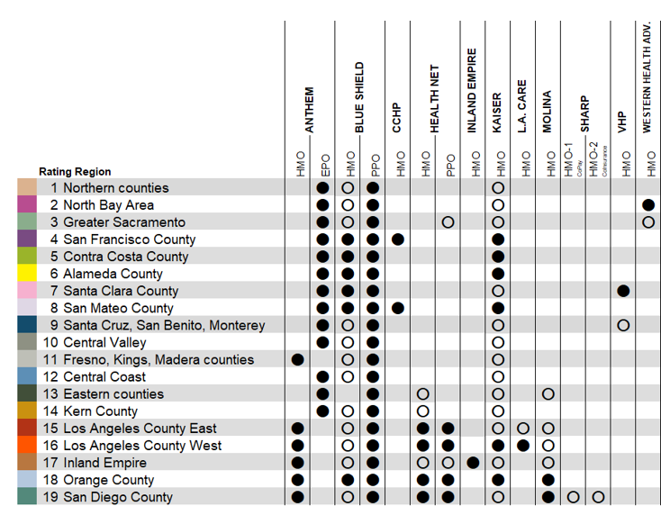

Federally Recognized AI/AN Enrollment by Region
As of | 4/10/2025 | 7/24/2025 | 9/29/2025
Issuer | # of Enrollees*
1 Northern Counties | 1460 | 1560 | 1570
2 North Bay | 570 | 620 | 620
3 Sacramento Valley | 800 | 850 | 850
4 San Francisco County | 110 | 110 | 110
5 Contra Costa County | 170 | 180 | 190
6 Alameda County | 210 | 220 | 200
7 Santa Clara County | 140 | 150 | 140
8 San Mateo County | 50 | 50 | 50
9 Monterey County | 120 | 140 | 140
10 San Joaquin County | 540 | 580 | 580
11 Central San Joaquin | 420 | 470 | 470
12 Central Coast | 430 | 450 | 450
13 Eastern Counties | 70 | 80 | 80
14 Kern County | 240 | 280 | 270
15 Los Angeles County, Partial | 390 | 420 | 420
16 Los Angeles County, Partial | 760 | 800 | 800
17 Inland Empire | 710 | 750 | 760
18 Orange County | 530 | 620 | 640
19 San Diego County | 570 | 640 | 630
Grand Total | 8,300 | 8,970 | 8,970
*Consumers are rounded to the nearest 10.
*Active or Pending Status

Slide 9
Mixed Households and Annual Enrollment
Mixed HH* by Metal Level (total unique HH) 1,469**
AI/AN Member
Catastrophic | <10
Bronze | 1,590
Silver | 520
Gold | 90
Platinum | 60
Total | 2,270
Non-AI/AN and or Non-Tribal
Catastrophic | <10
Bronze | 560
Silver | 1,160
Gold | 120
Platinum | 90
Total | 1,930
Enrollment Year over Year*
Year | Total Enrollment | AI/AN enrollment as percentage of total | AI/AN enrollment
2018 | 1,368,893 | 0.36% | 4,947
2019 | 1,341,113 | 0.39% | 5,244
2020 | 1,566,150 | 0.37% | 5,764
2021 | 1,683,450 | 0.37% | 6,251
2022 | 1,681,949 | 0.40% | 6,674
2023 | 1,780,172 | 0.38% | 6,742
2024 | 1,813,533 | 0.39% | 7,012
2025 | 1,981,218 | 0.39% | 7,736
*As of Sept. 29, 2025. No pending included
Enrollees that indicate race as AI/AN but NOT enrolled in an AI/AN Plan
RACE | COUNT
American Indian or Alaska Native | 1,480
*Mixed Households: Households with federally recognized tribal members and non-federally recognized and/or non-tribal members enrolled on one application in Covered CA
**Consumers are rounded to the nearest 10.

Slide 10
Rates And Carriers For 2026
  Preliminary 2026 Rate Increase: 10.3%
  Causes:
    Rising health care and pharmacy costs are major contributors to the proposed rate change.
    Broader industry challenges are also influencing higher rates.
    Worsening risk pool given the expiration of enhanced premium credits, causing consumers to face significantly higher costs in 2026
    This increase could be reduced if Congress takes timely action to extend the Federal Enhanced Premium Tax Credits.
    Covered California has a significantly lower average rate increase than the national average of 20 percent.
California’s Individual Market Rate Changes
YEAR | 2022 | 2023 | 2024 | 2025 | 2026
WEIGHTED AVERAGE | 1.8% | 5.6% | 9.6% | 7.9% | 10.3%
Full Rates Release: https://www.coveredca.com/newsroom/news-releases/2025/08/14/covered-california-rates-and-plans-for-2026-consumer-affordability-on-the-line-with-uncertainty-surrounding-federal-premium-tax-credit-extension/

Slide 11
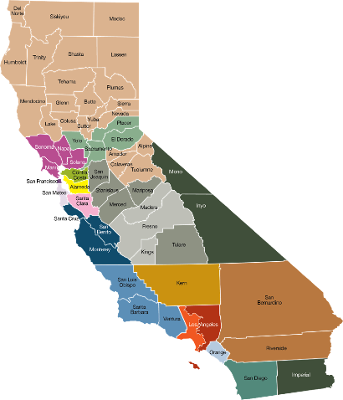




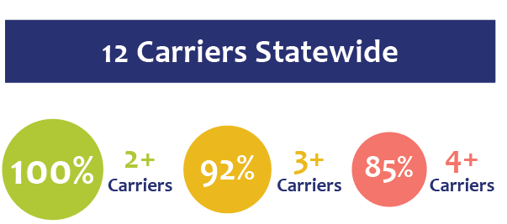








Health Coverage Updates
Aetna is exiting the marketplace in Regions 3 (Sacramento), 5 (San Joaquin), 6 (Fresno), and 11 (San Diego). Approximately 140* AI/AN enrollees and 21,000 non-AIAN enrollees in these regions can either select a new plan or be transitioned to the carrier offering the lowest-cost plan within the same metal tier.
Statewide Coverage:
3
5
6
11 Participating Carriers
11
11
7
*2025 Plan Selections Enrolled or Pending for Consumers Indicating they are Member of American Indian/Alaska Native (AI/AN) Tribe by Rating Region for Aetna Plan (as of 09.29.2025). Consumers are rounded to the nearest 10.

Slide 12





Dental Coverage Updates
    Preliminary 2026 Rate Increase: 0.35%
    5 Dental Carriers
California’s Dental Plan Rate Changes
YEAR | 2022 | 2023 | 2024 | 2025 | 2026
WEIGHTED AVERAGE | -0.95% | -1.7% | 4.31% | 1.55% | 0.35%
Full Rates Release: www.coveredca.com/newsroom/news-releases/2025/08/26/covered-california-announces-premium-change-for-2026-dental-plans-after-another-year-of-steady-growth/

Slide 13
Federal Policy Updates

Slide 14
Federal Update: Recent Actions Impacting Marketplaces
In late June and early July, Congress and the administration took multiple actions that will have sweeping impacts to Covered California and our enrollees:
  On June 25, the Centers for Medicare & Medicaid Services (CMS) issued the Marketplace Integrity and Affordability Final Rule.
    *On August 22, a district court issued a stay on several of the provisions contained in the rule.
  On July 4, President Trump signed the federal reconciliation bill H.R. 1, titled the One Big Beautiful Bill Act, into law.
The combined impact of these policies, alongside the impending expiration of the enhanced premium tax credits at the end of 2025—which neither action addressed—is projected to lead to substantial declines in Marketplace coverage and a rise in the number of uninsured individuals.

Slide 15
Major Marketplace Impacts Of H.R. 1
As many as 660,000 Covered California enrollees could go uninsured, all Covered California enrollees will see significantly higher costs, and there will be burdensome new red tape making it harder for Californians to get and stay covered.
Limiting Enrollment Opportunities and Imposing New Administrative Requirements
Imposes pre-enrollment verification and ending automatic re-enrollment: 2028
Eliminates income-based Special Enrollment Period (SEP): 2026
Restricting Eligibility for Immigrant Groups
Limits Premium Tax Credit (PTC) eligibility to certain immigrant groups: 2027
Affordability and Coverage Changes
Removes caps on repayment of excess Advance Premium Tax Credit: 2026
Denies Advance Premium Tax Credit to consumers who lose Medi-Cal due to work requirements beginning as early as 2027 but can be delayed until December 31, 2028
Ends Premium Tax Credit for low-income lawfully present immigrants: 2026
Fails to extend the Enhanced Premium Tax Credits: Absent Congressional action, these enhanced tax credits will expire at the end of the year and significantly reduce the affordability of Marketplace coverage.

Slide 16

CMS Final Rule Marketplace Provisions
The final rule adopts CMS policy changes aimed at strengthening consumer protections and Marketplace integrity, but despite some modifications, several concerning provisions remain.
Limited Enrollment &
Narrow Eligibility
Stricter Verification & Reconciliation
Reduced Affordability
Shortening the open enrollment period Nov 1-Dec 31, beginning with the 2027 coverage year*.
Excluding DACA recipients from Marketplace eligibility, effective 2025 – Completed.
Eliminating the monthly special enrollment period (SEP) for individuals below 150% of the federal poverty level (FPL), effective 2025.*
Prohibiting coverage of gender-affirming care as part of essential health benefits, effective 2026.
Tightening income verification requirements, effective 2025 and sunsetting after 2026.
Eliminating the automatic 60-day extension for resolving income inconsistencies, effective 2025.
Reducing the Failure to Reconcile period for advanced premium tax credits (APTC) to one year, effective for 2026 and reverting to two years for 2027.
Allowing issuers to require consumers pay past-due premiums before enrolling in new coverage, effective 2025.
Requiring consumers to pay at least 95% of premiums owed, effective 2025 and sunsetting after 2026.
Updating premiums and plan design requirements, effective for 2026.
*Federally recognized AI/AN members will not be impacted due to the monthly AI/AN special enrollment period.
Indicates implementation of provision was stayed by a federal court on 8/22/25

Slide 17
Impact of Expiration of Enhanced Federal Subsidies

Slide 18
Expanded Affordability From The Enhanced Premium Tax Credit
The federal enhanced premium tax credit (ePTC) has dramatically increased affordability for marketplace consumers by:
  Increasing the amount of financial help for all consumers eligible to receive the advanced premium tax credit (APTC).
  Guaranteed availability of two free Silver plan options for consumers with incomes below 150% FPL ($23,475 for an individual and $48,225 for a family of four).
  Eliminating the “subsidy cliff” for middle-income consumers above 400% FPL who were previously ineligible for APTCs ($62,600 for an individual and $128,600 for a family of four).
  The result is record enrollment in California and across the country.

Slide 19
Enhanced Premium Tax Credit Expiration Impacts
In place since 2021, the enhanced premium tax credits are set to expire at the end of 2025. The enhanced tax credits were previously extended in 2022.
While Covered California reports a 10.3% statewide average gross rate increase, the changes in net premium costs experienced by consumers will be much higher when also accounting for the decrease in generosity of tax credits, the loss of tax credit eligibility for middle income consumers, and other federal policy changes.
If no action is taken to extend the Enhanced Premium Tax Credits:
Enrollees will experience, on average, a 97% increase in monthly premium costs.
This translates to ,an average, $125 more that consumers will pay every month for their coverage.
An estimated 400,000 Californians could drop coverage due to lack of affordability.
This analysis demonstrates the financial impact to consumers due to the loss of enhanced federal tax credits and does not account for California’s 2026 premium subsidies.

Slide 20
The Enhanced Premium Tax Credit provides an additional $2.5 billion in annual premium savings
  The enhanced premium tax credit would account for $2.5 billion of potential savings, in addition to the $10.5 billion that consumers are projected to receive in 2026.
  The loss of enhanced tax credits will also impact the roughly 1 in 10 Covered California enrollees who do not receive any financial assistance as the result of higher rate increases.
Enrollee Income (by Federal Poverty Level) | Number of Enrollees | Annual Value of Enhanced Premium Tax Credit
0-150% FPL | 275,000 | $148 million
150-200% FPL | 499,000 | $461 million
200-250% FPL | 274,000 | $363 million
250-400% FPL | 462,000 | $576 million
>400% FPL | 161,000 | $969 million
Total | 1,671,000 | $2.5 billion
Source: Snapshot of July 2025 Covered California enrollees receiving monthly APTC. Income levels reflect relevant program FPL cutoffs for the 2026 plan year.

Slide 21
Premiums Will Increase if The Enhanced Premium Tax Credits Expire
$104
more
$85
more
$111
more
$77
more
$45
more
  Low Income Consumers with incomes less than 400% FPL ($62,600 for an individual), could see, on average, an $85 monthly increase in net premiums without the enhanced premium tax credit.
  Many consumers earning less than $40,000 annually will see their premiums double, or more.
  The return of the subsidy cliff will result in middle income consumers paying the full premium cost to retain coverage.
  More than 160,000 middle income Californians save an average of $502 per month in premium costs due to the enhanced premium tax credit.
Snapshot of July 2025 Covered Ca enrollees receiving monthly APTC. Income levels reflect relevant program FPL cutoffs for the 2026 plan year. Net Premiums reflect projected 2026 net premiums under each tax credit scenario.

Slide 22
Impact to American Indians if the Enhanced Premium Tax Credits Expire
The savings from the enhanced tax credit have been substantial for Federally Recognized AI/AN consumers:
  On average, consumers save an additional $68 on premium costs each month.
  More than 568 middle-income enrollees are now receiving a tax credit for their coverage where previously no financial help was available.
Source: Snapshot of July 2025 Covered California among Federally Recognized Tribal Members receiving monthly APTC. Income levels reflect plan year 2026 FPL for an individual.

Slide 23
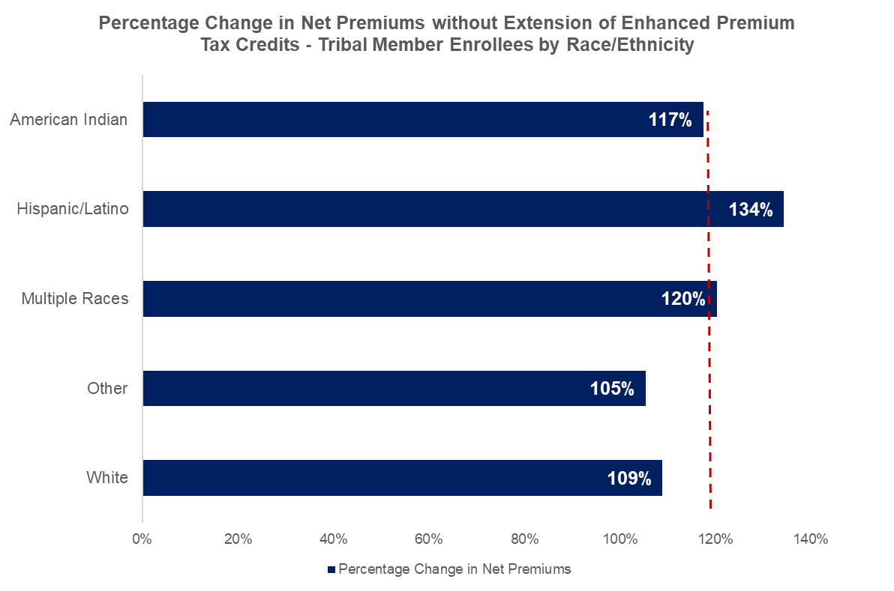
Projected Premium Increases For Federally Recognized Tribal Members
Covered California members from federally recognized tribes are projected to face an average 118% increase in premium costs.
However, premiums for Latino federally recognized members are expected to increase by an average of 134%, while tribal members identifying as multiple races will see an average premium increase of 120%.
118%
Source: Snapshot of July 2025 Covered California AI/AN enrollees receiving monthly APTC. Income levels reflect relevant program FPL cutoffs for the 2026 plan year.

Slide 24
Covered California's Efforts to Inform the Policies

Slide 25
Federal Policy Engagement
  Covered California continues proactive contingency planning, consumer outreach, and strategic engagement to inform policymakers and support enrollees amid federal policy uncertainty.
June: Continued federal engagement with state-based marketplaces (SBMs) nationwide on the potential expiration of EPTCs.
  Participated in national press conference and D.C. media briefings with SBMs (MA, PA, MD), generating national coverage and a Washington Post op-ed, The One Big Beautiful Bill would tangle Obamacare in red tape.
  Released statement with 16 State-Based Marketplaces (SBMs), continuing to cite increased cost and burden to consumers, restricted eligibility and enrollment opportunities, and lack of action to extend enhanced premium tax credits.
  Submitted joint comments with CalPERS to the Senate HELP Committee on affordability and access.
August–October: Sustained federal outreach and advocacy as expiration approached.
  Engaged Congressional offices in-district and in D.C. to share updated statewide and district data and stress the need for timely action.
  Sept 2: 20 SBMs sent joint letter to Congressional leadership urging extension.
  Sept 3: National press conference with SBM leaders, experts, and enrollees on consumer impacts.
  Sept 15: Governor Newsom and 17 governors sent a joint letter to Congress urging swift action before fiscal year-end.
  Oct: Government Shutdown: Enhanced Premium Tax Credit (EPTC) extension remains central to ongoing federal budget negotiations. Covered California continues engaging Congressional offices by participating in press conferences and virtual town halls to emphasize timely action.

Slide 26
Navigating Uncertainty &
Supporting Consumers

Slide 27
State Funding Scenarios for Covered California in 2026
Scenario 1: No Extension
of Enhanced Premium Tax Credits (ePTC)
Scenario 2: Extension
of Enhanced Premium Tax Credits
Health Care Affordability Reserve Fund (HCARF) appropriation will be used to reduce premiums for enrollees with incomes at or below 165% of the Federal Poverty Level (FPL).
$190 million will be redirected to fund the California Enhanced Cost-Sharing Reduction Program.
Adopted by Covered California’s Board in April 2025 to provide additional financial assistance to consumers.
Despite federal uncertainty, Covered California maintains one of the healthiest consumer risk pools in the nation, promoting a stable market and robust carrier participation.

Slide 28
Program Affordability for 2026
Covered California is preparing for two potential scenarios based on the status of the Enhanced Premium Tax Credits (ePTC).
Scenario 1: No Extension
of Enhanced Premium Tax Credits (ePTC)
Scenario 2: Extension
of Enhanced Premium Tax Credits
Renewal will include:
  Advanced Premium Tax Credits (APTC), federal cost-sharing reduction benefits, and the California Premium Subsidy Program.
  The California Enhanced Cost-Sharing Reduction Program will no longer be offered.
  If ePTC is extended, Covered California will reinstate the Enhanced Cost-Sharing Reduction program and discontinue the California Premium Subsidy Program.
  Consumers' eligibility will be re-evaluated, and updated notices will be sent.
  If the extension occurs after the 2026 Plan Year begins (i.e. March 2026), a Special Enrollment Period (SEP) will be considered.

Slide 29
Planning for EPTC Expiration and Supporting Consumers
Covered California is taking a comprehensive, enterprise-wide approach to navigate uncertainty surrounding the expiration of enhanced premium tax credits, including strategic contingency planning and organization-wide retention efforts designed to inform and support enrollees as they face significantly higher costs in 2026.
Covered California is supporting enrollees through direct communications designed to keep them informed of potential changes to the amount of financial help they will receive in 2026, empowering them with information and time to plan how they may be able to keep their coverage next year and where to seek help if they have questions or concerns.
Communications to members have been issued for July and August and will continue in September and October leading into renewal and open enrollment.

Slide 30
Enrollee Retention & Renewal is at the Forefront of Our Efforts
Given the uncertainty facing consumers, Covered California, led by our Marketing team, is intently focused on retaining and renewing our current enrollees. The goal is to meet the challenge of this moment, better serve Californians now and in the long-term, and position Covered California as a supportive partner and resource in light of the potential loss of financial help.
Key aspects of this effort include:
Evolving our retention approach to a more holistic, “always on” approach that goes beyond focused attention on consumers just before or during renewal and open enrollment – instead, focusing on the full customer experience.
Bolstering communication with enrollees prior to the renewal period so they are aware of what changes may come in 2026 and expanding efforts to deliver communication in their preferred language.
Improving alignment across divisions and consumer communications channels to ensure consistent messaging, and information being available direct-to-consumer, through our website, sales and enrollment channels, and other external partners.
Outreach to subsidy members included email and direct mail (July–September) in multiple languages, directing enrollees to their online accounts for financial help details. Members are encouraged to log in, update information, and connect with a Certified Enroller in preparation for renewal.

Slide 31
OE26 Objective
Launch a campaign that meets Californians in the moment and breaks through the noise with clarity, empathy and representation that drives action.
TRUST
SENTIMENT
VALUE
Redefine who we are as a brand and healthcare advocate for Californians, with empathy and strength.
Lean into our mission and differentiate ourselves from the rest of the category.
Be agile and prepared to quickly pivot to different OE outreach scenarios.
Go beyond the functional to address consumers’ emotional and social needs across our from awareness to enrollment, retention to renewal.
In doing so, convey the value that Covered California brings to consumers and inspire loyalty and advocacy.
Shift focus to retention. Deliver tailored messages about the end of EPTC credits and to promote utilization.
In the renewal and OE period, outreach intensifies with clear actions members can take to shop and compare, use their benefits, and stay covered.
Our campaign is organized around meeting these challenges Californians are facing

Slide 32

FPO :90
9/2 • GM :90 video

Slide 33

33
Connectors to Coverage
For over a decade, Covered California’s network has grown through the power of human connection.
Connectors to Coverage repositions Covered California from a marketplace that can feel transactional and impersonal, to a network of connectors who help Californians find their path to coverage.
Enrollers, navigators, doctors, community leaders – we ARE the network who are fighting for you. Our connectors form a human network – CCA leaders, CBOs, navigators, neighbors, leaders, and past enrollees – who translate coverage into real-life relevance and drive enrollment at the ground level.
We would also love for our tribal leaders and organizations to act as vital connectors between their communities and Covered California. By sharing trusted information, guiding members to resources, and elevating the importance of coverage, tribal partners can help ensure their communities access the care and financial protection they deserve.
We’re real people, helping real people connect to coverage.
For the Love of Californians.

Slide 34
Questions/Feedback

Slide 35
Health Equity and
Quality Transformation (EQT) Update

Slide 36
2025 Population Health Investment (PopHI) Implementation
S. Monica Soni, MD
Chief Medical Officer
Chief Deputy Executive Director
Health Equity and Quality Transformation (EQT)

Slide 37
Quality Transformation Initiative
37
Make Quality Count
Measures that Matter
Equity is Quality
Amplify through Alignment
0.8% to 4%
premium at risk for
a small set of clinically important measures
stratified by race/ethnicity
selected in concert with other public purchasers*
*Public purchasers includes CalPERS and DHCS/Medi-Cal

Slide 38
Guiding Principles: Use of Funds
38
Centered on goal to improve health outcomes for Covered California enrollees
Equity First: funds should preferentially focus on geographic regions or communities with the largest identified gaps in health and quality among California subpopulations
Direct: use of funds should lead to measurable improvements in quality and outcomes for enrollees that are related to QTI Core Measure performance
Evidence-based: use of funds should be grounded in approaches that have established evidence of success in driving improvements in quality or outcomes
Additive: funds should be used to advance quality in a currently underfunded arena.

Slide 39
Population Health Investments:
Selection Criteria
39
Is Feasible to Implement & Measure Impact
Population Health Investment Advisory Council
Meets Guiding Principles
Addresses Population Need

Slide 40






Population Health Investments
(PopHI)
Quality Transformation Initiative
$
$
Enrollee Programs
Provider Investments
Beyond Covered
Grocery Support Program
Beyond Covered
Child Savings Account Program
Equity and Practice Transformation

Slide 41

Grocery Support Program • Go Live 2/5/25
Purpose
The Beyond Covered by Covered California: Grocery Support Program is designed to help Covered California members facing chronic health conditions and financial challenges access nutritious food to help improve food security and health outcomes.
Eligibility
Covered California members who:
1. Have a household income up to 250% of FPL
2. Have a chronic health issue
3. Are experiencing food insecurity
Benefit
A reloadable debit card to purchase food, and either:
Monthly payments will be loaded onto the debit card for 12 months, OR
A lump sum payment will be loaded onto the debit card at the end of 12 months (equal to 12 monthly payments)
Funds are based on household size reported to Covered California at time of enrollment and may only be used to purchase fresh food, packaged food, baby food and non-alcoholic drinks.

Slide 42

Grocery Support Program: Early Successes
Enrollment Highlights
Households Invited: 76,681​
Households Enrolled: 6,975
Household Members Impacted: 13,090
Budgeted Amount Encumbered: 99.9%
Average Award Per Household $1,646
75.2% of approved applicants completed the baseline survey
Early Feedback
“To whom it may concern: I would like to be considered for this program. We do not eat healthy and I have heart disease. Please let me know what is required to qualify. Best regards. Thank you!”
"Wow! What an incredible program… I guess we are just waiting for a representative from Forward to reach out? Via Email? How will we know we’ve been offered this opportunity? I want to be sure not to miss any announcements, requests for information, etc.…”
Data as of 7/21/2025

Slide 43
Grocery Support Program Member Spending
Top 3 Categories for Spending month over month from March 2025 – July 2025:
Grocery Stores, Supermarkets
Wholesale Clubs
Discount Stores
Top 3 Categories:
Make up 92.14% of total funds spent
Account for $1,992,710 in member spending
Data as of 9/10/2025

Slide 44

Child Savings Account Program • Go Live 2/25/25
Purpose
The Beyond Covered by Covered California: Child Savings Account Program aims improve well-child visits and childhood immunization rates for children under the age of two enrolled in Covered California, while helping families invest in their child’s future.
Eligibility
Children under 2 years old who are:
1. Enrolled in a Covered California Health Plan
2. Born in California
3. Registered for a CalKIDS account*
Benefit
Families can earn up to $1,000 for their CalKIDS savings account, which can be used for educational expenses.
Steps
1: $150 Program Consent & CalKIDS Registration
2 - 6: $100 Per PC Visit & Vaccine(s) at Specified Age
7 - 9: $150 Per Flu Shot During Specified Time
*Beyond Covered program is designed to assist parents/guardians with CalKIDS account registration

Slide 45
2025 Direct to Member Pophi Enrollment Trends
Grocery Support Program Enrollment Rate
Overall Enrollment Rate: 9.10%
Child Saving’s Account Program Enrollment Rate
Overall Enrollment Rate: 6.66%
Date as of 9/10/2025. Blank areas are suppressed data due to counts too low to report.

Slide 46
PopHI Enrollment by Demographic
While enrollment mostly matches the demographics of Covered California’s overall enrollee population, PopHIs are tracked closely, and future adjustments will continue to center equity
Grocery Support Program
Child Saving’s Account Program
Covered California enrollee data from 2025 March Membership Profile.
Date as of 9/10/2025. Blank areas are suppressed data due to counts too low to report.

Slide 47


Equity & Practice Transformation • Go Live 2/2025
Purpose
Covered California’s investment is aimed at leveraging Equity and Practice Transformation (EPT) infrastructure to accelerate population health management capabilities in practices serving both Covered California and Medi-Cal enrollees.
Eligibility
30-40 practices participating in EPT, who serve Covered California enrollees will receive enhanced support through tailored enhancements to EPT’s technical assistance (TA) structure.
Benefit
Practices selected to participate in enhanced TA structure will receive:
High-Quality, 1:1 Subject Matter Experts Support
Virtual Learning and Peer Engagement through small group and 1:1 sessions
Advanced Data Integration and Testing
Learning System to distill insights from a diverse practice cohort and disseminate promising models to primary care practices across the state

Slide 48
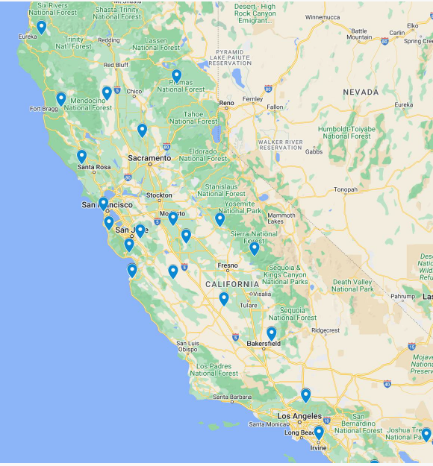

Equity and Practice Transformation (EPT): Early Successes
​EPT Program
The EPT Program consists of 45 provider organizations spanning 30+ counties throughout California. ​These providers serve both Covered California and Medi-Cal members, reinforcing our commitment to advancing health equity statewide.​
​Participant Engagement
The program launched with a well-attended kickoff session hosted by the PHLC, featuring active engagement from participating provider organizations and several QHP issuers.​
​Provider Reflections
Feedback emphasized the need for practical support and real-time guidance.
Covered California Cohort at a Glance
26,157 Covered California enrollment
617,714 assigned Medi-Cal lives
Broad geographic distribution
Practice Setting
  23: Independent Practices
  4: Tribal Clinics
  2: Health Systems
  16: Health Centers
Population of Focus (PoF)
  14: Children and youth
  17: Adults with chronic conditions
  11: Adults with preventive care needs
  2: People living with BH conditions
  1: Pregnant people

Slide 49
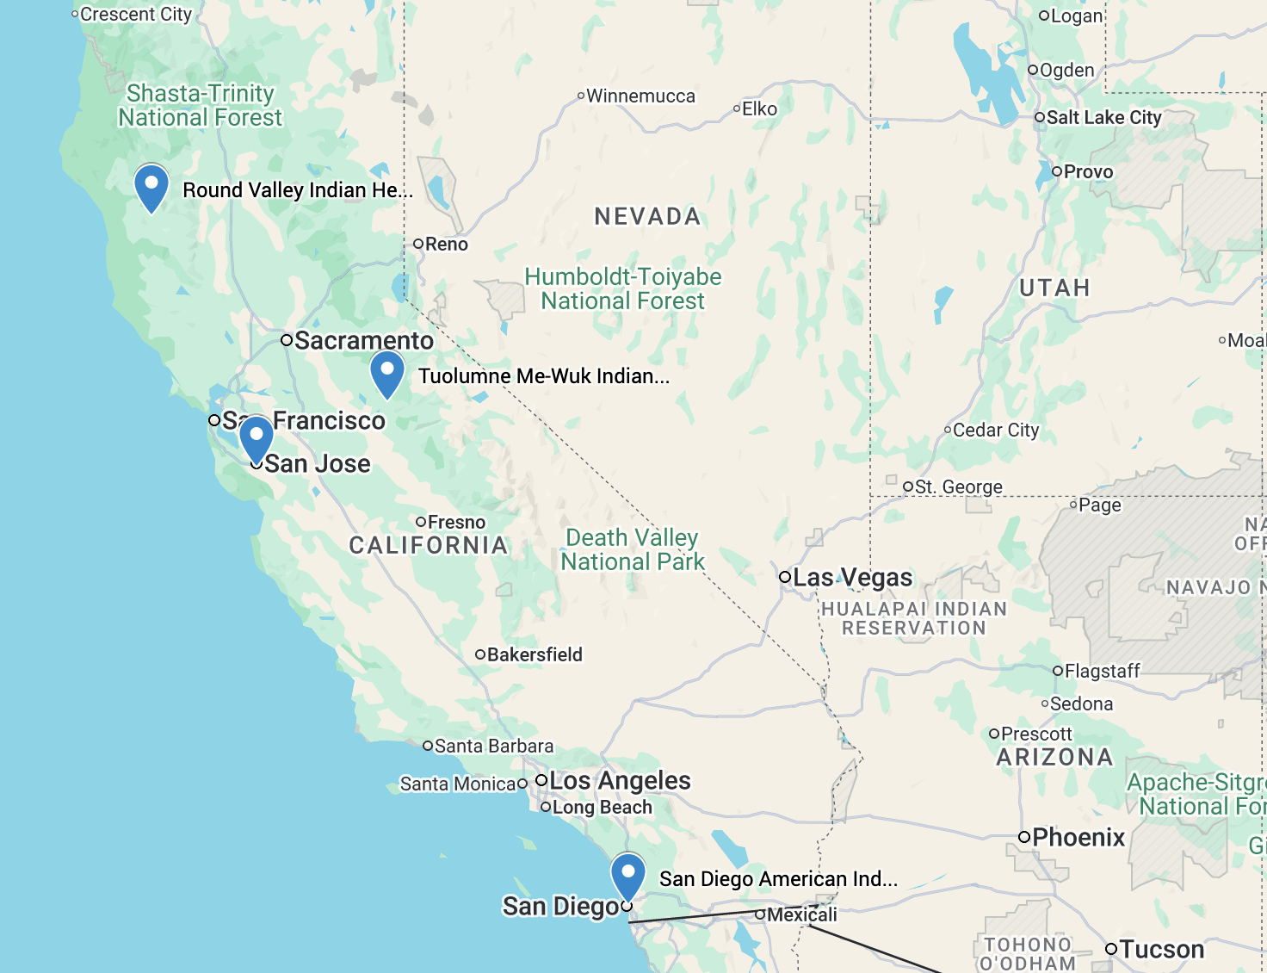
Participating Tribal Clinics
Name of Practice | Focus Population | FTEs | Assigned Medi-Cal Lives
Indian Health Center of Santa Clara Valley | Adults with chronic conditions | 40 | 32,461
Round Valley Indian Health Center | Children and youth | 4 | 1,062
San Diego American Indian Health Center | Adults with preventive care needs | 10.5 | 2,118
Tuolumne Me-Wuk Indian Health Center | Adults with chronic conditions | 17.5 | 25,755

Slide 50
EPT PopHI Investment for 2025
Accelerating practice transformation in the 45 Covered California practices
1:1 and Group SME support
Support to strengthen data systems to report EPT KPIs and close care gaps. Expert-led groups focused on data and workflow optimization and addressing challenges in POFs.
Advanced Data Integration
Design workflows and create implementation plan for data exchange with external partners for a measure-specific use case (8-15 practices).
DxF Bootcamp
Step-by-step guidance to identify priority data sharing use cases, assets, partner engagement best practices, and technology resources for a secure, real-time exchange roadmap.
Care Gap Closure Implementation Guides & Job Aids
Co-designed with EPT practices to maximize performance in EPT HEDIS-like measures.

Slide 51
Notable Early Improvements in EPT Practices
November 2024
May 2025
Percent of 45 CCA Practices With Continuity >70%
36%
51%
Percent of 45 CCA Practices With More than 90% of their Patients Empaneled
27%
44%
Percent of 45 CCA Practices With Time to Third Next Available Appointment <10 days
62%
82%

Slide 52
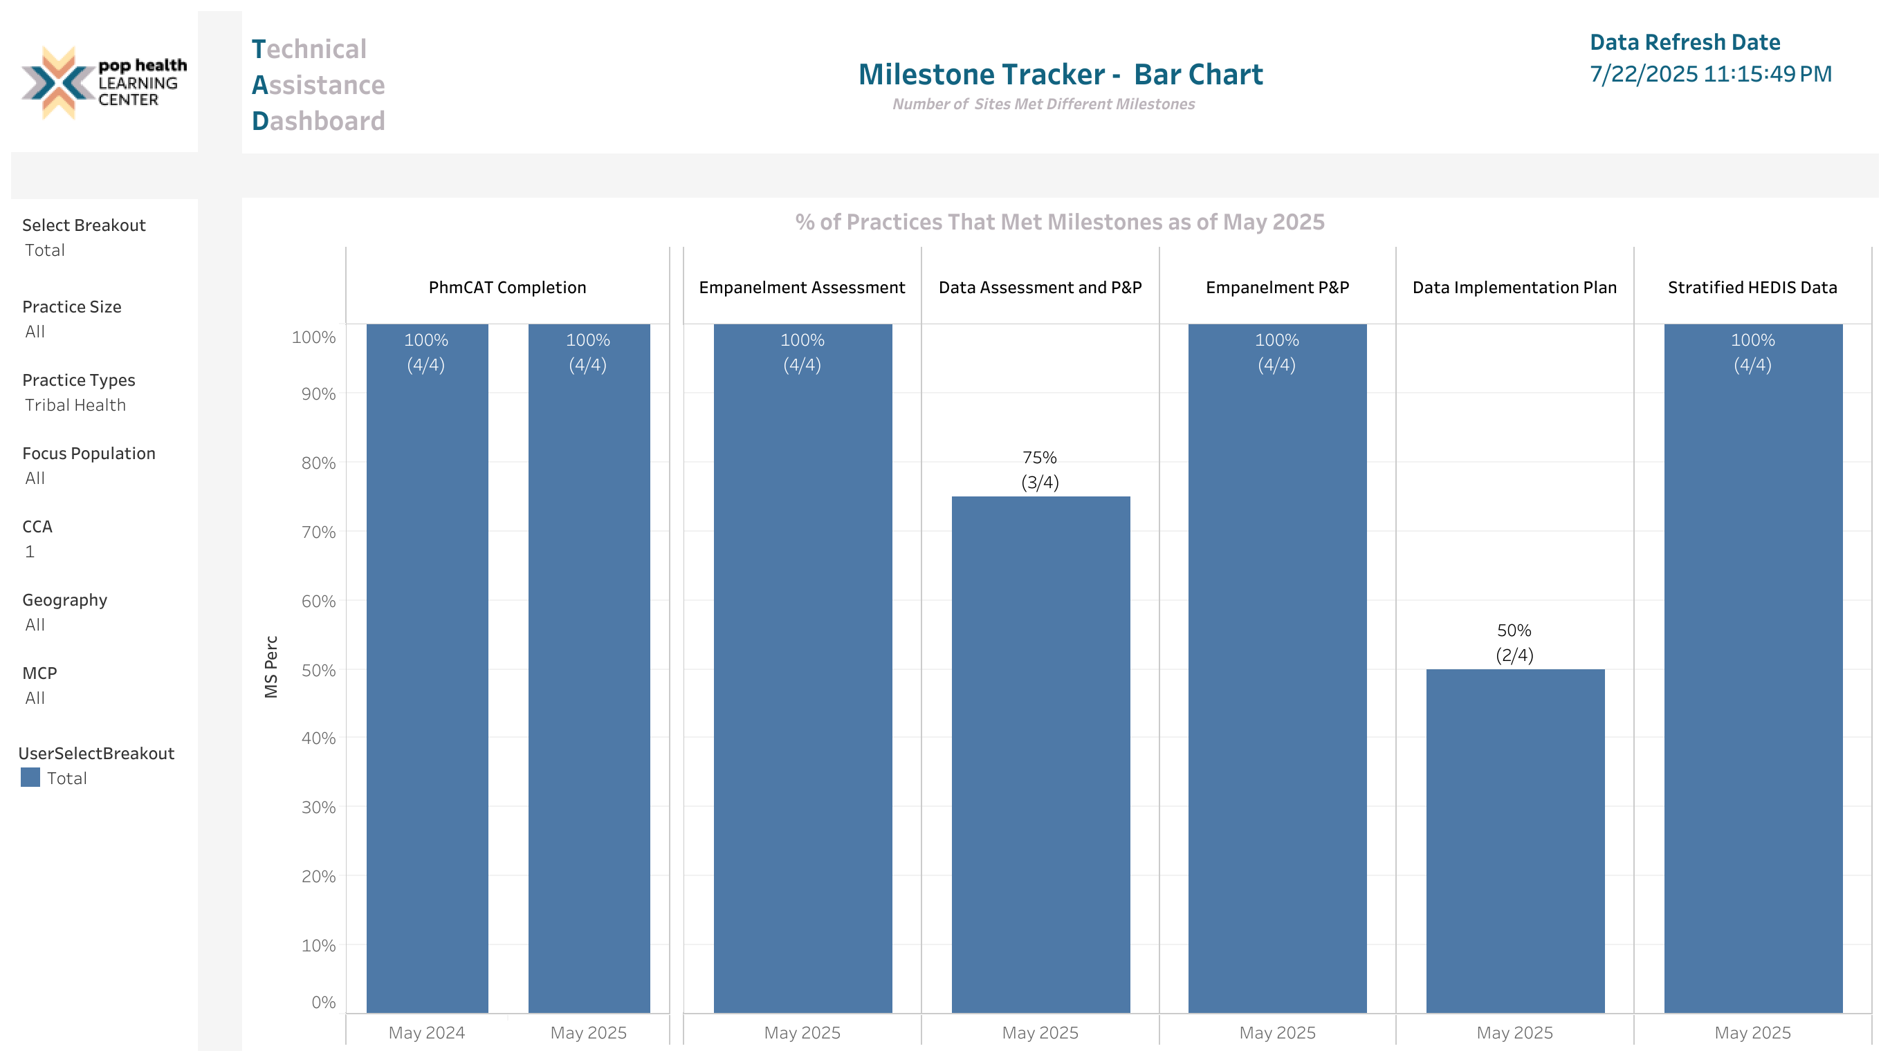
Tribal Clinic Milestones

Slide 53
Tuolumne Me-Wuk Indian Health Center
Practice Case Study on Access
“All the providers used to make their own weird schedule rules. A new scheduling system went live January 1st so we do the daily management huddle for primary care and we changed the scheduling template… It really did help with access to care.”
“And we have good continuity… If you have a care team, you shouldn’t have to re-establish the primary care provider… They wouldn’t schedule until a month and a half out because they (only) accepted new patients twice a day”
“Every week I go in and look for 3rd next available appointment... PHLC was the first place I ever learned about it… Going through and explaining the details, I wasn’t going to get that anywhere else”
Tuolumne Me-Wuk Indian Health Center is an FQHC clinic in Sonora, California.
The clinic’s risk and grant manager was interviewed by PHLC to gain insights on their use of data for operational improvement.

Slide 54
Moving the Needle On Quality
Childhood Immunization
Diabetes Control
Population Health Investments
Early Investments in Childhood Health and Wellness
Direct Investments to Enhance Food Security
Equity and Practice Transformation
Blood Pressure
Control
Colorectal Cancer Screening

Slide 55
Dental Program Overview
Taylor Priestley, MSW, MPH
Director, Health Equity and Quality Transformation (EQT)

Slide 56




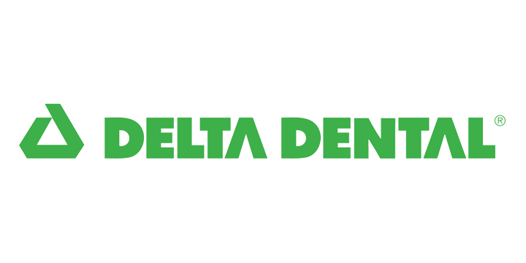

2025 Dental Plans

Slide 57
Qualified Dental Plan (QDP) Contracting
No financial assistance available to purchase benefits.
    Standalone dental plans and adult dental benefits are not subject to many of the ACA market reforms, although Covered California extends these consumer protections to the QDPs by contract.
    Covered California balances benefit richness and consumer protections by contract with price sensitivity and potential burden on participating dental plans to maintain adequate and meaningful choice and coverage for adult dental consumers.

Slide 58
Covered California Dental Benefit Policy
Dental Benefits
  No charge diagnostic and preventive services for children in 10.0 QHPs and all children and adults in QDPs
  Comprehensive coverage of Basic and Major Services for adults in DHMO and DPPO plans
  Embedded pediatric benefits are as comparable as possible to QDP pediatric benefits
  Standardized copayment schedule for copay plan design
  Each adult member in coinsurance plan must meet individual deductible
Maintain meaningful choice in dental plans and affordable QDP Premiums
  Waiting periods and annual limits are allowed for adult major services, but only included in the coinsurance plan design
    Six month waiting period waived with proof of prior coverage
  Family Dental Plan enrollment rules
  Adult dental benefit not fully standardized, some standard exclusions

Slide 59
Qdp enrollment Analysis:
Review of Key Findings

Slide 60
Dental Enrollment Continuity 2020-2024
Definition of Dental Enrollment Continuity: Average duration of enrollment (in months) for consumers who began in 2020 and have terminated by the end of 2024
Results: Between 2020 and 2024, there were a total of 864,051 individuals who have enrolled in a QDP. ¹ The average enrollment segment lasted 13.1 months.
  Among the ~283k cohort of 2020 QDP enrollees, 47,572 or 17% still remain and are enrolled through the end of 2024.
1. Consumers are identified by having enrolled and/or terminated a QDP enrollment between 2020 and 2024 but cannot have an enrolled status ending 2024/12/31.

Slide 61
Distribution of Enrollment Months 2023
Enrollment Months | # of Effectuated Enrollees | Percentage
1 | 25,846 | 6%
2 | 31,404 | 8%
3 | 24,784 | 6%
4 | 22,115 | 5%
5 | 18,779 | 5%
6 | 17,140 | 4%
7 | 15,730 | 4%
8 | 14,752 | 4%
9 | 15,957 | 4%
10 | 13,504 | 3%
11 | 27,610 | 7%
12 | 181,276 | 44%
Total | 398,978¹ | 100%
Dental enrollees tend to enroll for the full 12 months
However, 1 in 5 enrollees were enrolled in dental coverage for less than three months.
1 The total is based on the count of distinct members across all months.

Slide 62
2023 Renewing QDP Member Migration
For enrollees who continue with their dental coverage across multiple plan years, >99% stay with their same plan year to year. This is consistent across all plans as shown below.
Current Plan
Previous Year Plan | Anthem Blue Cross HMO | Anthem Blue Cross PPO | Blue Shield HMO | Blue Shield PPO | California Dental Network, Inc. HMO | Delta Dental HMO | Delta Dental PPO | Dental Health Services HMO | Total
Anthem Blue Cross HMO | 99.8% | 0.1% | 0.0% | 0.1% | 0.0% | 0.0% | 0.0% | 0.0% | 100.0%
Anthem Blue Cross PPO | 0.0% | 99.9% | 0.0% | 0.1% | 0.0% | 0.0% | 0.0% | 0.0% | 100.0%
Blue Shield HMO | 0.0% | 0.0% | 99.8% | 0.1% | 0.0% | 0.0% | 0.0% | 0.0% | 100.0%
Blue Shield PPO | 0.0% | 0.0% | 0.0% | 99.9% | 0.0% | 0.0% | 0.1% | 0.0% | 100.0%
California Dental Network, Inc. HMO | 0.0% | 0.0% | 0.0% | 0.1% | 99.6% | 0.1% | 0.0% | 0.0% | 100.0%
Delta Dental HMO | 0.0% | 0.0% | 0.0% | 0.0% | 0.0% | 99.8% | 0.1% | 0.0% | 100.0%
Delta Dental PPO | 0.0% | 0.0% | 0.0% | 0.0% | 0.0% | 0.0% | 99.9% | 0.0% | 100.0%
Dental Health Services HMO | 0.1% | 0.0% | 0.2% | 0.1% | 0.0% | 0.1% | 0.0% | 99.6% | 100.0%
Liberty HMO (exited 2022) | 0.1% | 0.0% | 1.3% | 0.4% | 93.7% | 3.2% | 0.1% | 1.3% | 100.0%
% of Total QDP Enrollment | 6.1% | 6.0% | 10.8% | 12.6% | 11.8% | 32.7% | 19.3% | 0.7% | 100.0%

Slide 63
QDP Utilization Analysis:
Review of Key Findings​

Slide 64
Equity and Disparities Reduction:
Equity is Quality
Data analysis reveals that disparities in dental service utilization among Covered California members are primarily driven by two factors: geographic differences and the distinct effects of plan types, especially PPO versus HMO plans.
The findings underscore the need for strategies that enhance dental care access and affordability, particularly in underserved regions, ensuring equitable oral health outcomes for all.

Slide 65
Methodology
Using HEI 2023 data, we assed utilization across a variety of service categories for enrollees in QDPs
Data was stratified for:
  Pediatric (0-18 years) and Adult enrollees (19+ years)
  90 versus 180-day continuous enrollment to evaluate enrollees with several months of coverage making it more likely that they'd utilize services
  Additional stratifications using CalHEERS data include race/ethnicity, income, and region
Often, we present utilization data as patients per 1000 members in order to normalize for differing membership sizes across plans and stratifications
Data is segmented into 11 service types, detailed in the appendix.
Rates will be suppressed if the numerator is less than 11 or the denominator is less than 30.

Slide 66
QDP Overall Utilization Rates for Pediatric and Adult Enrollees in 2023
Overall, fewer than half of enrollees in standalone dental plans utilize any services
Pediatric enrollees have higher rates of utilization as compared to adult enrollees
Applying a 180-day versus 90- day continuous enrollment rule only leads to a small increase in the portion of members utilizing care
Continuous enrollment period | Population | % of enrollees who utilized any service
90d | Pediatric | 44.8%
 | Adult | 35.0%
180d | Pediatric | 50.1%
 | Adult | 39.8%

Slide 67
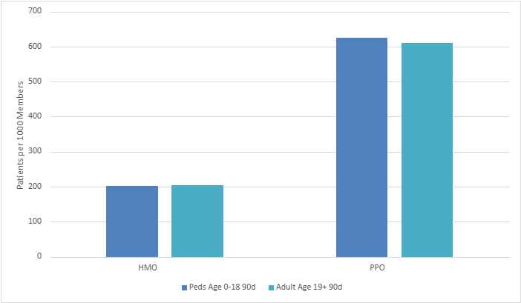
QDP 2023 Utilization Rates Per 1000 by Product
2023 QDP Utilization by Product Type for Adult and Pediatric Enrollees
Plan type (DHMO vs DPPO) results in the most significant difference in utilization rates.
  Over 600 patients / 1000 members in PPO plans use care, compared to about 200 patients / 1000 members in HMO plans
This holds true both for pediatric and adult populations.

Slide 68
QDP 2023 Utilization Rates by Income
Both pediatric and adult utilization rates tend to increase with rising income levels.
Pediatric and Adult member utilization is higher in 400+ income level, and this difference is statistically significant.
Income Level | Pediatric Age 0-18 Utilization (Patients / 1000 Members) | Adult Age 19+ Utilization (Patients / 1000 Members)
0<=138 | 362.5 | 309.85
138<=150 | --- | 290.15
150<=200 | 418.53 | 314.85
200<=250 | 328 | 312.47
250<=400 | 420.77 | 353.85
400+ | 467.29 | 418.23
Unsubsidized | 425.99 | 346.5
Aggregate | 448.61 | 349.56
Note: The data reported includes members with at least 90 days of continuous enrollment, as there was no significant difference in utilization rates compared to those enrolled for 180 days.

Slide 69
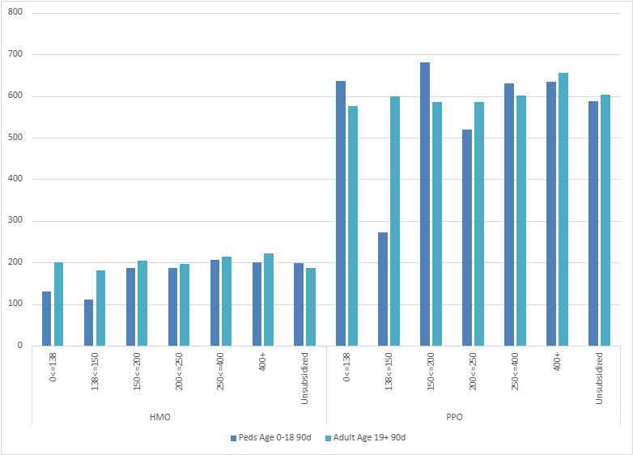
QDP 2023 Utilization Rates by Income & Plan Type
2023 QDP Utilization by Product Type and Income Level for Adult and Pediatric Enrollees
The differences in utilization by income are largely minimized when we stratify by income and plan type
The exception here is Pediatric enrollees (FPL 138<=150) in PPO plans have much lower utilization rates than other pediatric enrollees in PPO plans, although this difference is not statistically significant.
Note: The data reported includes members with at least 90 days of continuous enrollment, as there was no significant difference in utilization rates compared to those enrolled for 180 days.

Slide 70
QDP 2023 Utilization Rates by Race/Ethnicity
Race/Ethnicity Group | Pediatric Age 0-18 Utilization (Patients / 1000 Members) | Adult Age 19+ Utilization (Patients / 1000 Members)
American Indian/Alaska Native | 405.41 | 280.19
Asian | 446.98 | 354.19
Black or African American | 367.52 | 293.57
Hispanic or Latino | 371.04 | 288.78
Multi-racial | 451.81 | 300.42
Native Hawaiian/Pacific Islander | 500 | 283.78
Nonrespondent | 438.32 | 364.73
Other | 445.21 | 360.03
White | 468.19 | 366.36
Aggregate | 448.61 | 349.56
While we observe different utilization rates when stratifying by race and ethnicity, none of these findings are statistically significant.
Note: The data reported includes members with at least 90 days of continuous enrollment, as there was no significant difference in utilization rates compared to those enrolled for 180 days.

Slide 71
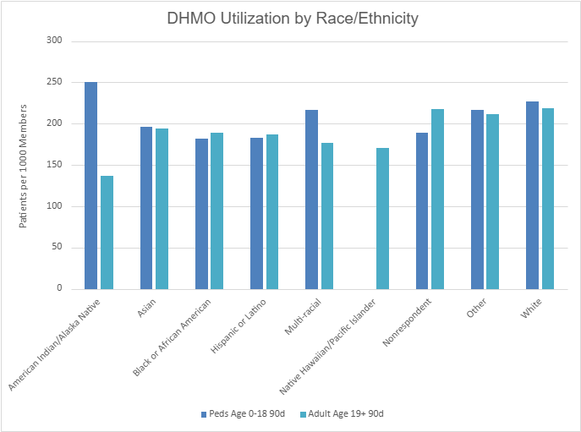
QDP 2023 QDP Utilization Rates by Race/Ethnicity and Plan Type
In DHMO plans, pediatric members identifying as American Indian/Alaska Native have higher utilization than other groups. Conversely, adults identifying as American Indian/Alaska Native have lower rates of utilization, but these differences are not statistically significant.
Note: The data reported includes members with at least 90 days of continuous enrollment, as there was no significant difference in utilization rates compared to those enrolled for 180 days.

Slide 72
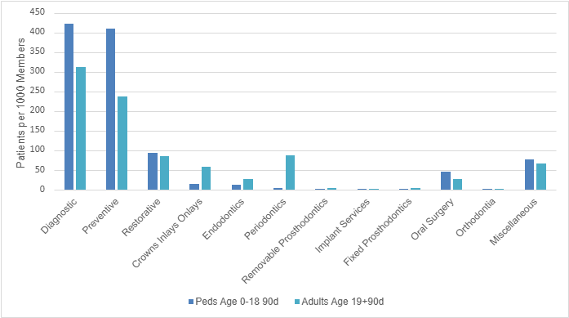
2023 QDP Dental Utilization by Service Category
2023 QDP Utilization Service Category for Adult and Pediatric Enrollees
As expected, the majority of Pediatric utilization occurs in Preventive and Diagnostic services.
Adult utilization patterns are predominantly in Preventive and Diagnostic categories but have a broader spread across other categories of services.
Note: The data reported includes members with at least 90 days of continuous enrollment, as there was no significant difference in utilization rates compared to those enrolled for 180 days.

Slide 73
2023 QDP Adult Utilization by Product Type and Service Category
For Adults in DHMO and DPPO plans, service utilization shows largely similar patterns, with most services in the diagnostic and preventive categories.
Note: The data reported includes members with at least 90 days of continuous enrollment, as there was no significant difference in utilization rates compared to those enrolled for 180 days.

Slide 74
Summary of Key Findings
Pediatric utilization of QDPs is overall higher than adult utilization, and services used skew more toward Preventive for children than adults
We see the largest differences in dental plan utilization by plan type, PPO utilization is 3 times DHMO utilization and this holds true for children and adults
No significant increase in utilization when we apply a 180-day continuous enrollment rule (180d) versus a 90-day rule (90d) (dental enrollees tend to enroll for the full 12 months )
While we observe differences in utilization rates by race/ethnicity, region, and income, these differences are generally not statistically significant.

Slide 75
Translating Dental Data into Action

Slide 76
2024-26 Principles and Dental Strategic Focus Areas
STRATEGIC FOCUS AREAS
Disparities reduction
Quality is central
Equity is quality
Measures that matter
Health Promotion & Prevention
Advanced primary care
Make quality count
2024-2026
refresh
Amplify through alignment
Promote public good
Care about cost
Data exchange
Value Based Payment
Alignment with the Department of Healthcare Services (DHCS) Data analytics / Healthcare Evidence Initiative

Slide 77
Contract Workgroup Process
Concept Formulation
Stakeholder Discussion
Draft Contract Development & Feedback
Covered California leadership and staff engage in strategic planning sessions to develop concept proposal for the framework, principles, and priority areas for focus
Contract Amendment Workgroup
  Scheduled monthly meetings
  Forum for large group discussion on QDP enrollment, utilization and proposed changes to Attachments 1 and 2
  Learning space to share ideas and best practices among stakeholders
  Participants review and give feedback on contract proposals and draft contract language
  Additional focus group meetings on specific priority areas scheduled as necessary to help facilitate contract development

Slide 78
QDP Issuer 2027 Amendment Timeline for Attachments 1 and 2
March – June
2025
July – Dec
2025
Jan – March
2026
Contract Workgroup
March – June 2025
Public Comment Period
August 2025
Public Comment Response
September 2025
Public Comment Period
October 2025
Public Comment Response
November 2025
Board Discussion
January 2026
Board Approval of
PY 2027 Amendment
Feb/March 2026

Slide 79
Questions/Feedback

Slide 80
Enrollment Application Changes for AIAN
Waynee Lucero
Deputy Director, Tribal Liaison
External Affairs and Community Engagement

Slide 81
Overview
AI/AN Consumer Experience Enhancements (Update)
Earlier this year, Covered California shared with the Tribal Advisory Workgroup (TAW) proposed improvements to highlight the benefits of AI/AN plans within the single streamlined application.
These included:
  Updated tooltip language to better describe the special benefits available to AI/AN consumers.
  A visible AI/AN indicator next to each applicant’s name once eligibility is submitted and pending or verified.
  Revised custom grouping language to improve clarity and accessibility.
  We distributed a survey in June to gather feedback on these ideas and received three responses.

Slide 82
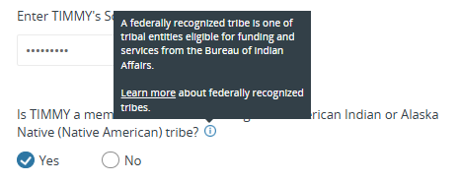
Implemented: Current AI/AN page with tooltip: Located at the beginning of the application
Current language:
Updated language:
A federally recognized tribe is a sovereign nation with a unique legal status that qualifies for federal funding and services. Learn more about your benefits.
Learn more Link: Financial Help for American Indians and Alaskan Natives

Slide 83
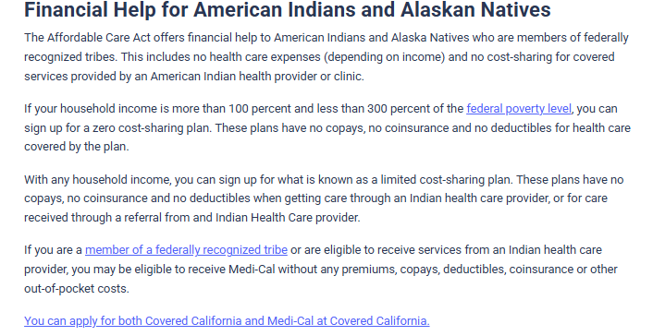
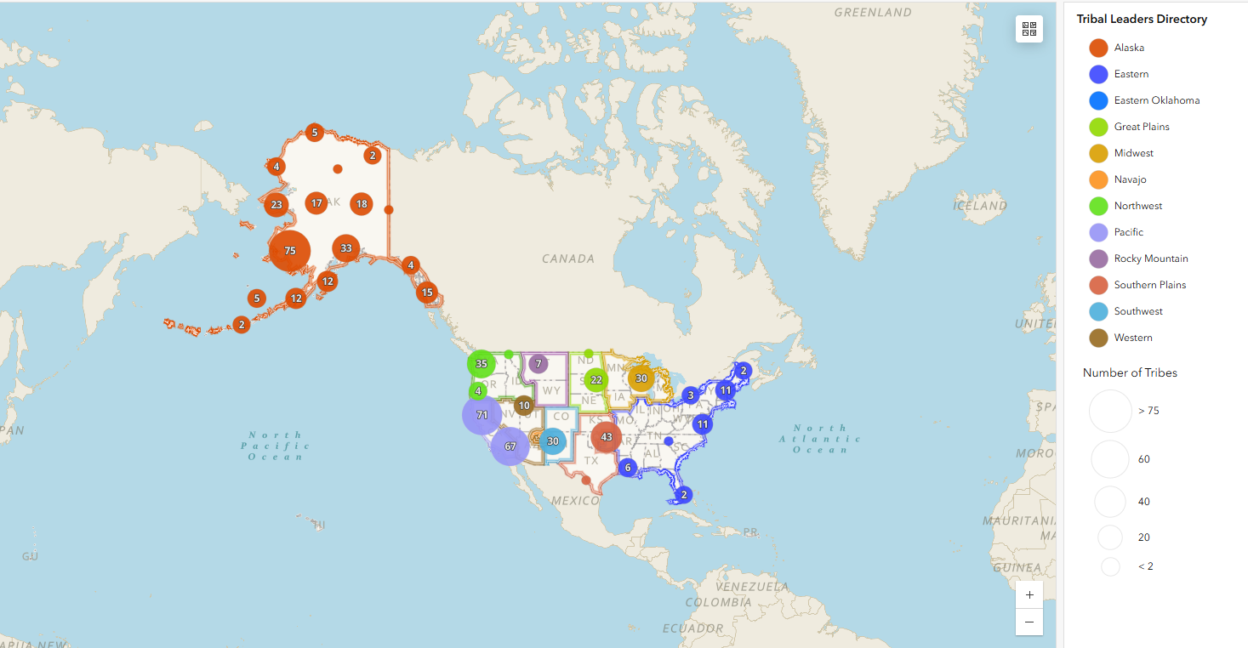
Implemented: Link in Tooltip - Located at the beginning of the application
Replaced the broken Learn more link in the tooltip with a verified Covered CA website page that outlines benefits available to AI/AN consumers and includes a comprehensive directory of federally recognized tribes, as maintained by the Bureau of Indian Affairs.
Financial Help for American Indians and Alaskan Natives
Member of a federally recognized tribe

Slide 84
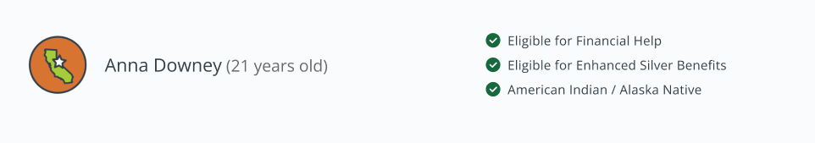

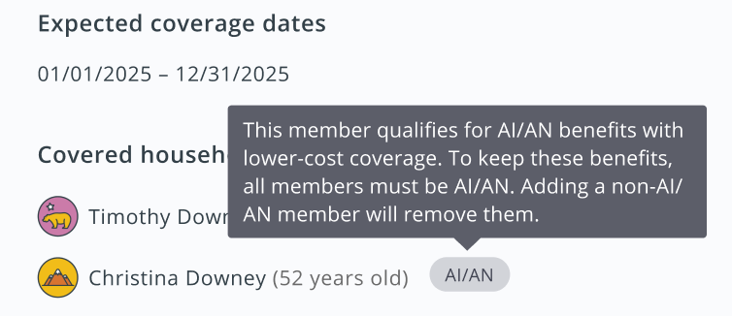
Proposed AI/AN indicator
AI/AN
Proposal 1: Have an AIAN status on top of the current visual indicator.
Proposal 2: Have an AIAN specific visual indicator. Feedback from TAW needed to ensure visuals are appropriate.
Proposal 3: Keep the current visual indicator but add a pill on the side indicating AI/AN status.
A tooltip explaining the AI/AN benefits can be added to these proposals when the consumer interacts with it.

Slide 85
Proposed AI/AN indicator Survey
Q1: From the proposals above, which of the proposed visual indicators do you feel most clearly identifies AI/AN status?
Q2: From the proposals above, which do you feel is most culturally appropriate to represent AI/AN identity?
Q3:Would your tribe or organization be interested in helping design a visual indicator that better reflects the AI/AN enrollees?
Q4: Contact information
Q5: Please share any other thoughts, concerns, or recommendations
Respondent 1:
  Q1: Proposal 2: A distinct AI/AN-specific visual
  Q2: Proposal 2
  Q3: No – We’re comfortable choosing from existing proposals
Respondent 2:
  Q1: Proposal 3: Existing icon with a pill-shaped label indicating AI/AN status
  Q2: Proposal 3
  Q3: Yes – We'd like to collaborate on a new design
Respondent 2:
  Q1: Prefer to suggest or co-design a culturally appropriate visual indicator
  Q2: Proposal 2
  Q3: No – We’re comfortable choosing from existing proposals
  Q5: I think that option number 2 is most appropriate but should also have the pill on the side

Slide 86
Next Steps:
  After the survey, Covered California reached out to Workgroup members and solicited recommendations on possible visuals and communicated it to the Design team for the proposed AI/AN indicator mock-ups.
Work with design team on mock-ups for TAW input and recommendations. Adjust and update mock-ups, as needed.
Engage on tooltip language and proposed custom grouping for AI/AN.
Implementation is currently targeted for September 2026, with ongoing collaboration from the Tribal Advisory Workgroup throughout the project.

Slide 87
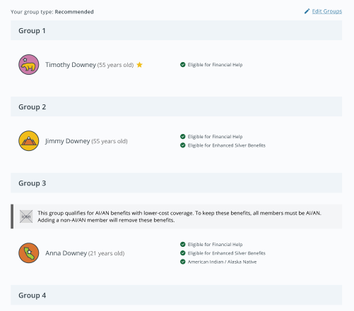
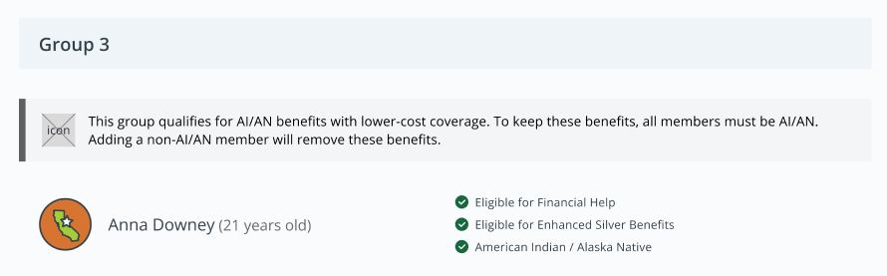
FEEDBACK Needed: Custom Grouping Message for AI/AN Members
On the Custom Grouping page, a more specific message can be added providing information on the benefits of AI/AN plans.

Slide 88
Discussion/Feedback

Slide 89
Tribal Program Updates
Waynee Lucero
Deputy Director, Tribal Liaison
External Affairs and Community Engagement

Slide 90

Tribal Land Acknowledgement internal SharePoint Site
The site Includes:
Background on Land Acknowledgements
A slide with our approved Land Acknowledgement Statement that can but included in meeting materials
Guidance on what circumstances are fitting to provide a Land Acknowledgement Statement
Information about Covered California’s partnership with California Tribes

Slide 91


Covered California Land Acknowledgement
Covered California respectfully honors and acknowledges that our staff throughout the state of California operate across unceded territories of the 109 federally recognized tribes in the state, as well as those tribal communities currently seeking recognition.
We reaffirm our commitment to honoring the enduring connection these tribes have with their traditional territories and recognize the resilience, strength, and sovereignty of California’s First Peoples. Covered California is dedicated to deepening our understanding of both historical and current issues affecting Native communities, and to addressing the legacy of our institution’s impact on Indigenous peoples, lands, and waters—recognizing these are inherently interconnected.
We express gratitude for the lands we inhabit and commit to fostering ongoing, meaningful collaboration with California Tribal Nations. Our goal is to ensure inclusive partnerships that support tribal stewardship, cultural preservation, and protection of homelands.

Slide 92

Engagement with Tribal Community
CMS I/T/U Training, presented Covered California 101 as well as a policy update.
Enrollment Events- partnered with a Certified Enrollment Partner, presented 101 to tribal members and connected them to enrollment.
  Graton Rancheria
  Wilton Rancheria
California Rural Indian Health Board, presented a 101 and policy update to Board Members.
  Upcoming presentation on Tribal Sponsorship –Oct 21

Slide 93

58th Annual Native American Day
Covered California tabled at the 58th Native American Day at the Capitol on September 26th, from 10AM to 2PM.
A local Enrollment Partner accompanied us to engage with the community.
We provided information about Special Benefits for American Indians and what to expect when considering health insurance plans from Covered California.

Slide 94
Tribal Sponsorship Update
Discovery phase:
  Engagement with other State Based Marketplaces and tribes.
  The discovery phase highlighted the unique approach each tribe takes to sponsorship and enrollment; therefore, our strategy must be inherently flexible.
Current efforts: the first steps
  Currently, Certified Application Counselors (CACs) and Certified Application Entities (CAEs) are not allowed to pay for the premiums of Covered California enrollees, per state regulation.
  This means that CACs and CAEs affiliated with tribal communities are not currently able to pay the premiums for their members.
  We are exploring options for enhancing the enrollment portal and other system functionality to improve the user experience for CACs affiliated with tribal communities.

Slide 95
The First Step - Updating Regulations
  Revising the Covered California state regulations to allow CACs and CAEs affiliated with tribal communities to pay for the premiums of their members is the first step in providing flexibility to our tribal partners.
  Covered California drafted proposed regulation changes that would allow CACs and CAEs affiliated with tribal communities to pay some or all monthly premiums and accept and enter premium payments and payment information on behalf of their Covered California enrollees.
  California Code of Regulations, tit. 10, Section 6864, subdivision (k)
  Certified Application Counselor Program – Roles and Responsibilities
  (16) Notwithstanding subdivisions (k)(11), (k)(12), and (k)(13) of this section, Certified Application Entities and Certified Application Counselors affiliated with Indian tribes, tribal organizations, and urban Indian organizations may accept premium payments from the consumer, input any premium payment information on behalf of the consumer, pay any part of the premium on behalf of the consumer, and provide any form of consideration to the consumer.

Slide 96
The First Step - Timing
We want to hear from you before the end of December
October-December 2025: External engagement through Tribal Consultation, Tribal Advisory Workgroup members, Certified Application Counselors affiliated with tribes, and other stakeholders.
January 2026: Proposed regulations will be presented to the Covered California Board for discussion. Covered California will initiate a formal public comment period, which will run in February and March 2026. Any changes to the proposed regulation will be communicated to stakeholders for review.
April/May 2026: Proposed regulations will be presented to the Board for action, and the regulations will be submitted to the Office of Administrative Law for approval, if adopted by the Board.
Summer 2026 and beyond: Make any necessary enrollment portal system updates that will help streamline the process to make it easier for tribes to sponsor the premiums of their members through our enrollment portal.
Note: These dates are subject to change.

Slide 97
Discussion/Feedback

Slide 98
Open Forum

Slide 99
Adjourn

Slide 100
Thank You
FOR AMERICAN INDIANS
Waynee Lucero
External Affairs and Community Engagement,
Deputy Director, Tribal Liaison
Waynee.Lucero@covered.ca.gov
Sana Zulfiqar
External Affairs and Community Engagement Specialist
Sana.Zulfiqar@covered.ca.gov

Slide 101
Appendix

Slide 102
Federal Policy Updates

Slide 103

Effective August 2025
Area | CMS Provision Rules
Immigration Eligibility | Excluding DACA Recipients from Marketplace Coverage​
Income | Requiring Income Attestation and Documentation When Tax Data Is Unavailable​
 | Eliminating the Automatic 60-Day Extension to Resolve Income Inconsistencies​
 | Requiring Documentation When Tax Data Shows Income Under 100 Percent FPL
 | Eliminating the Monthly <150 Percent FPL Special Enrollment Period
Premium | Modifying the Premium Payment Threshold Policy​
 | Allowing Issuers to Require Payment of Past-Due Premiums Before Effectuating New Coverage​
Indicates implementation of provision was stayed by a federal court on 8/22/25.

Slide 104
Effective Plan year 2026
Area | CMS Provision Rules
Benefit Service | Excluding Gender-Affirming Care from EHBs​
Cost Sharing | AV, MOOP, and Premium Methodology Changes​
Timeframe | Shortening the FTR Period for APTC
Area | H.R. 1
Immigration Eligibility | Prohibits PTCs for Lawfully Present Individuals Who Are Ineligible for Medicaid due to Immigration Status with Household Incomes Below 100 Percent FPL​
Income | Eliminating Income-based SEP​ Eliminating Income-based Caps on Excess APTC Repayment​
Area | Enhanced Premium Tax Credit
Financial Assistance | Expiration of Enhanced PTCs​
Indicates implementation of provision was stayed by a federal court on 8/22/25.

Slide 105
Effective Plan year 2027
Area | CMS Provision Rules
Timeframe | Shortened Open Enrollment Period​ - Open Enrollment Period 2027: November 1, 2026 through December 31, 2026
Area | H.R. 1
Immigration Eligibility | Restricting PTC Eligibility to "Eligible Aliens"​
APTC | Denial of APTC to individual who lose Medi-Cal due to work requirements.

Slide 106
Effective Plan year 2028
Area | H.R. 1
Eligibility Verification | Prohibiting Automatic Re-enrollment and Imposing New Pre-enrollment Verification Requirements on Most Enrollees​

Slide 107

Overall Effective Dates
Provision | Aug. 2025 | PY 2026 | PY 2027 | PY 2028+
Shortened Open Enrollment Period
Excluding DACA Recipients from Marketplace Coverage
Eliminating the Monthly <150 percent FPL Special Enrollment Period | No SEP |  | No subsidies with income-based SEP
Requiring Documentation When Tax Data Shows Income Under 100 Percent FPL
Requiring Income Attestation and Documentation When Tax Data Is Unavailable
Eliminating the Automatic 60-Day Extension to Resolve Income Inconsistencies
Allowing Issuers to Require Payment of Past-Due Premiums Before Effectuating New Coverage
Modifying the Premium Payment Threshold Policy
Excluding Gender-Affirming Care from EHBs
Actuarial Value Changes
Maximum Out of Pocket and Premium Methodology Changes
Shortening the FTR Period for APTC
Eliminating Income-based SEP
Prohibits PTCs for Lawfully Present Individuals Who Are Ineligible for Medicaid due to Immigration Status with Household Incomes Below 100 Percent FPL
Eliminating Income-based Caps on Excess APTC Repayment
Restricting PTC Eligibility to "Eligible Aliens"
Prohibiting Automatic Re-enrollment and Imposing New Pre-enrollment Verification Requirements on Most Enrollees
Expiration of Enhanced PTCs
CMS Final Rule
HR 1
Enhanced PTCs
Indicates implementation of provision was stayed by a federal court on 8/22/25.

Slide 108
Strategies: Retention & Open Enrollment

Slide 109
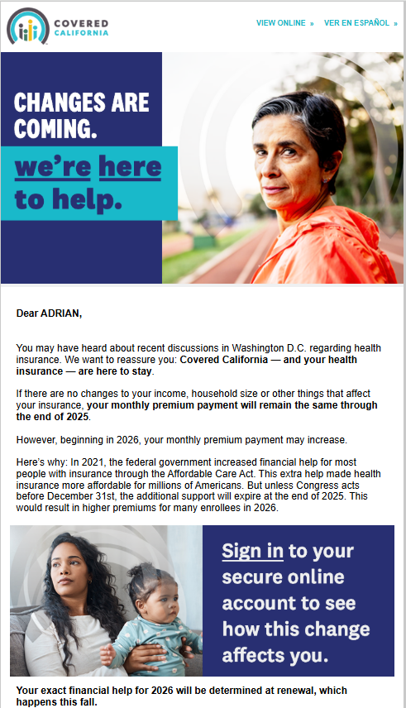
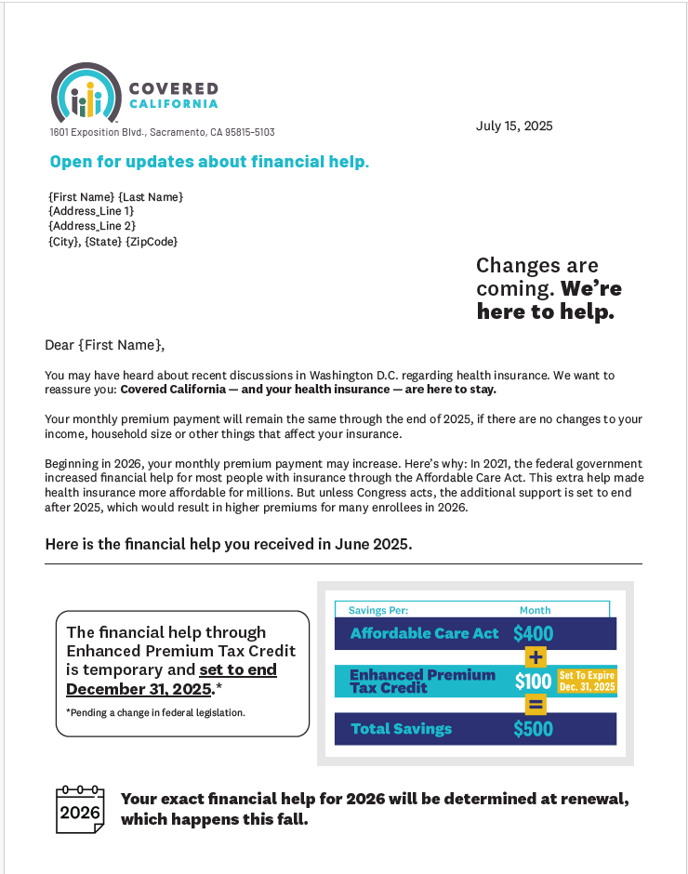
Email & Direct Mail
Email
Direct Mail Letter
Primary Message: The amount of financial help you receive in 2026 may be reduced if Enhanced Premium Tax Credit ends on 12.31.25.
CTA:
Log in to your online account to view details specific to you. Provide your mobile number for text alerts, visit the new landing page on the website, contact a certified enroller for help, update household information now in preparation for renewal.
HIGHLIGHTS
To: All Members with Subsidies Receive
Intent:
Email - point enrollees to their online accounts where financial help details are available.
Direct Mail Letter - provides details and is shown here and will be sent to three scenarios.
Languages: English, Spanish, Chinese (Traditional), Korean, Vietnamese, exploring others including Tagalog, Hindi, Hmong, Punjabi September-on
Send Dates/Target Send Dates:
July Direct Mail: 7/23
July Email: 7/29 & 7/30
August Direct Mail: 8/22
August Email: 8/25, 8/26 & 8/28
September Direct Mail: 9/22
September Email: 9/18, 9/19,9/22 & 9/23
Outreach will evolve to include further segmentation, additional languages and personalization, including informing members of their delegated Certified Enroller.

Slide 110
2026 Covered California Dental Benefits

Slide 111
Methodology: dental treatment categories
Data in certain segments of this report is presented by dental treatment category, which can be mapped to a specific CDT code range
Select dental treatment categories have CDT-level analysis included, such as those in the Preventive category, given that these services make up a high portion of overall services
Dental Treatment Category | CDT Code Range
Diagnostic | D0100-D0999
Preventive | D1000-D1999
Restorative | D2000-D2499
Crowns & Inlays/Onlays | D2500-D2999
Endodontics | D3000-D3999
Periodontics | D4000-D4999
Removable Prosthodontics | D5000-D5999
Implant Services | D6000-D6199
Fixed Prosthodontics | D6200-D6999
Oral Surgery | D7000-D7999
Miscellaneous | D9000-D9999

Slide 112
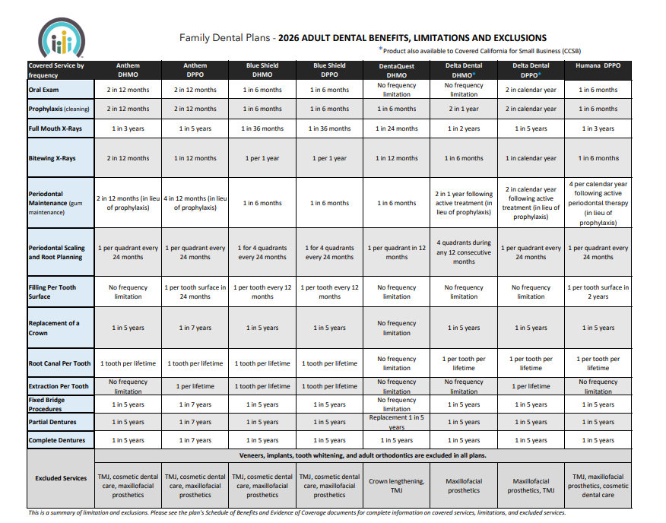
2026 COVERED CALIFORNIA DENTAL BENEFITS
https://www.coveredca.com/pdfs/2026_Dental_Benefits_Comparative.pdf
Learn more about Covered CA’s Dental Benefits: https://www.coveredca.com/dental/adult-add-on/hmo/

Slide 113
Proposal: Enrollment Application Changes for AIAN

Slide 114
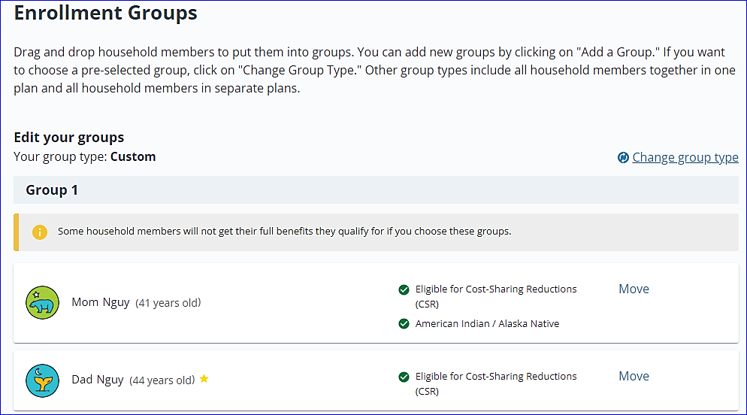
CURRENT PLAN CHOICE FOR MIXED AI/AN HOUSEHOLDS
If an AI/AN member is part of a mixed household and chooses custom groupings, the system shows a generic message that some household members will not get their full benefits they qualify for.

Slide 115
Tribal Advisory Workgroup Membership

Slide 116
TRIBAL ADVISORY WORKGROUP CHARTER
Membership:
Tribes nominated regionally diverse Tribal leaders and health program representatives to the Advisory Workgroup via a process facilitated by Covered California.
Members represent North, South, Central-East, and Central-West California along with non-federally recognized tribes.
Election of Chair:
The Workgroup could elect a Chair to coordinate with Covered California’s tribal liaison, help create meeting agendas, and act as a contact point.
Membership Terms:
Four-year terms starting in 2020, with no term limits.
New members could be nominated by the group, tribal leaders, or self-nominated.

Slide 117
CURRENT TRIBAL ADVISORY WORKGROUP
REGION | MEMBERSHIP
NORTHERN | Karen Shepherd, Consolidated Tribal Health Project VACANT
SOUTHERN | Chris Devers, Southern California Tribal Chairman's Association. Advisory Group Chair Della Freeman, Indian Health Council Inc.
CENTRAL EAST | Bill Thomsen, Riverside-San Bernardino County Indian Health, Inc. Selina De La Pena, Fresno American Indian Health Project
CENTRAL WEST | VACANT Scott Black, American Indian Health & Services
NON-FEDERALLY RECOGNIZED | VACANT

Slide 118
2025 Federal Poverty Level Chart

Slide 119
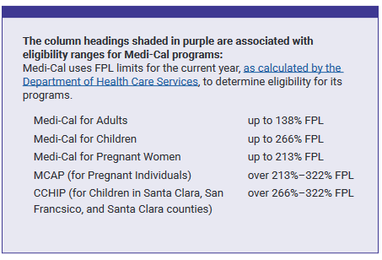
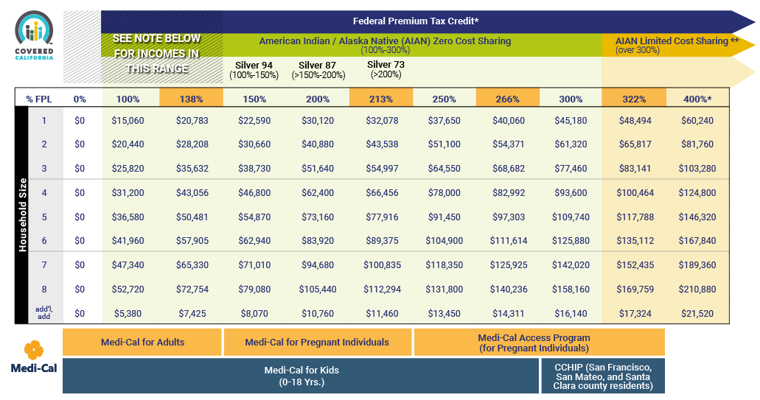
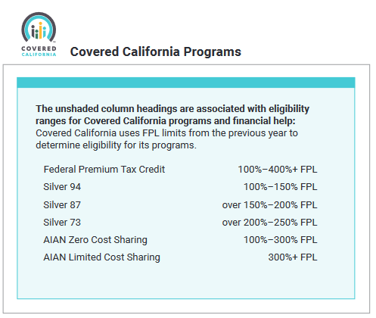
PROGRAM ELIGIBILITY – FEDERAL POVERTY LEVEL 2025
Program Eligibility by Federal Poverty Level for 2025
Your financial help and whether you qualify for various Covered California or Medi-Cal programs depends on your income, based on the Federal Poverty Level (FPL)

