Slide 1



Slide 2
THE AFFORDABLE CARE ACT
AND COVERED CALIFORNIA

Slide 3
FEDERAL REFORMS UNDER THE AFFORDABLE CARE ACT
The Patient Protection and Affordable Care Act (ACA) was signed into federal law in March 2010. This act included groundbreaking provisions that expanded coverage and reformed the health care and insurance markets. Three core provisions of the Affordable Care Act included:
Health Benefit Exchanges and Federal Subsidies:
The ACA created Federal and state-based marketplaces to buy health insurance and receive financial assistance.
Insurance Market Reforms:
The ACA changed the insurance market to allow for guaranteed issue and renewal; no annual or lifetime limits; coverage for essential health benefits; and dependent coverage up to age 26.
Medicaid Expansion:
The ACA expanded Medicaid to low-income childless adults.

Slide 4
COVERED CALIFORNIA’S ESTABLISHMENT AND GOVERNANCE
California became first the state in nation to enact legislation creating a health benefit exchange under the Affordable Care Act:
  Assembly Bill 1602 [Chapter 655, Statutes of 2010 (Pérez)] - California Patient Protection and Affordable Care Act in California
  Senate Bill 900 [Chapter 659, Statutes of 2010 (Alquist)] established structure and requirements for the state’s health benefit exchange.
Covered California was established in law as an independent public entity, governed by a five-member Board:
  Two members appointed by the Governor
  One member appointed by Senate Rules Committee
  One member appointed by Speaker of the Assembly
  Secretary of the California Health and Human Services Agency - ex-officio, voting member

Slide 5
COVERED CALIFORNIA’S MISSION AND CORE PRINCIPLES
Covered California’s mission is to increase the number of insured Californians, improve health care quality, lower costs, and reduce health disparities through an innovative, competitive marketplace that empowers consumers to choose the health plan and providers that give them the best value.
State-based exchange where eligible Californians can compare and shop for health insurance plans on the individual market.
The only place where eligible Californians can receive financial assistance to help pay for health plan premiums and out-of-pocket costs.
Active purchaser that fosters a competitive marketplace by selective contracting with health insurance carriers to offer coverage throughout the state. Covered California negotiates premiums rates with carriers to keep premiums low, and establishes standard, patient-centered benefit designs to make shopping easier for consumers and foster greater access to affordable care.
  Drives value, payment and delivery system reform, quality improvement, addresses health disparities and health equity.
Operates the state’s public small business exchange called Covered California for Small Business

Slide 6
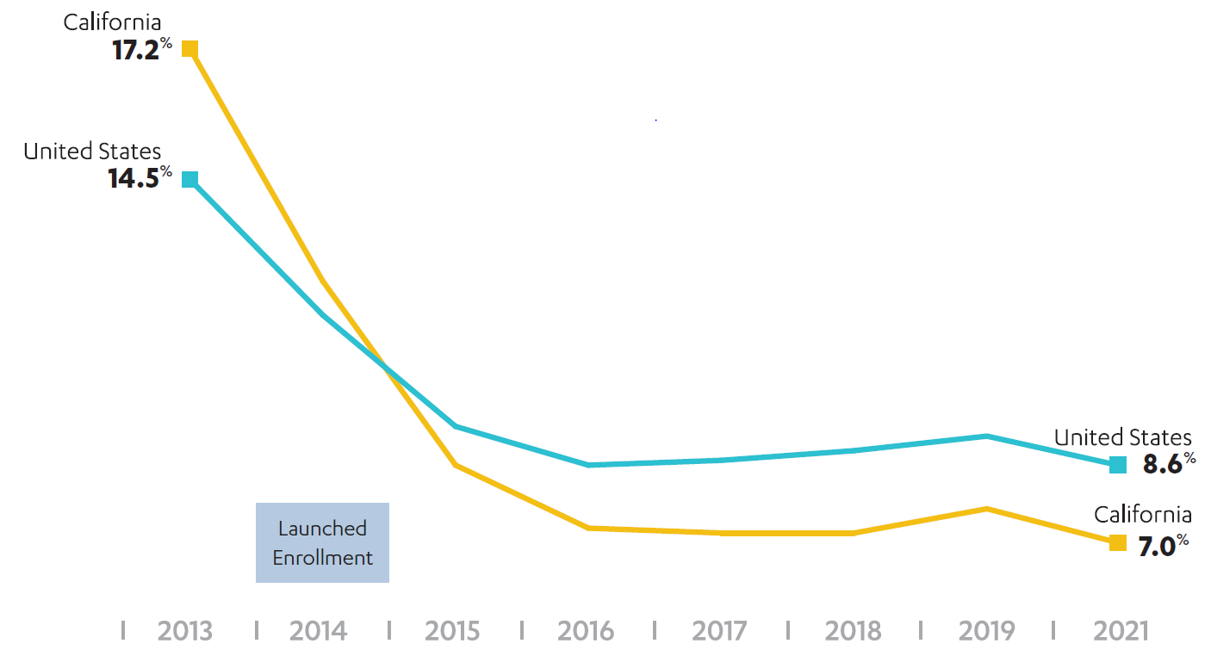
1.7 MILLION PEOPLE ARE ENROLLED IN COVERED CALIFORNIA, HELPING DRIVE THE STATE’S UNINSURED RATE TO A RECORD LOW
Comparing the Uninsured Rate in California and the United States*
California experienced the largest percentage point drop in the uninsured rate of any state in the nation.
Since first opening its doors, more than 5.2 million Californians have been insured through Covered California for at least one month.
New federal data shows California’s uninsured rate hit a record-low in 2021.
*Source: American Community Survey. Due to the pandemic, the survey did not report results for 2020.

Slide 7
THE INFLATION REDUCTION ACT SUBSIDY EXTENSION

Slide 8
NET PREMIUMS WITH THE ARP SUBSIDIES
With enhanced subsidies available through the American Rescue Plan, nearly a quarter of subsidized enrollees had a $0 monthly net premium in 2022.
Nearly half of enrollees pay $50 or less per month.
Source: Snapshot of May 2022 Covered California enrollment, among individuals receiving monthly APTC. Premiums reflect net of subsidy cost per member per month.

Slide 9
INCREASED AFFORDABILITY WITH THE PASSAGE OF THE IRA
Without the subsidy extension, middle income consumers would have no longer received any federal financial assistance.
Now, middle income consumers who are eligible for financial help will save an average of $324 on their monthly premiums.
$279 less per month
$324 less per month
$317 less per month
$346 less per month
Source: Snapshot of May 2022 Covered California enrollment, among individuals receiving monthly APTC. Premiums reflect net of subsidy cost per member per month, using preliminary 2023 rates. Individuals who can purchase a benchmark silver plan at cost below the maximum percentage of income set by program rules are not included in these estimates.

Slide 10
INFLATION REDUCTION ACT SUBSIDY EXTENSION
Nearly a quarter of subsidized enrollees have a $0 monthly premium in 2022.
Nearly half of enrollees pay $50 or less per month.
Nearly half of current enrollees with incomes under 400% FPL can enroll in a Silver plan for less than $10 a month in 2023.
About 260,000 uninsured Californians could get covered with a Covered CA plan for under $10 a month. Of these, over 240,000 could get a Bronze plan for free.

Slide 11
PRODUCTS OFFERED THROUGH
COVERED CALIFORNIA

Slide 12












2023 COVERED CALIFORNIA QUALIFIED HEALTH PLAN COMPANIES
2023 Health Plans
Covered California Individual & Family Market
Covered California provides quality health coverage from private health insurance companies.
Health companies offer one or more of these products: PPO, HMO, and/or EPO; and a wide variety of doctors and hospitals.
These 12 companies meet all the state and federal requirements for health plans, plus additional contractual requirements set by Covered California.

Slide 13








2023 FAMILY DENTAL AND VISION COMPANIES
All health plans include dental care for children at no extra cost.
Adults can purchase a family dental plan when they enroll in a Covered California health insurance plan.
  There must be at least one adult (age 19 or older) enrolled in
  a family dental plan in order for a child in the family to enroll. (Not all adults in the household are required to enroll.) If a family chooses to enroll children in a family dental plan, all children younger than 19 who live in the household must enroll.
Children under age 19 get free vision care included with their parent’s Covered California health plan.
Adults can enroll directly with one of our two contracted vision companies. Both offer excellent benefits.
https://www.coveredca.com/individuals-and-families/getting-covered/dental-coverage/family/
https://www.coveredca.com/vision/adult/

Slide 14
American Indian/Alaska Native Covered CA Plans
Due to the Affordable Care Act, American Indians and Alaska Natives (AI/AN) individuals are offered enhanced special benefits when they enroll in a Covered California AI/AN plan, including:
  Opportunity to enroll at any time of year
  Zero cost-sharing plan option for household incomes at or below 300% of the Federal Poverty Level
  Limited cost-sharing plan option for household incomes above 300% of the Federal Poverty Level
  No copays, deductibles, coinsurance for zero and limited cost-sharing plans when receiving care from Indian health care providers

Slide 15
ESSENTIAL HEALTH BENEFITS
Regardless of the plan selected, the following essential benefits are covered:
Outpatient services
Emergency services
Hospitalization
Maternity and newborn care
Mental health and substance abuse disorder services
Prescription drugs
Rehabilitative and habilitative services and devices
Laboratory services
Preventative and wellness services and chronic disease management
Pediatric services

Slide 16

FINANCIAL ASSISTANCE ELIGIBILITY REQUIREMENTS
Factors that determine eligibility for financial assistance and the amount:
Household income,
Household size,
Age of household members, and
Location of the household (which determines the pricing region)
Not enrolled in Minimum Essential Coverage (MEC) or have MEC made available to them
Members who received financial assistance from the federal APTC and must file their federal taxes to reconcile the APTC amount with the IRS.

Slide 17
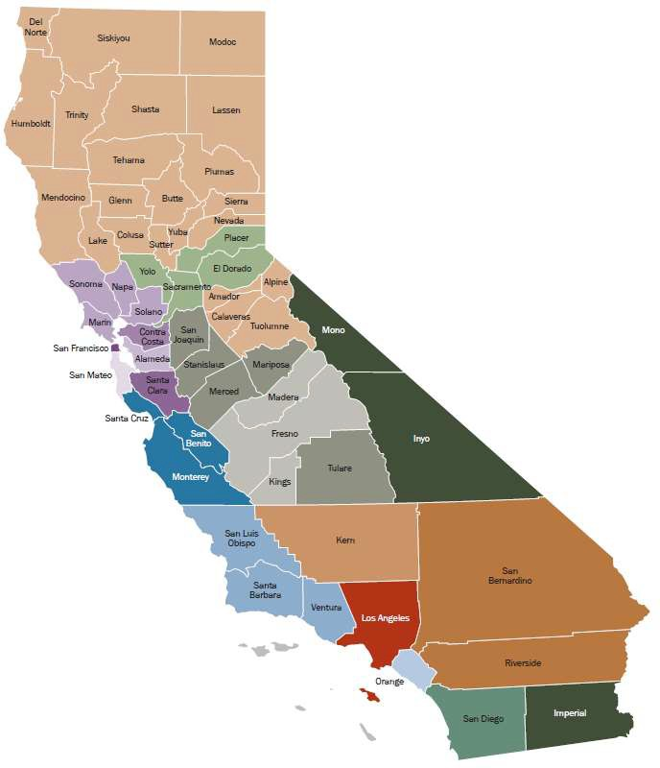
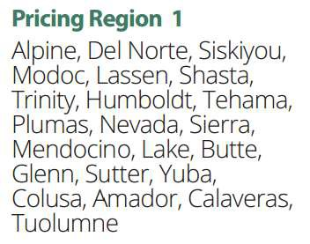

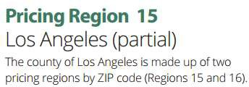
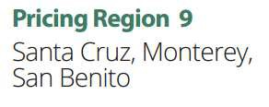
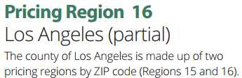

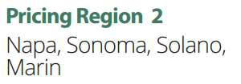

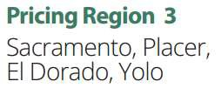










PRICING REGIONS

Slide 18
2023 HEALTH BENEFIT DESIGN BY METAL TIER
Benefits in blue are NOT subject to a deductible. Benefits in blue with a white corner are subject to a deductible after the first three visits.
Drug prices are for a 30 day supply.
* Copay is for any combination of services (primary care, specialist, urgent care) for the first three visits. After three visits, future visits will be at full cost until the medical deductible is met.
** Price is after pharmacy deductible amount is met.
*** See plan Evidence of Coverage for imaging cost share.

Slide 19
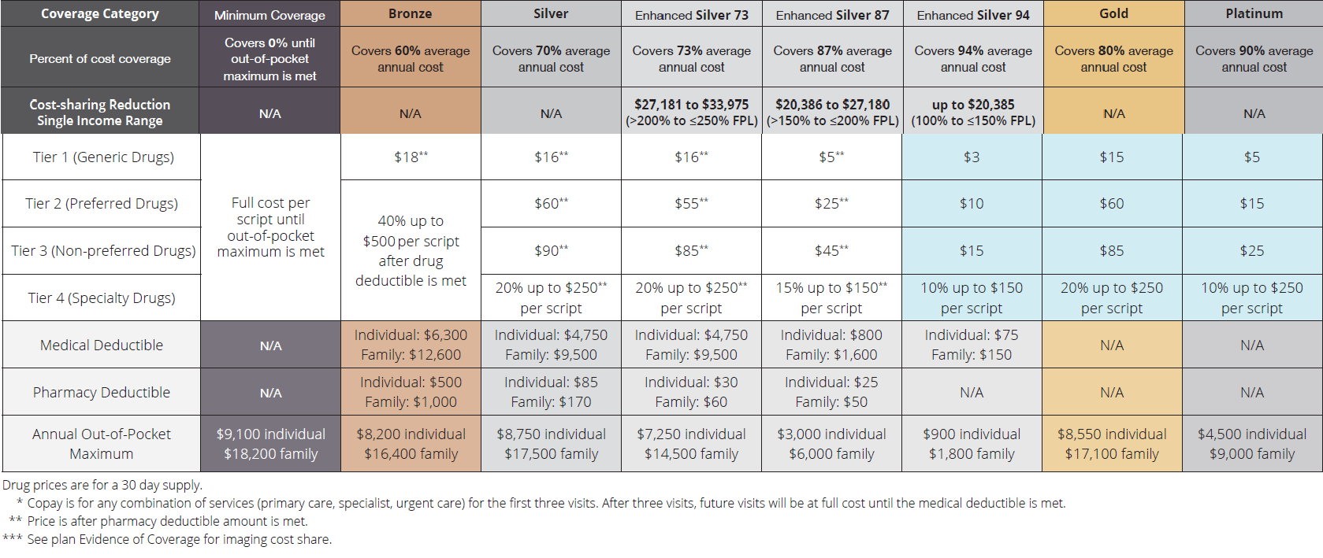
2023 HEALTH BENEFIT DESIGN BY TABLE TIER

Slide 20
OPEN AND SPECIAL ENROLLMENT

Slide 21
ENROLLMENT WINDOWS
Open Enrollment:
Eligible Californians can sign-up for Covered California between November 1 and January 31. Unless qualified for “special enrollment,” individuals and families cannot enroll outside of the open enrollment period.
Special Enrollment:
Short time window in which eligible Californians can sign-up for Covered California. Special Enrollment can only be triggered by a change of circumstance (loss of employment, marriage, birth, relocation, etc…).

Slide 22
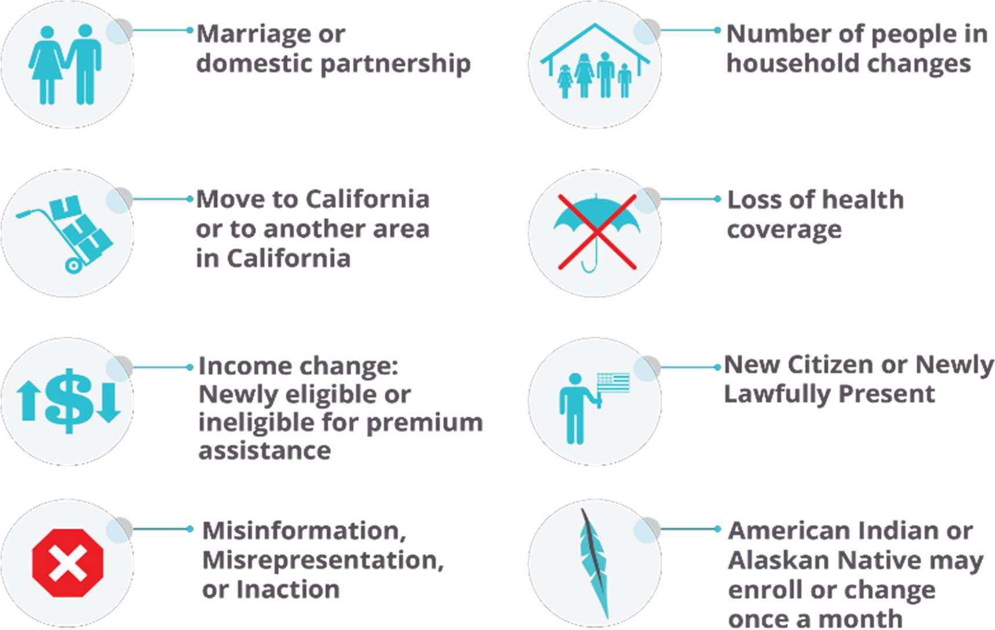
SPECIAL ENROLLMENT EXAMPLES

Slide 23




HELPING CONSUMERS ENROLL
Find an Enroller
Licensed Insurance Agents and Certified Enrollers are ready
to help.
Help on Demand
Have a certified enroller call you. Most calls are returned in under 15 minutes.
Local Medi-Cal Offices
For those who want to apply for Medi-Cal health coverage.
Call Us
Speak with a service center representative during our regular business hours.
(800) 300-1506

Slide 24

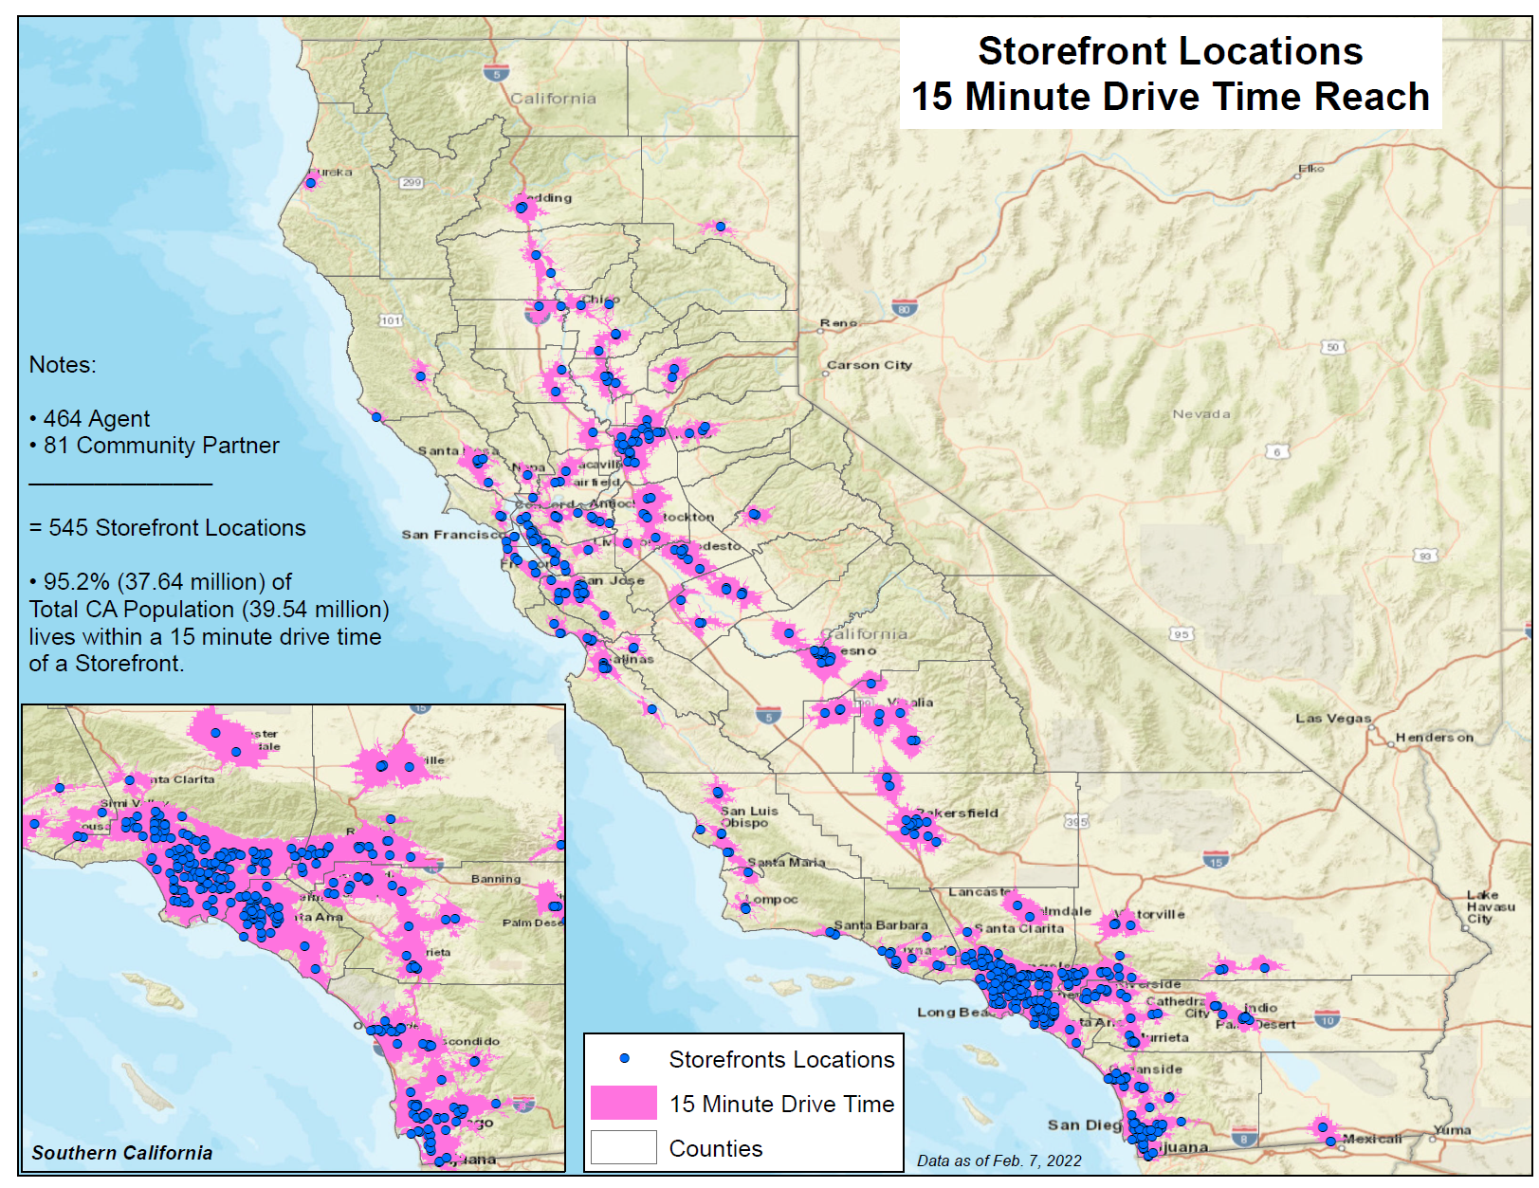

COVERED CALIFORNIA CERTIFIED AGENTS
More than 11,000 insurance agents have been trained to sell Covered California products and are consistently the largest channel for enrollment.
To spur enrollment, Covered California engages with licensed insurance agents and navigators who offer free confidential assistance.
Consumers can get enrollment assistance in 16 languages from Covered California licensed insurance agents.
Consumers can go to this site to find insurance agents licensed by Covered California.
95% of all Californians are within a 15-minute drive from one of Covered California’s storefront locations.
556
storefront locations*
*Data as of 2/22/2023

Slide 25
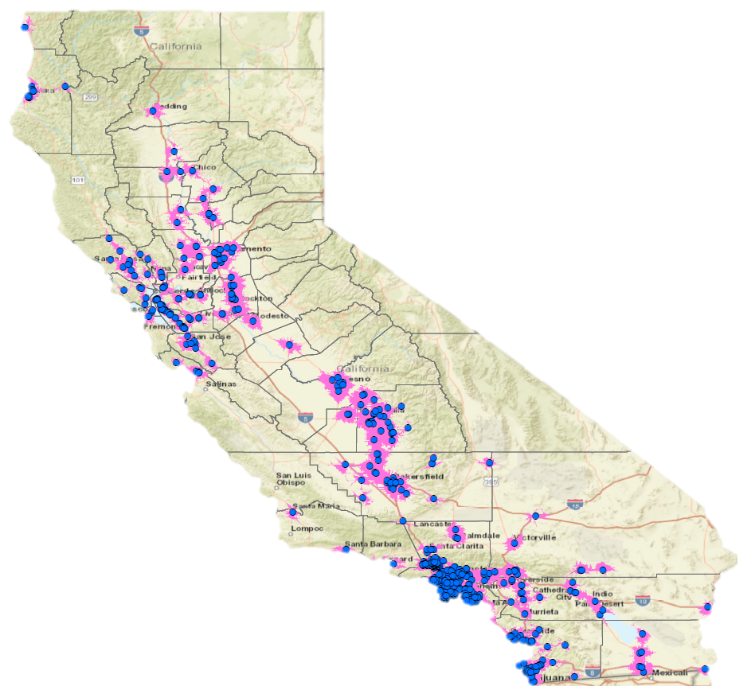
NAVIGATOR PROGRAM
88 Entities with 827 enrollment locations*
(38 Lead and 50 Sub-Contractor Active Enroller Entities with 1,216 active certified enrollment counselors)
89.6% of Californian’s total population lives within a 15-minute drive time of a Navigator location.
Covered California awards up to $6.5 million annually to support more than 100 community organizations through the Navigator Program.
Covered California’s Navigator Program is a partnership with community organizations across the state who have experience in reaching and assisting California’s diverse populations and have proven success enrolling consumers in health care programs
Navigators are certified enrollment counselors that assist consumers in hard-to-reach populations through a variety of outreach, education, enrollment, post enrollment, and renewal support services
Navigators are located across the state from northern California, Bay Area, Central Valley, Central Coast, and Southern California.
*Data as of 2/3/2023

Slide 26

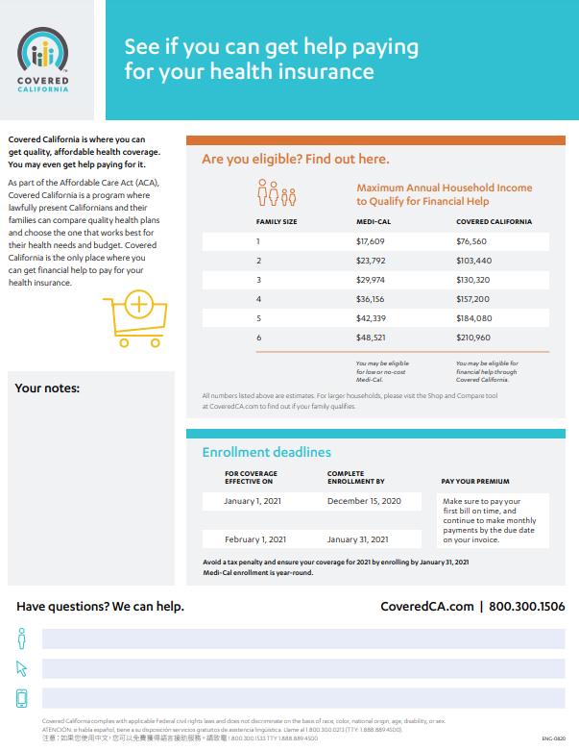

CONSUMER COLLATERAL MATERIALS
https://hbex.coveredca.com/toolkit/collateral.html
Paper Calculator
Get Affordable Health Coverage Brochure
Enrollment Guide
Now That You're Enrolled
Special Enrollment Fact Sheets
Immigration Fact Sheet
Penalty Comparison Chart
Consumer Protection Fact Sheet
Tax Penalty Fact Sheet

Slide 27
COVERED CALIFORNIA ENROLLMENT DATA
Covered California’s Active Member Profile shows counts of enrollees who have paid and have effective coverage through Covered California during specified reporting months.
Data is available by various cross sections including ethnicity, age, product, health plan, county, zip code, congressional and legislative districts.
Visit: http://hbex.coveredca.com/data-research/

Slide 28
CASEWORK

Slide 29
ESCALATING CONSTITUENT ISSUES
If your office needs assistance with Covered CA constituent issue, you can email us to at externalaffairs@covered.ca.gov.
It is helpful to include the following information in your email to help us research the case:
Constituent’s Name,
Constituent’s Telephone Number,
Case # or Application ID # (optional),
Constituent’s Date of Birth, and
Description of the issue.

Slide 30
FOR QUESTIONS OR TO REQUEST
MORE INFORMATION CONTACT:
externalaffairs@covered.ca.gov

