Slide 1
Amendment to Slide Deck
Amendments have been made to the 4/9/19 slide deck provide clarity to the information as requested by the webinar participants. Changes are in red strikeout for deletion of words or red underlined for addition words on the following slide pages:
Page 24
Page 31
Page 43
Page 45

Slide 2
2019-2022 Navigator Program
Request for Application (RFA #2018-16) Webinar
April 9, 2019 – 10 AM to 12 PM PST
The webinar will begin at 10 a.m. Please call in for audio. All participant phone lines will be muted during the webinar.
Please use the webinar chat feature to submit questions.

Slide 3
Webinar Housekeeping
Webinar Online Content | Click this link: https://hbex.coveredca.com/solicitations/RFA-2018-16/ to download the slide deck.
Technical Difficulties | Submit technical difficulty comments/questions via chat feature so we can assist you.
Q & A | We will take time for questions and answers after the presentation. Please submit your questions via the chat feature so we can track all questions.
Webinar Posting | This webinar is being recorded. Webinar video, slide deck, questions and answers will be posted on our website https://hbex.coveredca.com/solicitations/RFA-2018-16/ on or before April 20, 2018.

Slide 4
Topics
Affordable Care Act (ACA) & Covered California
Navigator Program Overview
Navigator Request for Application
Navigator Application Process
Navigator Application Evaluation and Selection Process
Questions & Answers

Slide 5
Affordable Care Act (ACA) &
Covered California

Slide 6
ACA & Covered California Timeline
March 23, 2010
The Patient Protection and Affordable Care Act (known as the ACA) was signed by President Obama and enacted.
September 2010
The California Health Benefit Exchange (HBEX) was created.
October 2012
HBEX is named Covered California.
August 19, 2013
First California Healthcare Eligibility, Enrollment, and Retention System (CalHEERS) release
October 1, 2013
CalHEERS is available for public use and first Open Enrollment begins
January 1, 2014
First day of Covered California coverage and Medicaid expansion is in effect

Slide 7
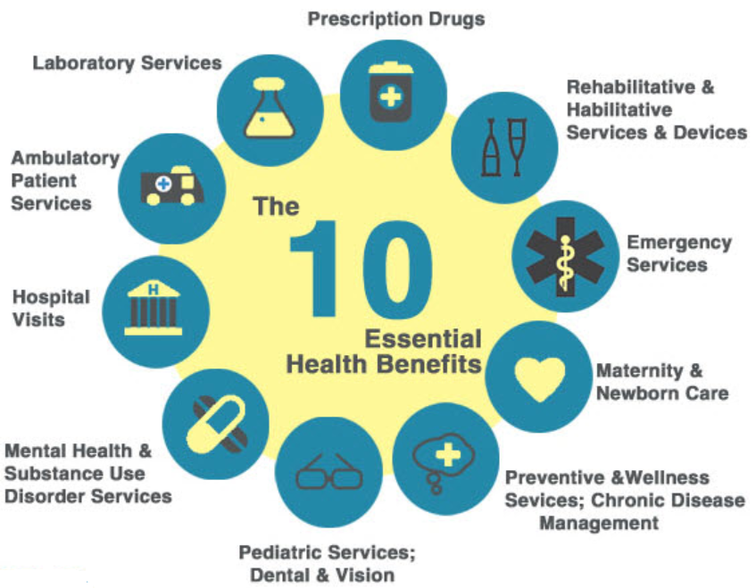
Health Benefit Exchange
Major Functions:
Standardizing benefits
Screening and Enrolling into the Exchange, Medicaid, and CHIP programs
Provide an Electronic Calculator and Create a Website
Determine Eligibility for Advanced Premium Tax Credits (APTC), and Cost Sharing Reductions (CSR)
Eligibility Criteria for the Exchange includes:
Income Above 100% (or 138% in Expansion States) of the Federal Poverty Level (FPL)
US Citizens and Lawfully Present
Benefits of Exchange Enrollment
APTC and CSR available on sliding scale based on income between 100% and 400% FPL
  APTC can be used to lower monthly premiums or can be saved and received as a tax refund or a reduction of taxes owed
  CSRs limit out-of-pocket spending
Notes:
Here are a few of the functions of any of the State Based and the Federally Facilitated Exchanges.

Slide 8
Covered California’s Promise
Vision:
To improve the health of all Californians by assuring their access to affordable, high quality care.
Mission:
To increase the number of insured Californians, improve health care quality, lower costs, and reduce health disparities through an innovative, competitive marketplace that empowers consumers to choose the health plan and providers that give them the best value.
Better Care | Healthier People | Lower Cost
Notes:
The California exchange's vision is to improve the health of all Californians by assuring their access to affordable, high quality care.
Our mission is to increase the number of insured Californians, improve health care quality, lower costs, and reduce health disparities through an innovative, competitive marketplace that empowers consumers to choose the health plan and providers that give them the best value.
Our triple aim is to have a system that works of nurses, providers, partnerships to deliver better care, have healthier people, and lowering cost.

Slide 9
Covered California: Strategic Pillars
Affordable Plans | Staying Healthy and Getting Needed Care | Effective Outreach and Education | Positive Consumer Experience | Organization Excellence
Consumers purchase and keep Covered California products based on their perception that this is a good value for them. | Consumers receive the right care at the right time. | Consumers understand what we offer and have a positive attitude about Covered California. | Consumers have a positive experience from initial enrollment to keeping their coverage. | Covered California has the right tools, processes, and resources to support our team to deliver on our mission.
CROSS-CUTTING AREAS OF ATTENTION
Innovating for the long term and being nimble in the present.
Trailblazing and sharing our experience in California and nationally.
Working in partnership with others: DHCS, and other public and private entities.
Notes:
How we organize to carry out our mission.
Covered California’s strategic pillars were designed by the agency’s management and reviewed by the board to guide the organization while making decisions, setting priorities, determining initiatives and preparing annual budgets. The five pillars and the broad strategy behind each and its new enhancements for the upcoming fiscal year are:
Affordable Plans: Consumers purchase and keep Covered California products based on their understanding of how their coverage is a good value for them.
Broad Strategy
▪ Actively negotiate rates and benefits with carriers to provide consumers with the best value.
▪ Invest in marketing and outreach to promote the value of coverage and maintain a healthy risk mix.
▪ Offer patient-centered benefit designs to make care more affordable by increasing a consumer’s understanding of benefits that maximize access to appropriate care.
Enhancements for Fiscal Year 2018-19
▪ The new Consumer Experience Division will create a stronger focus on the enrollee to ensure he or she is empowered to choose the health plans and providers that provide the best value.
Staying Healthy and Getting Needed Care: Consumers receive the right care at the right time.
Broad Strategy
▪ Work with all contracted qualified health plan issuers, in every corner of the state, to ensure consumers have ready access to doctors, hospitals and care.
▪ Hold health insurance companies accountable for improving the care delivered, addressing disparities of care and moving to a patient-centered system that rewards quality and value, rather than being rewarded for quantity only.
Enhancements for Fiscal Year 2018-19
▪ Expanding efforts to promote improvements in care delivery through clinical, enrollment and qualitative survey data to identify opportunities to promote change.
▪ Adding staff to the Plan Management Division to strengthen relationships with qualified health plan issuers to ensure that policies, processes and rules continue to meet the needs of our consumers.
• Effective Outreach and Education: Consumers understand what we offer and have a positive attitude about Covered California.
Broad Strategy
▪ Make significant investments in marketing and outreach to motivate consumers to enroll get and maintain their insurance coverage.
▪ Educate and support Covered California’s 20,000 sales partners in order to promote enrollment and increase the number of insured Californians.
Enhancements for Fiscal Year 2018-19
▪ The proposed budget includes more than $107 million for marketing and outreach and $105 million for our Service Center to help individual consumers.
• Positive Consumer Experience: Consumers have a positive experience from initial enrollment to keeping their coverage.
Broad Strategy
Operate and staff Service Centers as well as partner with 20,000 Certified Insurance Agents, enrollers and Navigators to assist consumers in a variety of languages.
Mobile website design allows consumers to use all features on any device.
Ombuds Office established to help consumers as needed.
Enhancements for Fiscal Year 2018-19
▪ The new Consumer Experience Division will measure the consumer experience directly as a baseline to ensure the experience improves over time.
▪ Investing in Information Technology (IT) to stay on the cutting edge of technologies that can benefit consumers.
• Organizational Excellence: Covered California has the right tools, processes and resources to support its team to deliver on our mission.
Broad Strategy
▪ Operate as a nimble and responsive enterprise that responds quickly to the changing environment in health care.
▪ Implemented Healthier U, a program designed to improve the health and well-being of state employees; an Employee Recognition Program to create a culture of acknowledgement; and a Career Development
Program to help staff prepare for career advancement at Covered California.
Enhancements for Fiscal Year 2018-19
▪ The new Covered California Leadership Academy will assure that managers and key staff are equipped to successfully manage and lead the organization.
These five pillars are supported and complemented by the following crosscutting initiatives:
Innovating for the long term and being nimble in the present.
▪ In the past year, Covered California developed and implemented a policy to protect consumers from being negatively affected by the administration’s decision to end cost-sharing reduction reimbursement
payments. This policy is known as the CSR surcharge. A majority of other states followed our example to protect their enrollees from unnecessary premium hikes.
▪ Executive leaders toured state-of-the-art businesses in California to learn about the latest advances in health care, how consumers will get care, and the tools they will use to stay healthy in the coming years.
▪ In planning for FY 2018-19, Covered California is developing efforts to communicate effectively to consumers the dangers of “junk” short-term, limited-duration insurance plans.
Using Covered California’s experience to inform policy in California and nationally.
▪ Covered California actively seeks opportunities to contribute to the policymaking discussions in California and Washington D.C. by sharing our experiences and analysis of how policy issues could affect the individual
market and health care costs and quality more broadly.
▪ In the past year, analysis provided to the administration documented the dramatic drop in new enrollees in the federally facilitated marketplace, potential 3-year premium hikes of up to 90 percent in some states due to
uncertainty at the federal level and the potential impact of the removal of the individual mandate penalty.
▪ Covered California learns from and shares its experiences with other state-based marketplaces, academic institutions, along with private and public partners to practice evidence-based policy development.
• Working in partnership with others to promote changes in care delivery that benefit all Californians.
▪ Collaborating with DHCS to make “churn” smoother and addressing the complexities of enrolling mixed families for consumers moving between Medi-Cal and Covered California.
▪ Actively working with DHCS and other public and private purchasers to promote improvements in care by adapting common efforts, such as Smart Care California, which is currently focused on tackling the issues of
opioids, lower back pain and overuse of C-sections.

Slide 10
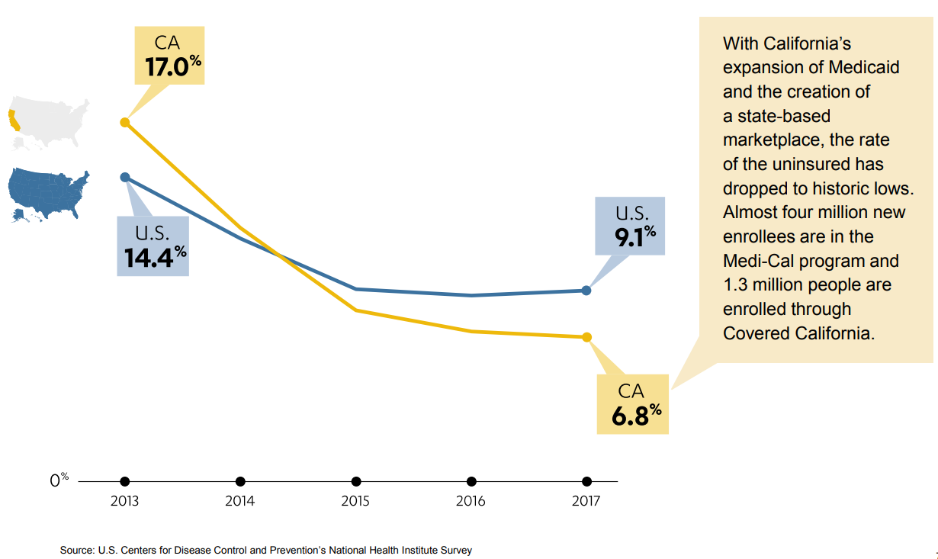
Impact of the ACA in California
Notes:
This data is as of the 2018 calendar year. CCA will be reporting out on 2019 data as soon as we can
Covered CA’s commitment to all Californians to increase access to care and lower the uninsured has borne fruit. We continue to work towards reducing the uninsured percentage and the job is never done. Californians constantly have changes in their lives that make Covered CA a needed safety need. We act as a bridge for individuals moving between Medi-Cal and Employer Sponsored Coverage. We provide access to affordable coverage for self-employed individuals and their families.

Slide 11
Covered California Navigator Program

Slide 12
Outreach and Navigator Grant Program Timeline
2013 | 2014 | 2015 | 2016 | 2017 | 2018 | 2019 | 2020 | 2021 | 2022
5/1/13 – 12/31/17
Outreach & Education Grant Program
10/1/14 – 7/31/15
Navigator Grant Cycle Year 14/15
8/1/15-7/31/18
Navigator Grant Cycle Years 15/16, 16/17, & 17/18
8/1/18 – 6/30/19
Navigator Grant Cycle Year 17/18, 10 month extension
7/1/19 – 6/30/22
Navigator Grant Cycle Years 19/20, 20/21, & 21/22

Slide 13
Navigator Program
Covered California’s Navigator Program is a partnership with community organizations across the state who have experience in reaching and assisting California’s diverse populations and have proven success enrolling consumers in health care programs.
Navigators are Certified Enrollment Counselors that assist consumers through a variety of outreach, education, enrollment, post enrollment, and renewal support services.

Slide 14
Navigator Program Requirements
Mandatory requirement of the Patient Protection and Affordable Care Act, funded from revenue generated by Covered California.
Have a competitive application process for applicants to apply for the grant contract and funding amount award period.
Requires elected grant entities to conduct outreach and education throughout the grant award period and assist consumers with the enrollment application process during both the annual Open Enrollment Period and the Special Enrollment Period.

Slide 15
Navigator Program Goals
Maximize enrollment and re-enrollment of eligible consumers Covered California Health Insurance Plans.
Prioritize outreach, enrollment, renewal, and post enrollment assistance.
Engage with organizations that maintain trusted relationships with target markets as defined by geography, employment sector, culture, language, or other shared characteristics.
Partner with organizations that have the capacity to serve as an integral part of Covered California’s service delivery channels.
Maintain a cost effective grant program.

Slide 16
Navigator Role & Activities
Conducting outreach, education, enrollment, renewal assistance, and post-enrollment support;
Raising public awareness of key enrollment facts and dates through effective outreach activities, including potential of in-person, as well as, earned, paid, and social media outreach;
Informing Covered California-eligible consumers of the availability and benefits of obtaining health care coverage;
Promoting the value of purchasing health care coverage;
Motivating consumers to act;
Helping consumers to shop and compare plans;
Facilitating enrollment into Covered California Health Insurance Plans or Medi-Cal;
Assisting consumers with the Covered California-eligible renewal process; and
Providing post-enrollment support to Covered California-eligible consumers.
Notes:
Purpose of the Navigator Program
The Navigator Program is a requirement of the Patient Protection and Affordable Care Act of 2010 and is funded as an element of the annual operating budget from revenue generated by Covered California.
Navigator Grantees are organizations selected from a competitive application process for each grant cycle and award period. The process allows Covered California to identify organizations that will provide the best overall value, quality strategies to address the identified areas of enrollment opportunity, and the most effective activities to meet the goals, objectives, and guiding principles of the Navigator Program.

Slide 17
Navigator Program
Request for Application (RFA #2018-16)

Slide 18
RFA Purpose
To implement a performance-based funding model with grant payments given when the grantees meet the performance requirement at defined intervals throughout the grant contract term.
To solicit applications from interested organizations to participate and identified areas of enrollment opportunity to establish an outreach, education, and retention strategy that incorporates a staffing plan to accomplish the goals.
To have a critical mechanism in administering and delivering cost effective, hard to reach, underserved, and targeted activities to support enrollment goals and initiatives.
To ensure we have statewide coverage in providing assistance to consumers throughout the state.
To ensure consumers effectuate coverage during new enrollment and renewal.

Slide 19
Grant Awards: Contract & Amount
Grant Contract Period Fiscal Years:
2019-22
The grant contract award period is from July 1, 2019 through June 30, 2022.
The total grant funding amount for these three-year period cannot exceed $19.5M.
Grant contracts awarded under this RFA may be renewed, upon approval by the Board, for two 1-year extensions.
Grant Amount Period
Fiscal Year:
2019-20
The grant amount period of July 1, 2019 through June 30, 2020.
The total grant funding amount for FY 2019-20 cannot exceed $6.5M.
Grant amounts per entity can range from $50,000 to $500,000 in $25,000 increments.
Grant contract amounts for the extension periods of FY 2020-21 and 2021-22 will be determined by the Board each state Fiscal Year (FY)

Slide 20
Core Funding Goals

Slide 21
Grant Funding: Core and Optional
Core Funding – Performance-based Model
Primary geographic: building statewide access to enrollment assistance and sustaining a network of Navigator organizations.
Target populations: hard to reach, subsidy-eligible uninsured populations, and populations that face barriers to enrollment
2. Targeted Area Pilot Funding (Optional)
Distinct geographic: four meta-regions identified with 37 zip codes
Distinct populations: populations that exceed 1,000 people and are outside of a 15-minute drive from a current Navigator grant entity or a Certified Application Counselor entity location.

Slide 22
Effectuated Enrollment and Renewal Goals
Grant Amount | Goal | Cost Per Effectuation
$50,000 | 286 | $175
$75,000 | 429 | $175
$100,000 | 571 | $175
$125,000 | 714 | $175
$150,000 | 857 | $175
$175,000 | 1,000 | $175
$200,000 | 1,143 | $175
$225,000 | 1,286 | $175
$250,000 | 1,429 | $175
$275,000 | 1,571 | $175
$300,000 | 1,714 | $175
$325,000 | 1,857 | $175
$350,000 | 2,000 | $175
$375,000 | 2,143 | $175
$400,000 | 2,286 | $175
$425,000 | 2,429 | $175
$450,000 | 2,571 | $175
$475,000 | 2,714 | $175
$500,000 | 2,857 | $175
Notes:
The tables below depict potential award amounts and suggested funding allocation and the projected number of enrollments and renewals by award size.
Year over year, Covered California policy changes and decisions may result in changes to effectuated enrollment goals (e.g., the Fiscal Year 2019-20 $175 Cost Per Effectuation basis of the grant award tier amounts is based on a declining market enrollment trend). Should new affordability measures or a return of the individual mandate penalty cause the enrollment trend to increase, Covered California will reevaluate the Cost Per Effectuation basis and adjust it to reflect the prevailing market trends.
Covered California strongly encourages cost-effective proposals that are likely to achieve significant enrollment of eligible consumers in Covered California Health Plans.
Applicants are encouraged, but not required to utilize these figures as guidelines in defining their grant proposals and proposed enrollment and renewal goals.

Slide 23
Effectuated Enrollment and Renewal Goals
Year over year, Covered California policy changes and decisions may result in changes to effectuated enrollment goals (e.g., the Fiscal Year 2019-20 $175 Cost Per Effectuation basis of the grant award tier amounts is based on a declining market enrollment trend). Should new affordability measures or a return of the individual mandate penalty cause the enrollment trend to increase, Covered California will reevaluate the Cost Per Effectuation basis and adjust it to reflect the prevailing market trends.
Covered California strongly encourages cost-effective proposals that are likely to achieve significant enrollment of eligible consumers in Covered California Health Plans.
Applicants are encouraged, but not required to utilize these figures as guidelines in defining their grant proposals and proposed enrollment and renewal goals.

Slide 24
Outreach Activity Goals
Navigator grant entities will be assigned outreach expectations based on their Grant Amount Award tier
Goals and activity points may be adjusted in each contract renewal grant cycle.
Performance to goal may be used along with enrollment productivity to make decisions on year over year funding adjustments including the decision to terminate grant contract agreements
Navigator grant entities will earn points throughout the grant award year by participating in, tracking, and reporting various outreach activities as listed in Table 4. Activities that Earn Outreach Points on the next page.
Grant entities with subcontractors may report on the activities of sub-entities and will be awarded points for activities tracked.
Grant Amount | Outreach Points Goal
$50,000 | 50
$75,000 | 64
$100,000 | 78
$125,000 | 92
$150,000 | 106
$175,000 | 120
$200,000 | 134
$225,000 | 148
$250,000 | 162
$275,000 | 176
$300,000 | 190
$325,000 | 204
$350,000 | 218
$375,000 | 232
$400,000 | 246
$425,000 | 260
$450,000 | 274
$475,000 | 288
$500,000 | 300

Slide 25
Activities that Earn Outreach Points
Category | Point(s) Earned | Qualifying Activity
Events | 3 | 1 3 points earned per education or enrollment event logged in the event portal or bi-monthly report (Note: office hours do not constitute events)
Paid Media | 1 | 1 point earned per $100 spent on advertising promoting Covered California enrollment
Earned Media | 10 | 10 points earned per documented instance of earned media
Twitter | 1 | 1 point earned per month wherein 4 tweets are published mentioning Covered California (via in-tweet “@CoveredCA” linked tagging) from an account with at least 1,000 followers (Max 1 point per month per primary Grantee)
Facebook | 1 | 1 point earned per month wherein 2 posts are published mentioning Covered California (via in-post “@Covered California” linked tagging) (Max 1 point per month per primary Grantee)
Instagram | 1 | 1 point earned per month wherein 2 posts are published mentioning Covered California (via in-post “@CoveredCA” linked tagging) (Max 1 point per month per primary Grantee)
LinkedIn | 1 | 1 point earned per month wherein 2 posts are published mentioning Covered California (via in-post “@Covered California” linked tagging) (Max 1 point per month per primary Grantee)

Slide 26
Targeted Area Pilot Funding - Optional

Slide 27
Targeted Area Pilot Funding - Optional
Organization must apply for the core funding in order to apply for this optional funding.
Up to four $25,000 awards may be funded for one grant entity per region to target with outreach, education, and enrollment events and activities for the 2019-20 agreement term.
Selections for these awards will be limited to organizations who were selected for core funding, and these awards will be made in addition to core funding grant amount awards.
The four awards may be made to separate entities, or multiple awards may be issued to the same entity, depending on evaluation of the application.
Performance in the specified zip codes will be evaluated throughout the grant term year, and continuation of the pilot and funding will be contingent on results meeting appropriate cost per acquisition targets.

Slide 28
Targeted Area Pilot Funding - Optional
Meta-Region 1. Yosemite
  10 Zip Codes
  46,091
Meta-Region 2. San Bernardino
  8 Zip Codes
  34,885
Meta-Region 3. North of Redding
  8 Zip Codes
  26,270
Meta-Region 4. Sierra Foothills
  11 Zip Codes
  47,630

Slide 29
Payment Schedule
Five Total Payments will be issues throughout the 2019-20 grant funding amount term as follows:
Four payments of 20% of award amount
One payment of 20% of award amount adjusted by ±$30 per consumer over or under the established effectuated enrollment goal.
  For example, if the grantee exceeds goal by 10 consumers, the final payment will be increased by $300. Conversely, if the grantee falls short of goal by 10 consumers, the final payment will be decreased by $300.
Month/Year | Payment | % Paid of Award
July - October 2019* | 20% of award | 20%
December 2019 | 20% of award | 40%
February 2020 | 20% of award | 60%
April 2020 | 20% of award | 80%
June 2020 | 20% of award* | 100%**
* The month of the first payment is contingent upon execution of the contract agreement and receipt of the grantee’s strategic work plan.
** The final payment will be performance adjusted as described above.

Slide 30
Use of Funds
Appropriate Use Of Funds:
Funding must only be used to conduct the Navigator Program activities and services contained within the Agreement.
Funds are to be used to perform outreach, education, enrollment, post enrollment, and renewal support to Covered California Health Plan eligible consumers.
Inappropriate Use Of Funds:
Any acquisitions made with grant funding shall be in compliance with state and federal law.
The State shall recoup or withhold all or part of a Grantee’s funding for failure to comply with the standards set forth in the Standard Agreement upon which the award was based.
Navigator Program Grant funds shall not supplant federal, state or private funds allocated to conduct the same or similar work contained within the Standard Agreement.

Slide 31
Eligible Organizations to Apply
Entities eligible for the Navigator Program cover a broad range of organization types including:
American Indian Tribe or Tribal Organizations | Non-Profit Community Organizations
Chambers of Commerce | Ranching and Farming Organizations
Cities, Counties or Local Government Agencies | Resource Partners of the Small Business Administration
Commercial Fishing Industry Organizations | Safety-Net Clinics (including Community Clinics, Free Clinics, FQHC, FQHC Look-Alikes, IHS Direct Services Clinics, IHS 638 Contracting or Compacting Clinics, IHS Urban Indian Health Centers)
Community Colleges and Universities
Faith-Based Organizations
Indian Health Services Facilities | School Districts
Labor Unions | Tax Preparers as defined in Section 22251(a)(1)(A) of the Business and Professions Code
Licensed Attorneys (e.g., Family Law Attorneys who have clients that are experiencing life transitions) | Trade, Industry, and Professional Organizations

Slide 32
Organizations Not Eligible to Apply
The following entities are ineligible for the Navigator Program:
Any entities or individuals licensed by the Department of Insurance | Licensed Health Care Institutions
Associations that include members of, or lobby on behalf of, the insurance industry | Licensed Health Care Providers
Health insurance issuers or stop loss insurance issuers | Licensed Health Care Clinics (except for Safety Net Clinics)
Recipients of any direct or indirect consideration from any health insurance issuer or stop loss insurance issuer in connection with the enrollment of any individuals or employees in a QHP or non-QHP

Slide 33
Collaborative Applications & Use of Subcontractors
Identify existing partnerships that can demonstrate operational readiness and the ability to meet effectuated enrollment goal.
Identify a lead organization and list all other collaborative partners as subcontractors.
Lead organization is responsible to ensure subcontractors meet the organization eligibility criteria and follow all other aspects of the Navigator Program.
Submit a copy of their subcontractor agreements prior to executing an agreement with the lead organization.
The lead organization and each subcontractor must submit a Letter of Intent to Participate.
Refer to Section A.2 and A.2.1 in Attachment I. Navigator Grant 2019-22 Application.
Note: Lead organizations selected for award are required to submit their subcontractor agreement(s) prior to executing an agreement with Covered California.

Slide 34
RFA Criteria
Highly competitive applications will demonstrate:
Cost-effective program
Cultural competency
Existing access and ability to reach target markets
Robust infrastructure to support intake, follow-up, enrollments, and post enrollments
Driving enrollments as the cornerstone of the grantee strategy
Innovative enrollment events with specific marketing strategies
Clear understanding of the populations to be targeted during the open enrollment period and the special enrollment period

Slide 35
Collaborative Application & Use of Subcontractors
Covered California will consider collaborative applications.
Collaborative applications should identify existing partnerships that can demonstrate operational readiness and the ability to meet enrollment goals.
Collaborative applications should identify a lead organization, and list all other collaborative partners as subcontractors.
It is the sole responsibility of the Grantee (lead organization) to ensure subcontractors meet the eligibility criteria and follow all other aspects of the Navigator Program.
Covered California may require lead organizations to submit a copy of their subcontractor agreements prior to executing an agreement with the lead organization.

Slide 36
RFA Criteria – Subcontractor
If a prospective applicant plans to subcontract any part of this effort, the Grant Application must include the information detailed in Subcontractor Information of the Grant Application (Attachment I, Section 1).
The applicant must submit Subcontractor Information and Letter of Intent to Participate for each Subcontractor of the proposal (Attachment I, Section A).
There is no provision for re-granting.
The use of any subcontractor(s) must be fully explained in the Grant Application (Attachment I).

Slide 37
Navigator Program
Application Process, Schedule, & Instructions

Slide 38
Application Process

Slide 39
Application Process
A competitive process by which Covered California will evaluate strengths and weaknesses of each applicant and make final selections based on the criteria contained in the RFA.
The goal is to identify organizations that will provide the best overall value, quality strategies to address the identified areas of enrollment opportunity, and the most effective activities to meet the goals, objectives, and guiding principles of the Navigator Program.
Applicants who demonstrate their experience and ability to effectively provide the services will be favorably considered for grant funding.

Slide 40

Single Point of Contact
GRANT APPLICATION SINGLE POINT OF CONTACT
Email Address: CommunityPartners@covered.ca.gov

Slide 41
Application Process
Multi-Step:
Letter of Intent to Respond (Optional)
Grant Applicant Webinar (Optional)
Grant Application Submission (Required)
Grant Application Evaluation and Selection Process (Required)
Grant Award (Required)

Slide 42
Application Schedule

Slide 43
Grant Application Schedule
Activity | Approximate Date
Release of Navigator Request for Application Solicitation | April 3, 2019
Grant Applicant Webinar with Questions and Answers | April 9, 2019
Last Day to Submit Inquiries and Questions | April 9, 2019
Response to Applicant Questions Posted on Covered California’s Website | April 16, 2019
Letter of Intent to Respond Due (Optional) | April 16, 2019
Final Application Submission Due | April 23, 2019
Grant Application, Evaluation, and Selection Process | April 24, 2019 – May 15, 2019
Notification of Intent to Award Posted on Covered California’s Website | May 17, 2019
Last Day to Submit Protest | May 24, 2019
Navigator Grant Award Period | July 1, 2019 – June 30, 2022
Unless otherwise stated, the deadline for all scheduled activities is 5:00 p.m. (PST) on the specified date. All dates are approximate and subject to change as necessary without an addendum to this Grant Application. Changes will be posted at https://hbex.coveredca.com/solicitations/RFA-2018-16/ and here: http://hbex.coveredca.com/navigator-program/

Slide 44
Applicant Questions and Clarification
Due April 9, 2019, 5pm PST
Covered California will accept written questions or concerns related to this Grant Application and/or its accompanying materials, instructions, or requirements.
Organizations may submit questions by emailing the Single Point of Contact at CommunityPartners@covered.ca.gov.
Questions received after the deadline are not guaranteed to be answered. Covered California may, at its sole discretion, post responses to questions at the date and time specified above.

Slide 45
Letter of Intent to Respond (Optional)
This letter is optional for lead applicants to notify Covered California their interest to apply for the grant.
Due April 16, 2019
Submit on the organization’s letterhead;
Identify a single contact person, including their first and last name, title, email address, and direct phone number;
Signed by a person who is authorized to contractually bind the organization in a potential future contract;
Identify the estimated number of consumers the applicant will enroll and effectuate during the first year of the grant award period; and
Identify the target population(s) for outreach, education, and enrollment.
Email the letter to the Single Point of Contact at CommunityPartners@covered.ca.gov.

Slide 46
Application Submission Package
Due April 23, 2019, 5pm PST
Cover Letter
References -Two Letters of Recommendation
Evidence of Eligibility Document –*For the lead AND each subcontractor
    IRS Determination or IRS Affirmation Letter of your organization’s 501(c)3 or 501(d) status, if applicable
    All other organizations must provide a Federal Tax Identification Number and any corresponding status determination with on your company’s official letterhead
    All entities must provide the most recent Form 990 or Tax Return.
Attachment I - Navigator Grant Application
Attachment II - Subcontractor Information and Letter of Intent to Participate (separate document required for each subcontractor), if applicable.

Slide 47
Application Submission Requirements
Organizations that submit an application must respond to each narrative question completely, and should not reference other sections of the Application to supplement their responses, as each section will be scored independently.
Applicants must ensure that their application complies with the instructions contained in the Request for Application (RFA) document.
Applicants must adhere to the page limits. Additional pages submitted will not be evaluated.
Covered California will only accept Applications that are submitted electronically. Paper copy submissions will not be accepted.
Applications must be submitted electronically via email to CommunityPartners@covered.ca.gov.
Grant applications are due and must be submitted by April 23, 2019 (by 5 p.m. PST). Late submissions will not be accepted or considered.
Applications must be submitted with all required components as listed in Sections A, B and C of the application (Attachment I).

Slide 48
Application Instructions
Sections A, B, C & Disclosure Form

Slide 49
Section A – General Information
A.1 Applicant Information
A.1.1. Lead Organization Information
A.1.2. Primary Contact
A.1.3. Organization Entity Type and Documentation of Eligibility
A.1.4. Previous Applicant Experience
A.1.5. Additional Funding
A.1.6. Estimated Activity and Enrollment Information
A.1.7. Demographic Populations
A.2 Subcontractor Information and Letter of Intent to Participate
A.2.1. Primary and Subcontractor Partnership Agreement

Slide 50
A.1.4. Previous Applicant Experience
Provide three (3) examples of experience, current or recent contracts and/or grants, related to Navigator Program activities as identified in this Request for Application. Specifically, describe the Applicant’s experience in motivating consumers to enroll in health care or other programs or services. Define successful strategies, outcomes, and measurements of impact and success.

Slide 51
A.1.5. Additional Funding
Is the applicant currently receiving other funding for Outreach, Education or Enrollment related to health care reform (Medicaid, State Children’s Health Insurance Program, etc.) or other programs?
Additional Funding – Applicant may add as many additional sources as needed on a separate document. Please reference this application section at the top of the document and attach it to the application submission.

Slide 52
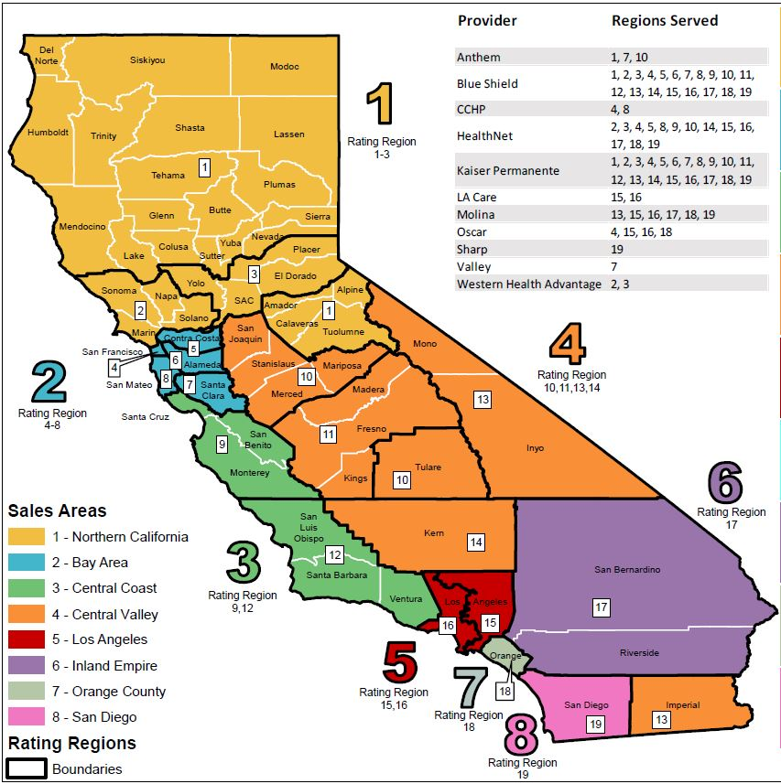
A.1.6 Estimated Activity and Enrollment Information
Review the map defining the targeted Sales Areas and boundaries available here: https://hbex.coveredca.com/toolkit/webinars-briefings/downloads/Regional-Staff-FINAL.pdf
Sales Areas
County Names
Rating Regions
2019 QHPs

Slide 53
A.1.6 Estimated Activity and Enrollment Information
Then, complete the table:
  Enter the total requested funding for this application;
  List the county/counties per applicable targeted Sales Area(s) that your organization are applying to cover for the Navigator Program RFA 2019-20 grant cycle; and
  Enter the corresponding Projected # of Outreach Activity Goals and Projected # of Effectuated Enrollments.
Your grant amount requested should correlate with the:
  1) Totaled Projected # of Effectuated Enrollment requirements in Table 2.
  2) Totaled Projected # of Outreach Activity Goals in Table 3. Proposed Outreach Activity Goals

Slide 54
A.1.6 Estimated Activity and Enrollment Information
Requested funding Amount should correlate with the projected effectuated enrollment and outreach activity goals.

Slide 55
A.1.7 Demographic Populations
Estimate the percentage next to the ethnic demographic population(s); in-language services, income levels; and age groups of the targeted population(s) that you intend to reach under this grant.
Fill in a percentage for at least one population, in addition to any others that apply. Ensure the total percentage for ethnicity and special demographics totals to 100%. For each target population identified, also provide a projected number of individuals to be assisted.

Slide 56
A.1.7 Demographic Populations
Ethnicity
In-Language

Slide 57
A.1.7 Demographic Populations
FPLs
Age Groups

Slide 58
A.2 Primary and Subcontractor Letter of Intent (LOI) to Participate
Organization applying as a collaborative applicant where you are a lead organization with subcontractors
For more than one contractor, please complete Attachment II. Application Section A.2 Letter of Intent (LOI) to Participate included in this RFA announcement. This must be filled out for EACH subcontractor.
  For example, if you have five subcontractors you will be partnering with, then you will have five Attachment II forms to submit. If you have not finalized your selection of subcontractors, please fill in this section with as much information as possible and be sure to indicate your intended partnerships in Section B.1.3, Proposed Personnel.
This Primary and Subcontractor Letter of Intent (LOI) to Participate information is REQUIRED if the Applicant is applying as a collaborative (lead organization with subcontractors).

Slide 59
Section B – Narrative Sections
B.1. Cover Letter
B.2. Qualifications
B.3. References
B.4. Proposed Personnel
B.5. Approach to Statement of Work
B.5.1. Target Population
B.5.2. Navigator Strategic Workplan
B.5.3. Approach to Project Management and Quality Assurance
B.5.4. Optional: Targeted Area Pilot Funding

Slide 60
B.1 Cover Letter
3,000 characters/1 Page Limit:
Include a cover letter (on company letterhead) with the following information:
Title of this Grant Application and submission date of the application;
Requested funding amount;
A summary of the proposed project, including a description of the Covered California subsidy-eligible population and communities targeted by the project, proposed approach and likely impact; and
Signature of an individual authorized to enter into contracts on behalf of the organization/applicant.

Slide 61
B.2 Qualifications
9,000 characters/3 Page Limit
Provide a written narrative that demonstrates the applicant meets the minimum desired qualifications identified in the RFA. Please order and number your responses including this Section number, title as follows:
Provide an overall description of the Applicant’s organization for the purposes of providing on-site, walk-in, and appointment-based in-person enrollment assistance. Include a description of the capacity and plans to have a storefront (including hours and address / location) or other public location where consumer assistance will be provided outside of normal business hours.
Describe how the Applicant’s established physical sites facilitate access to the communities targeted by this project. If the Applicant is applying as a collaborative lead organization with subcontractors, describe the nature of the collaborative, the mission, qualifications, experience, and role of each partner and established physical sites providing service.

Slide 62
B.2 Qualifications
(Continued…)
9,000 characters/3 Page Limit
Describe the Applicant’s operational readiness to meet effectuated enrollment goals and outreach activity goal requirements during the Open Enrollment and Special Enrollment periods, including the Applicant’s program management experience and administrative and fiscal capacity to manage a project of this scope.
If the Applicant is applying as the lead organization for a collaborative with more than one subcontractors, please provide the number of forms - Attachment II. Application Section A.2 Letter of Intent to Participate submitted with this application.

Slide 63
B.3 References
Attach two (2) letters of recommendation from organizations that have successfully collaborated in the past with the Lead Applicant. These letters must be presented on the referring organization’s letterhead and contain the name and contact information of the person signing the letter.
Letters of recommendation from any Subcontractor performing services as part of the Applicant’s proposal, or from any entity that might have a financial interest in the Award, will not be accepted. The two reference letters are not included in the character limit for this section.

Slide 64
B.3 References
(Continued…)
Each letter should address:
  The nature and length of the relationship between the entities;
  The Applicant’s strengths and examples of success in similar programs;
  A statement recommending the Applicant for Covered California’s Navigator Program, which focuses on subsidy-eligible population enrollment outreach activities and difficult to reach targeted populations.
  *Attach your Reference letters to the application when you submit the completed application.

Slide 65
B.4 Proposed Personnel
6,000 characters/2 Page Limit
Order and number your responses as follows:
Describe the Applicant’s strategy for staffing enrollment activities and why this approach is effective in meeting enrollment goals.
Describe the Applicant’s current staffing capacity to perform the services requested in this grant Application and the hiring schedule for additional staff.
Describe current staffing capacity of all subcontractors to perform the services requested in this grant application and the hiring schedule for additional staff.
If the applicant is planning to partner with other organizations but has not finalized the selection of its subcontractors, include a description of the potential partners.

Slide 66
B.4 Proposed Personnel
(Continued…)
6,000 characters/2 Page Limit
Include brief biographical statements for the project manager and senior staff members who will be responsible for oversight of the Grant.
If the Applicant is applying as a collaborative with a lead organization and subcontractors, describe the role of each partner in this project and the value added to the proposed enrollment, outreach, and enrollment campaign.
Describe how the proposed staffing for this project reflects the cultural, linguistic, and other characteristics/preferences of the target populations that the Applicant proposes to serve.

Slide 67
B.5 Approach to Statement of Work
18,000 Characters / Approximately 6-Page Limit
Statement of work must address the following:
Target Population
Navigator Strategic Work Plan
Approach to Project Management and Quality Assurance
Optional: Targeted Area Pilot Funding

Slide 68
B.5.1 Target Population
Identify individuals and organizations in the communities served and what will motivate or influence them to partner with the Applicant to design and implement enrollment campaigns. Describe how the Applicant will leverage and build upon this coalition.
Describe the nature of the Applicant’s relationship with the communities served, how many consumers are reached annually, and how the Applicant proposes to leverage these relationships for the proposed project.
Describe the Applicant’s approach, and the demonstrated ability to eliminate barriers in order to motivate them to enroll in Covered California Qualified Health Plans.
Notes:
it’s very important that you’re concise and clear and how you’re planning to implement your strategy to reach your target population and we’re really looking for you to tell us what population you are reaching and what do you think the effective strategy is to reach that population? We also want to know if there are any key influencers or community organizations or partners that you’ll be working with to reach that target population and to describe any existing relationships that you have, that will be leveraging for this project.
Describe how you’re going to implement the grant and you should describe your strategies for reaching the target population. What we are looking for, is have you found that workshop, going to churches, going to the mall, doing one on ones, are successful strategies to reach your target population and provide ongoing post enrollment support to consumers in your population.

Slide 69
B.5.2 Navigator Strategic Workplan
Describe the Applicant’s proposed approach and strategy for maximizing enrollments during the Open Enrollment and Special Enrollment periods.
Describe some proposed enrollment events and the outreach and education strategy that will drive enrollments. Describe the settings and venues where Navigator activities will take place and why these venues are appropriate to reaching the target populations.
Describe current or historical media strategies including paid media, earned media and social media strategies. Detail total annual paid media expenditures promoting enrollment assistance. Summarize total annual earned media impressions with specific breakouts of print, digital, television, and radio distribution. Provide current social media activity including platforms used (e.g., Twitter, Facebook, Instagram, LinkedIn), accounts used (e.g., entity account names and/or counselor account names), and the number of followers on each account.

Slide 70
B.5.2 Navigator Strategic Workplan
(continued…)
Describe the capacity and plans to have a store front (including hours of operation and address / location) or other public location where consumer assistance will be provided outside of normal business hours.
Describe the Applicant’s existing infrastructure and/or relationships that would facilitate the Applicant’s ability to address the needs of the target Covered California subsidy-eligible population.
Describe the applicant’s proposed approach for assisting with renewals and supporting retention efforts.

Slide 71
B.5.3 Approach to Project Management and Quality Assurance:
Describe the Applicant’s plan for managing and monitoring Navigator Program Activities.
If the Applicant is applying as a collaborative (lead agency with subcontractors), describe how the lead agency will monitor progress toward accomplishing project goals. Describe any anticipated challenges with managing the collaborative and how the Applicant proposes to overcome them.
Describe how your organization captures data for the number of consumers assisted and/or enrolled. For consumers who were assisted but not enrolled, is there a follow-up process in place? If so, describe the process.
Describe the Applicant’s policies and procedures related to protecting consumer’s privacy and security.

Slide 72
B.5.4 Optional: Targeted Area Pilot Funding
(If an Applicant wishes to apply for more than one of the meta-regions specified in the Targeted Area Pilot Funding, numbers 1-3 below must be completed for each meta-region for which the Applicant wishes to be considered.)
Specify the meta-region(s) your organization is applying to target through the Targeted Area Pilot. Describe your organization’s experience reaching the communities in zip codes listed for this meta-region.
How would your organization utilize the additional funding for targeted outreach? Provide a budget overview for the $25,000 provided for outreach in this meta-region, including personnel.
Detail the outreach strategy specific to this meta-region, discussing both Open Enrollment and Special Enrollment Period strategies.
Project how many consumers your organization would enroll in this meta-region through the Targeted Outreach Pilot. Detail the assumptions and expectations that support this projection.

Slide 73
Section C – Line Item Budget
Submit a line item budget including detailed description of how grant funds will be spent. The budgeted line items and amounts should align with the personnel and activities outlined in the application. The total proposed budget should match the amount requested in Section A.1.6.
Important Document Submission Final Note
*IMPORTANT NOTE: This Attachment I. Navigator Program 2019-22 Grant Application is designed to be used both as a formatting tool and as a submission template; therefore, it is important that you attach all additional pages and narrative where needed when you submit your Application. You should use all the template where applicable, but make sure you include and note “see attached” where you attach additional documents and information.

Slide 74
Disclosure Form and Signature for Application Submission
This page should be included in your application packet. It will not count toward any page limits.
By submitting the grant application and the supporting application documents and materials, you are agreeing the terms in this form.
Please print this application, sign the “Authorized Signature” box above, and scan the application with all applicable attachments and documents prior to submitting the complete application via email to CommunityPartners@covered.ca.gov by 5 p.m. PST on April 23, 2019.

Slide 75
Navigator Program
Evaluation & Selection Process

Slide 76
  Navigator Grant Application
  Evaluation Process
Scoring – Core Funding
Core Funding: The evaluation process will use a 55-point (solo Applicant) or 65-point (collaborative Applicants) rating, using the following factors and points:
Rating Factors | Application Section | 55-point (solo Applicant) | 65-point (collaborative Applicants)
1. Organization General Information & Previous Experience | Section A.1 | 8 points | 8 points
2. Narrative Sections 1-4: Cover Letter, Qualifications, References, and Proposed Personnel | Sections B.1-B.4 | 20 points | 28 points
3. Narrative Section 5: Statement of Work | Section B.5 | 24 points | 26 points
4. Line Item Budget | Section B.1.4 | 3 points | 3 points

Slide 77
  Navigator Grant Application
  Evaluation Process
Scoring – Optional Funding
Optional Funding: The evaluation process will score the Targeted Area Pilot Outreach separately from the Core Funding; 8 points possible per meta-region. These points do NOT count toward the main core funding score.
Rating Factors | Application Section | 24-point (solo Applicant) | 24-point (collaborative Applicants)
1. Meta-Region 1. Yosemite | Section B.5.4 | 8 points | 8 points
2. Meta-Region 2. San Bernardino | Section B.5.4 | 8 points | 8 points
3. Meta-Region 3. North of Redding | Section B.5.4 | 8 points | 8 points
4. Meta-Region 4. Sierra Foothills | Section B.5.4 | 8 points | 8 points

Slide 78
Navigator Grant Application Selection Criteria
Covered California will thoroughly review responses to this Application and will consider the following:
Alignment with the Navigator program objectives;
Degree of innovation, including the use of grant funds on storefronts or other permanent locations where consumers can receive enrollment and renewal assistance outside of normal business hours;
Experience and demonstrated success in providing enrollment assistance to Covered California eligible consumers;
Evidence demonstrating likely effectiveness of outreach, education, enrollment and post-enrollment strategies; and
Distinctiveness from other funded activities.
Notes:
Covered California will select Grantees based on an assessment of the best overall value to implement Navigator Program Activities to Covered California eligible consumers. Covered California is not required to select the lowest priced Application submitted.

Slide 79
Navigator Grant Entity Notification
Awards will be based on the evaluation criteria identified in Navigator Grant Application Selection Criteria (Section A).
Notification of Intent to Award will be posted on May 16, 2019, per the Grant Application Schedule (Section B.1) at http://hbex.coveredca.com/navigator-program/.
Awards may be announced in phases.

Slide 80
Deadline Dates
Inquiries and Questions Submission:
April 9, 2019 – 5:00 PM PST
Application Submission:
April 23, 2019 – 5:00 PM PST

Slide 81
Questions?
Please submit your questions via the chat feature so we can track all questions.

Slide 82
Thank You!

