Slide 1

Request for Proposal
RFP 2026-06: Unarmed Security Guards
Proposer’s Conference
October 16, 2026

Slide 2
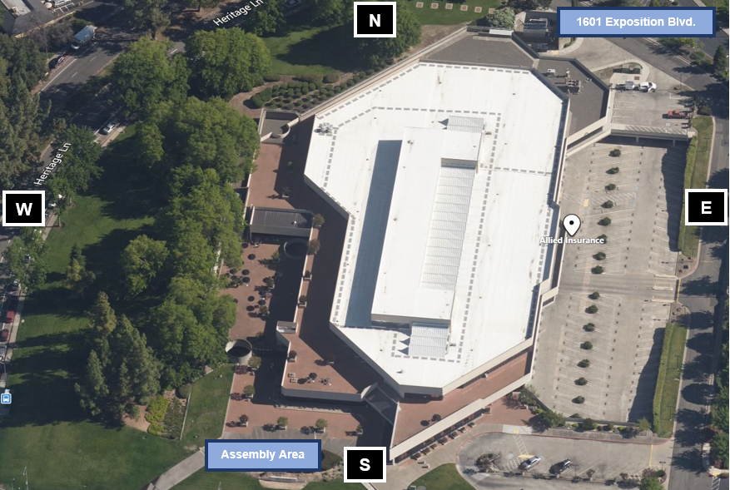
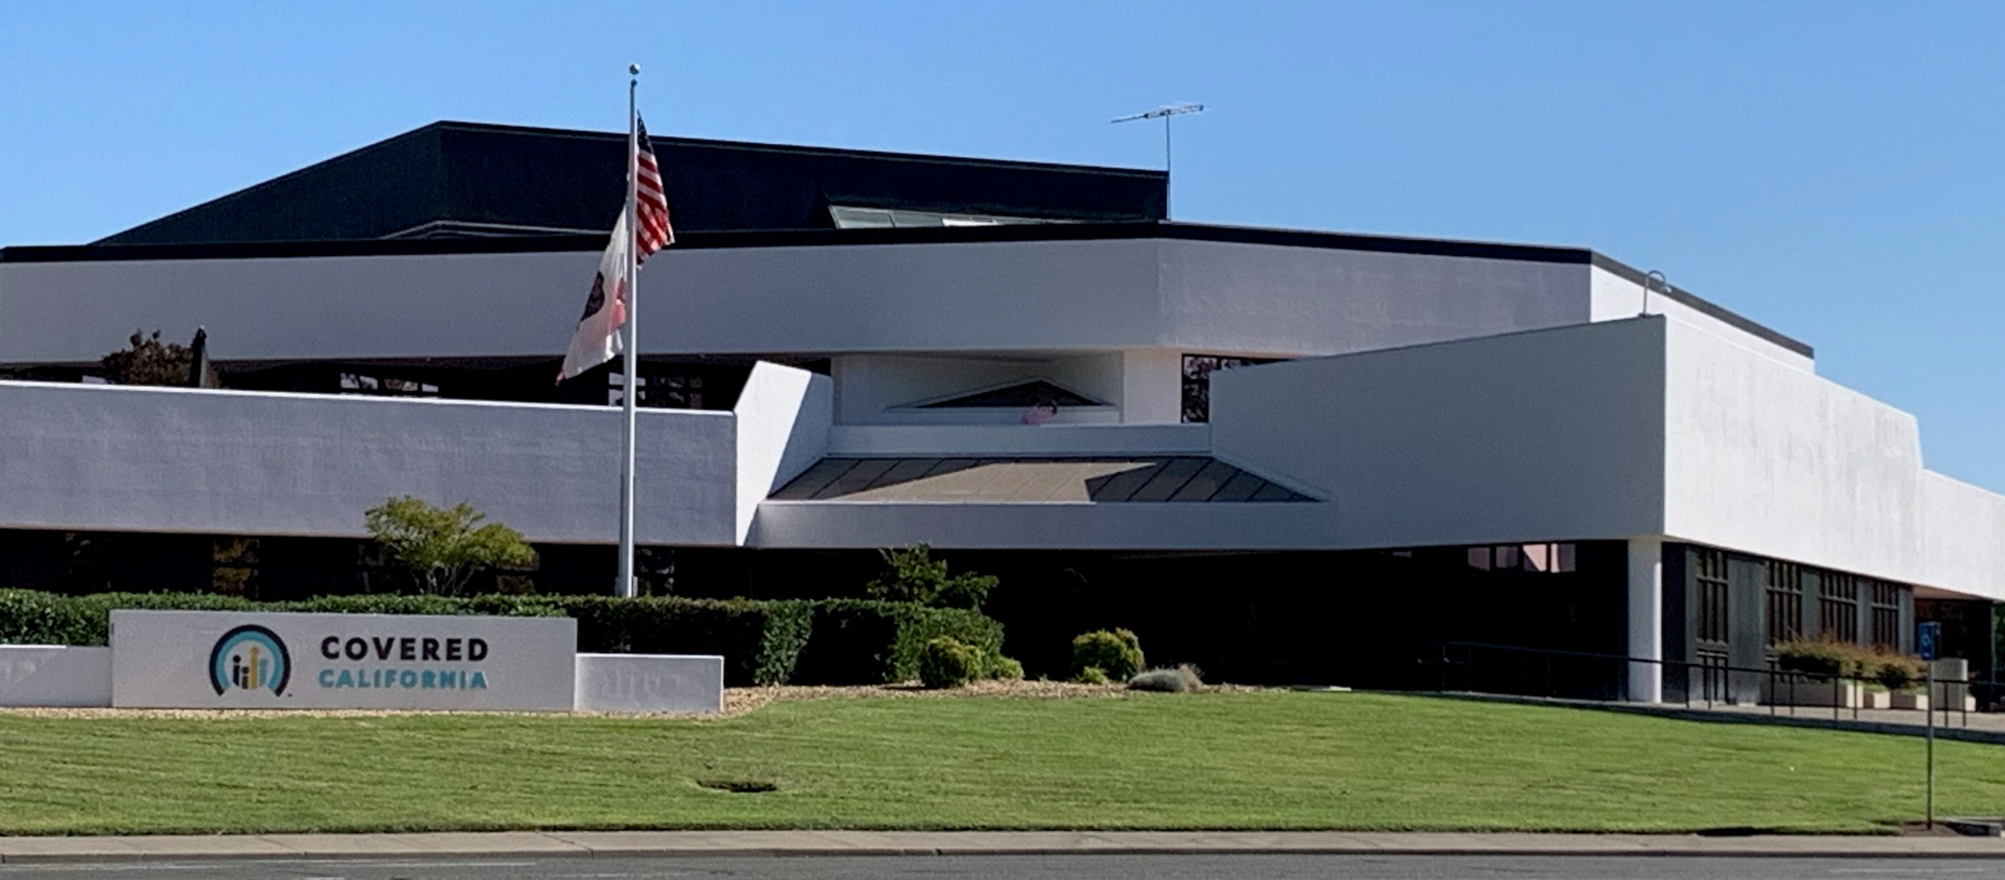
1601 Exposition Blvd.
Sacramento, CA

Slide 3
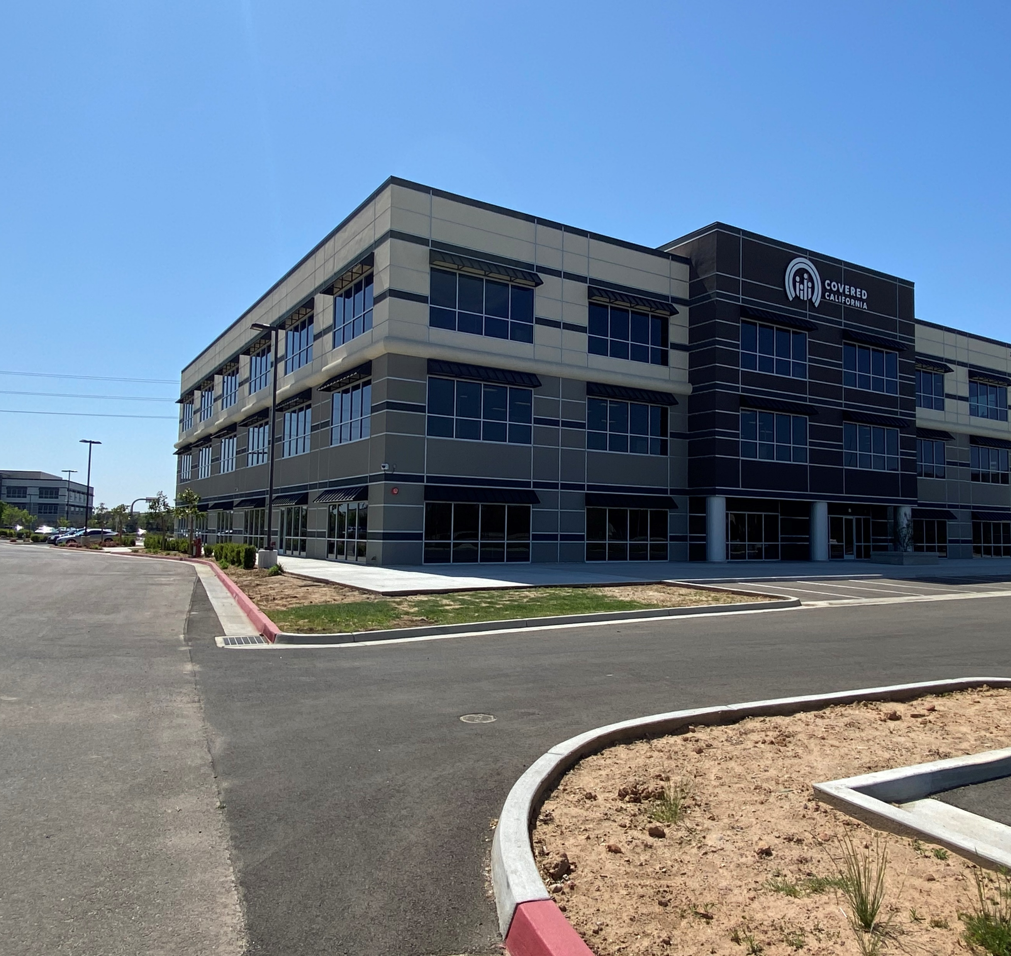
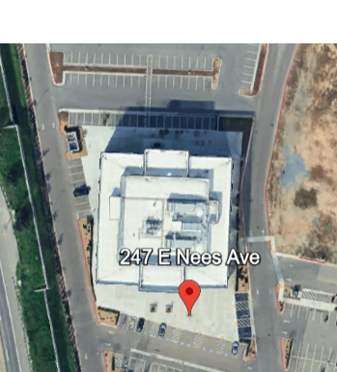
247 E. Nees Ave.
Fresno, CA

Slide 4
RFP
Key Dates
Request for Proposal Release September 4, 2026
RFP Questions Due September 10, 2026, by 12:00 PM
Responses to Questions September 24, 2026
Proposers’ Conference October 16, 2026,
10 AM – 12 AM
Proposal Due October 29, 2026, by 12:00 PM
Notice of Intent to Award Week of November 16, 2026
Anticipated Contract Term: JANUARY 1, 2027 through June 30, 2029

Slide 5
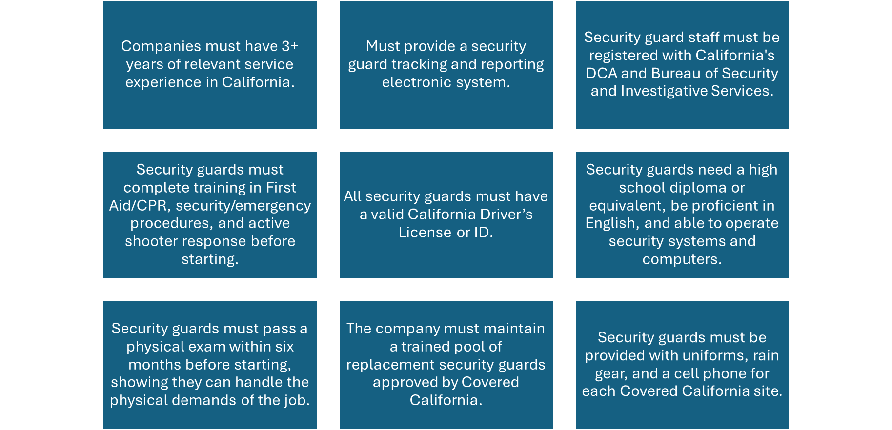
Minimum Qualifications

Slide 6


Work Hours
Covered CA Headquarters
1601 Exposition Blvd.
Sacramento, CA
Covered CA Service Center
247 E. Nees Ave.
Fresno, CA
Normal business hours: 8:00 a.m. to 5:00 p.m. PT, Monday through Friday (excluding State holidays).
Security guard requirements for normal business days:
  One guard from 6:00 a.m. to 2:30 p.m.
  One guard from 7:30 a.m. to 4:00 p.m.
  One guard from 1:30 p.m. to 10:00 p.m.
During Open Enrollment (October through February):
  Work hours may change; may start before regular hours and extend until midnight PST, including State holidays.
  An additional guard may be required.
  Open Enrollment period can change annually.
Additional guards for Open Enrollment or special events will be paid according to Exhibit B-Cost Worksheet.
Normal business hours: 8:00 a.m. to 5:00 p.m. PT, Monday through Friday (excluding State holidays).
Security guard requirements for normal business days:
  One guard from 6:00 a.m. to 2:30 p.m.
  One guard from 9:00 a.m. to 5:30 p.m.
  One guard from 1:30 p.m. to 10:00 p.m.
During Open Enrollment (October through February):
  Work hours may change; may start before regular hours and extend until midnight PST, including State holidays.
  An additional guard may be required.
  Open Enrollment period can change annually.
Additional guards for Open Enrollment or special events will be paid according to Exhibit B – Cost Worksheet.

Slide 7


Administrative Requirements
Proposals must include specific attachments, all of which, if requiring a signature, must be signed by an authorized representative. Both photocopies of wet signatures and electronic signatures are acceptable. These attachments are:
  Proposal Cover Page (Attachment 1, completed and signed)
  Payee Data Record (STD. 204, Attachment 2, completed and signed))
  Contractor Certification (Attachment 3, completed and signed)
  Statement of Economic Interests Certification (Attachment 4, completed and signed)
  Bidder Declaration (GSPD-05-105, Attachment 5, completed and signed)
  Proposal Checklist (Attachment 6, completed and signed)
  GenAI Reporting and Factsheet (STD 1000, Attachment 7, completed)
Upon contract execution, the proposer agrees to submit a completed Statement of Economic Interests (Form 700) for representatives and applicable staff identified as code filers. Further information can be found on Covered California's Conflict of Interest Code and the Fair Political Practices Commission's website.
To claim the DVBE incentive, proposers must also include the completed and signed Disabled Veteran Business Enterprise Declarations (STD. 843, Attachment 8), if applicable.

Slide 8

Required Documents
Mandatory Insurance Documents
Certificate of Liability Insurance with coverage of at least $1,000,000.00.
Workers’ Compensation Liability Insurance evidence.
Automobile Liability Insurance proof, including coverage for non-owned vehicles, with a minimum of $1,000,000.00 per occurrence for individuals performing services under this contract.
Professional Liability Insurance proof.
Compliance and Exceptions
Proposers unable to furnish any of the required insurance certificates or proofs at the time of proposal submission must provide a comprehensive written rationale for such non-compliance.
Covered California reserves the right to consider accepting proposals lacking the specified insurance documents, contingent upon the proposer’s valid explanation for the omission and a commitment to furnish the requisite certificates prior to the finalization of the contract.
A contract will not be executed without the acquisition of the essential insurance certificates. Failure to provide the necessary documents before contract execution will lead to the contract being awarded to the next highest-scored proposer.
Corporate Proposer Requirements
Incorporated proposer organizations must demonstrate their Active status with the California Secretary of State (SOS) by providing either: a. A current Certificate of Status issued by the SOS. b. A copy of the proposer’s Entity Detail page from the SOS’s Business Search website.

Slide 9
Response to the Model Contract
Using the Model Contract Exhibit A – Scope of Work and Exhibit A, Attachment 1 – Work Authorization provided, include a revised Exhibit A – Scope of Work with suggested tracked changes in Microsoft® Word®.
Using the Model Contract Exhibit B – Budget Detail and Payment Provisions and Exhibit B, Attachment 1 – Cost Worksheet provided, include a revised Exhibit B – Budget Detail and Payment Provisions with suggested tracked changes in Microsoft® Word®.
Using the Model Contract Exhibit C – General Terms and Conditions provided, include a revised Exhibit C – General Terms and Conditions with suggested tracked changes in Microsoft® Word®.

Slide 10

Technical Requirements
Understanding and Approach
(no more than 5 pages)
Corporate Qualifications
(no more than 5 pages)
Project Team Qualifications
(no more than 5 pages) *Resume for project team
Past Projects Completed
(no more than 5 pages)
Project Assumptions
(no more than 5 page)
https://hbex.coveredca.com/solicitations/#RFP-2026-06

Slide 11
RFP 2026-06: Unarmed Security Guards
Questions and Answers
1. Is attendance at the October, 2026 in-person Proposers’ Conference optional, and will non-attendance affect proposal responsiveness or eligibility?
Attendance for the in-person Proposer’s Conference is optional and does not affect proposal responsiveness or eligibility.
2. Section 2.1, item 10 states that the proposer must “provide offices/security” at both 1601 Exposition Boulevard in Sacramento and 247 E. Nees Avenue in Fresno. Please confirm whether this means providing security coverage at both worksites, rather than maintaining contractor offices at both locations.
Yes, Proposers are expected to provide security coverage at both worksites.
3. Please confirm whether scheduled hours or quantities in the Model Contract are estimates only or guaranteed minimums, and whether the cost worksheet must include all relief/replacement coverage with no separately reimbursable overtime.
The 6,100 hours, 100 overtime hours are the estimate hours needed annually per worksite under this contract. They are not guaranteed minimums, but align with estimates. Overtime is not a guarantee but has been used on occasion.
4. Who is the current incumbent and how long have they serviced Covered California?
5. Who is the current incumbent?
The current incumbent is American Global Security, Inc. They have been servicing Covered CA for one year and six months.
See response to Question #4.
6. When was the current contract awarded, and could you please provide a copy of the contract?
The current agreement was awarded on January 23, 2025. In accordance with state law exempting applicable Covered California information from disclosure under the PRA (GC Section 100508): If you wish to file a PRA request for a copy of the records, you are free to do so but should expect that the request will likely be denied. Please send your request for documents to PRA@covered.ca.gov.
7. What was the total amount spent on the contract over the past 12 months, and what was the most recent monthly spend?
$285,639.91 for the past 12 months. Recent monthly spend was $24,142.10.
8. Are there any separately billable items or reimbursable expenses (e.g., vehicles, equipment, or supplies)?
The rates are fully loaded rates, per the language in the model Contract, Exhibit B – Attachment 1. The rates must include all expenses.
9. Have there been any significant changes from the previous contract to the current one (e.g., increased/decreased hours, changes in staffing levels, armed vs. unarmed services, additional sites, or expanded scope)?
No changes.
10. Are there any anticipated services or requirements not identified in the RFP that the successful contractor should be prepared to provide (e.g., seasonal coverage, special events, or future site additions)?
No. All of the required services are outlined in Exhibit A of the Model Contract.
11. Beyond applicable state and federal minimum wage requirements, are there any prevailing wage, living wage, local ordinance, or contract-specific wage requirements?
Contractor is responsible for this knowledge and must comply with any wage, hour, and employment requirements applicable by law, including any requirements that become applicable based on the location or manner in which services are performed. Per Exhibit B, Attachment 1 – Cost Worksheet, the California Department of Human Resources maintains the minimum hourly rates for Security Guards: https://www.calhr.ca.gov/wp-content/uploads/sites/361/2025/07/2024-Personal-Service-Contract-Rates.pdf

Slide 12
RFP 2026-06: Unarmed Security Guards
Questions and Answers
(Continued)
12. Can you please confirm whether the estimated annual contract value of $300,000 is accurate? Based on our calculations, that equates to an approximate bill rate of $24/hour, while the required blended pay rate is 25.91/hour. Can you confirm our understanding that we would be required to compensate the security guards at $25.91/hour (wages plus benefits), but would effectively only be able to bill approximately $24/hour?
We are looking for your actual, fully loaded rates, aligned with the CalHR requirements. If this exceeds the total allowable cost per the agreement, we will accept the bid.
13. If subcontractors are currently being utilized under this contract, please provide details regarding the scope of services they perform, the number of subcontractors engaged, and the percentage of the overall contract value assigned to each subcontractor.
Subcontractors are not being utilized under the current agreement.
14. Is there any page limit for staff Resumes?
There is no page limit for Exhibit C, Attachment 1- Resumes
15. RFP Section 1.5 “Contract Amount” states that proposals that exceed $300,000.00 per year will not be accepted. 2026 CalHR hourly rate paid to security guards (SG1) is $30.71 per hour per GC19134. Exhibit B Cost worksheet requires 6100 annual hours at Cal Expo and 6100 annual hours at Fresno for total of 12,200 annual hours. When you divide $300,000.00 by 12,200 total annual hours the billing rate will be $24.59?
16. How could RFP mandate that company compensate Security guards $30.71 per hour and maximum hourly billing rate to Covered California will be $24.59?
We are looking for your actual, fully loaded rates, aligned with the CalHR requirements. See contract amount changes in Addendum #2.
We are looking for your actual, fully loaded rates, aligned with the CalHR requirements. See contract amount changes in Addendum #2.
17. Exhibit B, Attachment 1. Expo and Fresno have (6,100 hours, 100 Overtime). Are you asking us to provide total cost for 6,100 plus 100 overtime hours? Each location cost for 6,200 annual Hours?
Refer to Addendum # 2 with revised Exhibit B, Attachment 1. For the first year, provide the total cost for 3,600 hours plus 50 overtime hours for each location. For the following two years, provide the total cost for the 6,100 hours plus 100 overtime hours for each location.
18. What is the reason Covered issued new RFP since current contract started March 24, 2025 and the term of the current contract was for 3 years plus 2 option years?
Covered CA regularly reviews its business and procurement needs and may decide to go back out to bid when appropriate. The current contract remains in place and continues to be governed by its existing terms.
19. What is the preferred uniform type/style?
See Exhibit A, Attachment 1 Item H.
20. Are there any special training requirements? Ex. First Aid/CPR/AED, etc.?
All minimum requirements are detailed in RFP 2026-06, Section 2.1. See Exhibit A, Attachment 1 Item D.
21. Is there any equipment provided by the State?
CoveredCA will provide desk computers, printers, general office supplies, and walkie talkies for communication.

Slide 13
RFP 2026-06: Unarmed Security Guards
Questions and Answers
(Continued)
22. What other equipment is required for the Security Professionals?
Please refer to RFP 2026-06 Section 2.1.9. See Exhibit A, Attachment 1.
23. What is the State’s standard payment terms?
Please refer to Exhibit B of the Model Contract for detailed information about the State’s Payment Terms.
24. Is the State exempt from payment of state and local sales and use taxes?
The rates are fully loaded rates, per the language in the model Contract, Exhibit B – Attachment 1.
25. What challenges is the State experiencing at two (2) locations?
26. Does the State have a preference to retain incumbent employees that are in good standing and meet the hiring criteria of the Proposer?
The biggest challenge has been maintaining a pool of security guards for each location that could be added to the rotation if a guard falls ill or the schedule needs additional guards (e.g., have been trained, passed background checks, etc.).
There is no preference.
27. Are there restroom facilities in close proximity to all of the posts at all sites?
Yes.

Slide 14
RFP 2026-06: Unarmed Security Guards
Questions and Answers
(Continued)
28. For inclement weather, is there shelter available for the security professionals at all sites?
Yes.
29. How are security officers relieved when taking required Rest and Meal Breaks?
Security officers are responsible for adhering to CoveredCA’s P.O.S.T. orders while onsite for relieving themselves for rest and meal breaks. There are security rooms and cafeterias for rest and meal breaks.
30. Are the security officers given 30 minutes unpaid or paid breaks?
No, shifts include a paid 30-minute break.
31. Is the current security workforce covered by a collective bargaining agreement with their employer? If so, will a copy of the CBA be provided, since vendors may be legally bound to honor economic aspects of that CBA?
32. What is the reason for going out to bid for security services?
No.
See response to Question #18.
33. Is employee parking available at both locations to the contractor’s employees? If so, is there a fee associated with parking?
Yes, parking is available to the contractor’s employees. There is no fee associated with parking.
34. Is there a place for the Security Professional to store and charge their contractor issued cell phone
Yes.

Slide 15
RFP 2026-06: Unarmed Security Guards
Questions and Answers
(Continued)
35. On Exhibit B, Attachment 1, it states that contractors must provide two (2) hourly rates for each fiscal year. However, the example given shows an “Hourly Rate” and “Overtime Rate.” Shouldn’t the 2nd rate be labeled “2% increase Rate” instead of “Overtime Rate”, since overtime is paid at 1.5 of the regular rate and is already represented on the Cost Worksheet?
Please provide your actual hourly rates and overtime rates in the table provided.
36. On page 2 of Exhibit B, Attachment 1, the Cost Worksheet asks for “Total Contract Amount Not to Exceed” amount. Please confirm that this is the three (3) year total?
Yes. Please refer to Addendum #2, Exhibit B, Attachment 1- Cost Worksheet.
37. It is mentioned on Page 5 of Exhibit A, Attachment 1 that part of the Security Professional’s responsibilities include inspecting roofs to ensure they are secure. Can the State elaborate on exactly what the Security Professional how they are getting to the roof and what they are doing on the roof?
This is a visual inspection of roof access doors, ensuring they are locked, or viewing the roof from the ground. There is no expectation for the guard to access the roof as it is not part of our leased space.
38. What are the safety procedures for security personnel securing the roof?
39. What is the injury history of the security professional’s duties?
See response to Question # 37.
None to date.

Slide 16
Questions?

