Slide 1
Artwork Consulting Plan
Bidder’s Conference – April 17, 2025

Slide 2
Welcome and Housekeeping
Agenda:
Overview of the RFP process and requirements
In depth conversation about the artwork needs for your response
Walking tour of building
Housekeeping

Slide 3
Key Action Dates
April 2, 2025
RFP released
Bidder’s conference
RFP questions due from bidders due by noon
April 24, 2025
Covered California will respond to questions
May 2, 2025
Proposals due by noon
Week of May 12, 2025
Possible Interviews
Week of May 26, 2025
Notice of Intent to Award to post
Proposed contract term
April 17, 2025
April 21, 2025
June 16, 2025 to June 30, 2027

Slide 4
Request for Proposals Responses
Two parts
Administrative Requirements – must fully respond to all items or risk being disqualified
Technical Requirements:
Understanding and approach narrative (up to 10 pages)
Corporate qualifications (1 page)
Project team qualifications (1 page)
Resumes are not part of this page count but do need to be included for the project team
Past projects completed – 5 projects from the past 2 years that relate to the tasks outlined in this RFP’s scope of work (5 pages)
Project assumptions (1 page)

Slide 5
Scope of Work Phases
One: Art Design Plan
Two: Artwork Selection
Three: Installation
Four: Future Planning

Slide 6
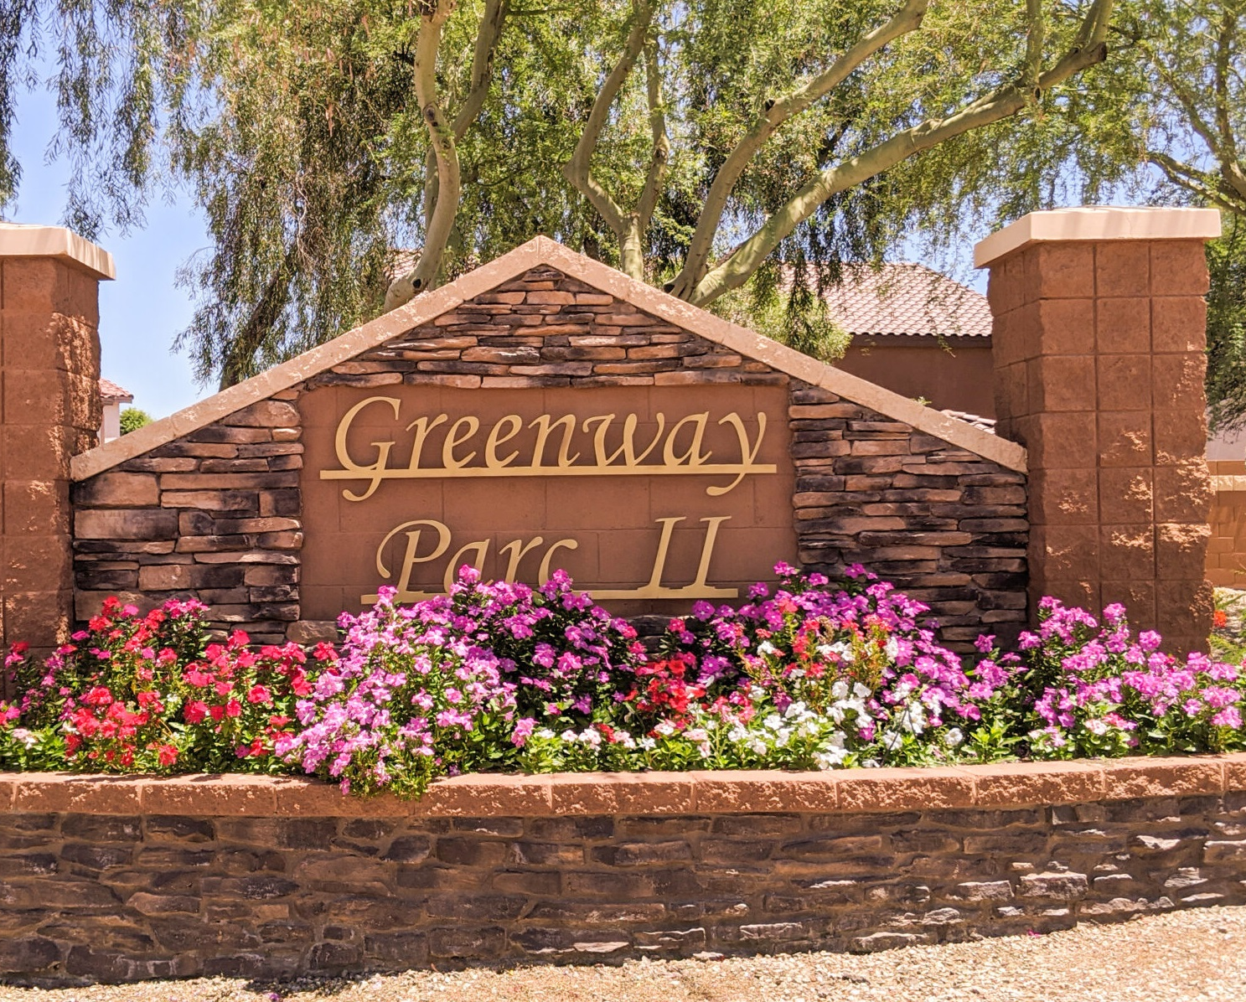
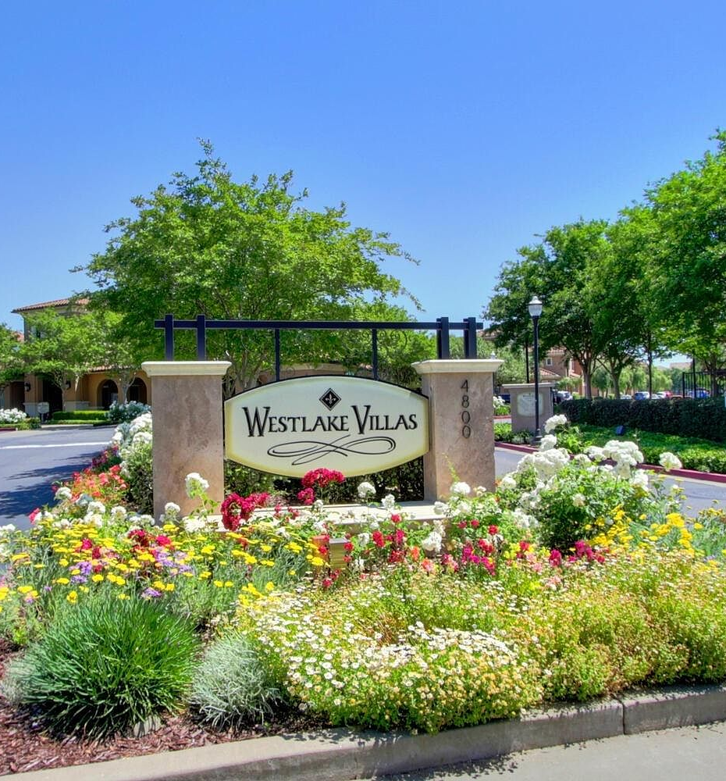
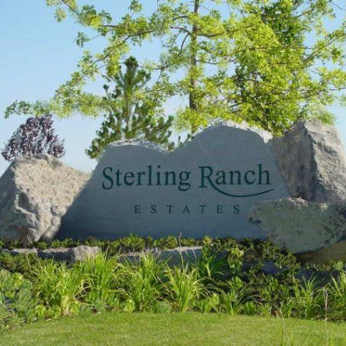
Entrance to Building – Re-imagine
Can we bring in a statement piece outside?

Slide 7
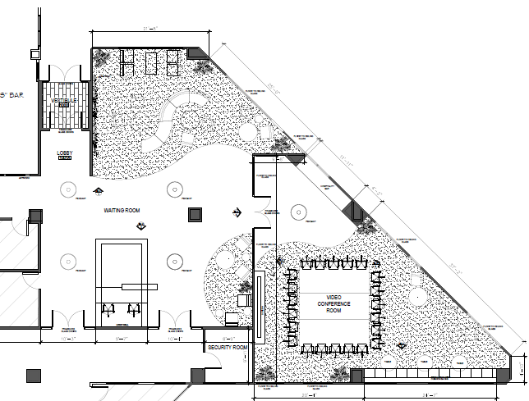
Lobby - Signature
Seeking “signature artwork” ideas for front lobby walls
Note: Architects are working on design options for the front security desk
c

Slide 8
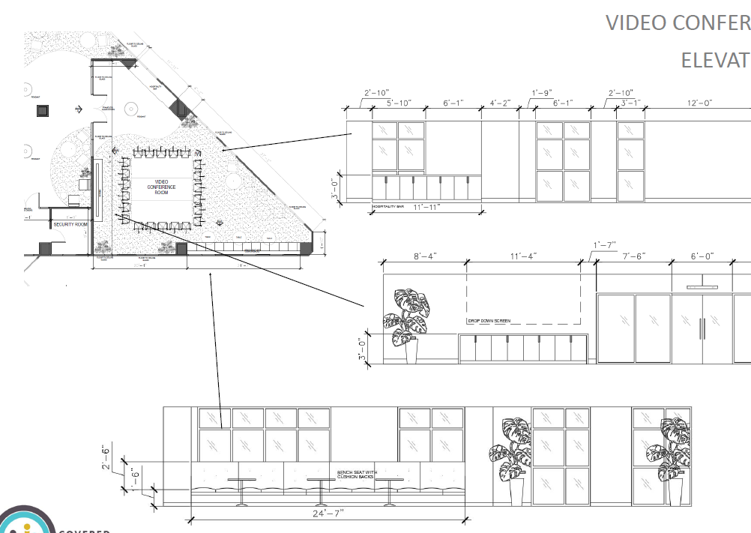
Covered California – Branded Formal Conference Room
Seeking suggestions, ideas on how to showcase Covered California in this space through artwork.
Audience is external parties as well as employees – mostly for in-person meetings.
AV Wall

Slide 9
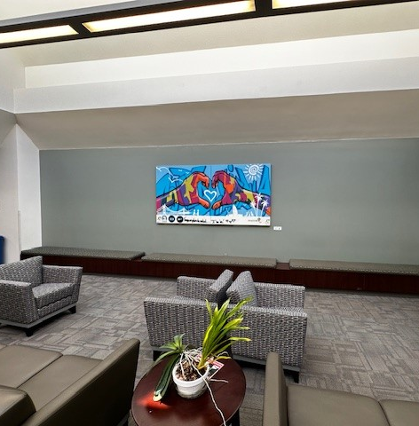
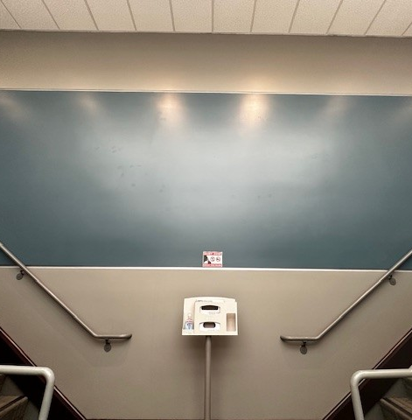
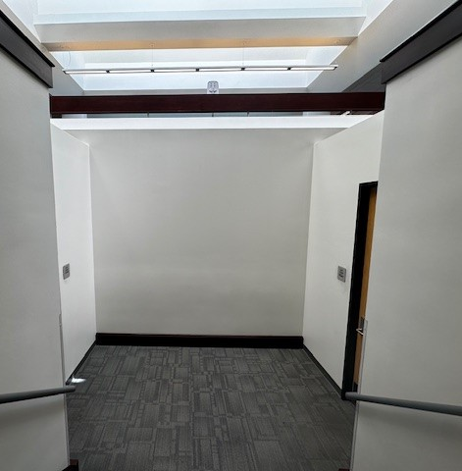
South Stairs and Upper Landing - Signature
Looking for signature wall as employees come up to the 2nd floor.
Image shows existing artwork to be removed/relocated outside of Executive Conference Room.

Slide 10
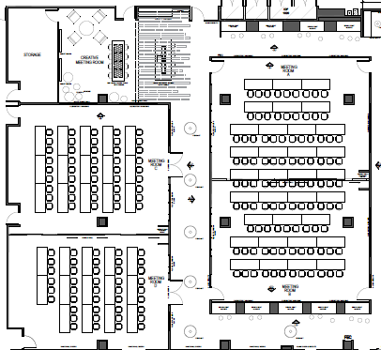
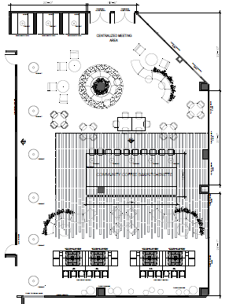
New Conference Space – Signatures or Standard (see last slide for Standard Specs)
Add signature artwork outside of new conference rooms.
This centralized meeting space will be used by staff during in-person team building meetings, collaboration space, and community hub.
c
c

Slide 11
Conference Room Wall Elevations

Slide 12
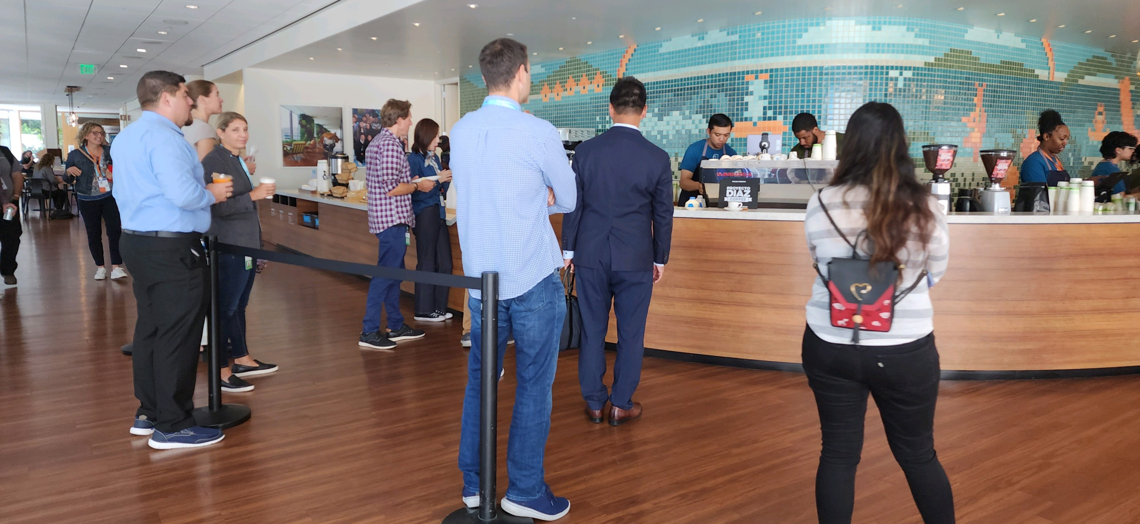
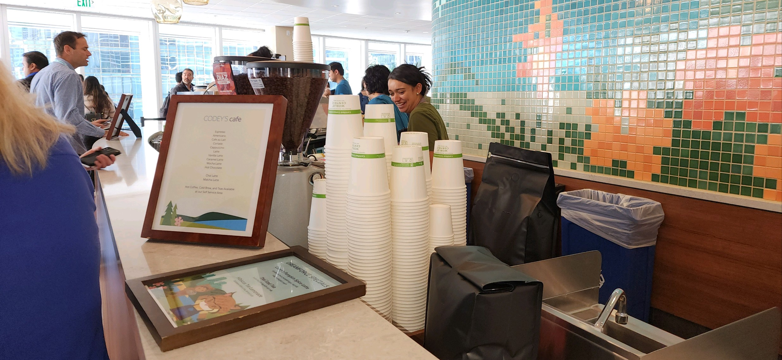
New Conference Space – Tiled Mosaic Backsplash
Looking for a tiled mosaic backslash by an artist that represents Covered California and brings an element of fun and sense of community into this social space.

Slide 13
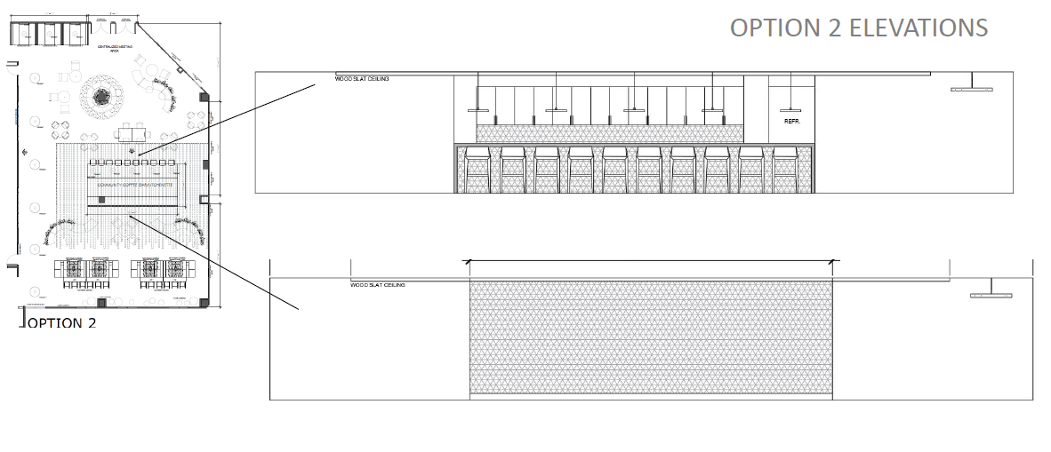
Elevations for Kitchen Space

Slide 14
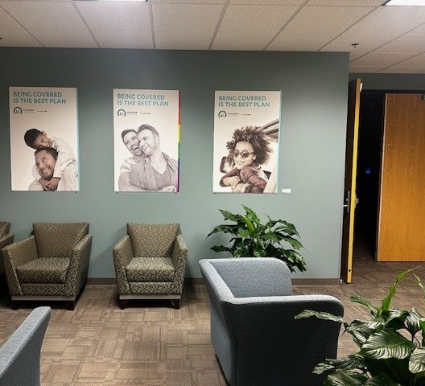
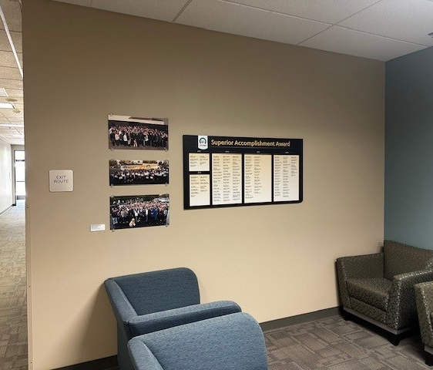
Outside of Tahoe – Signature Wall
Looking for signature artwork outside of our public auditorium (Tahoe)

Slide 15
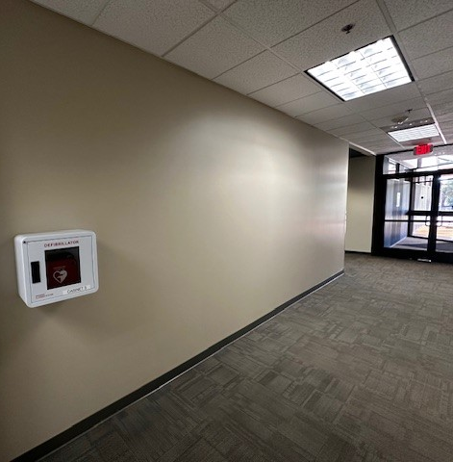
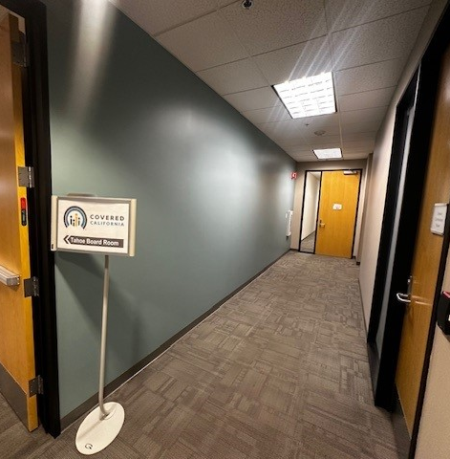
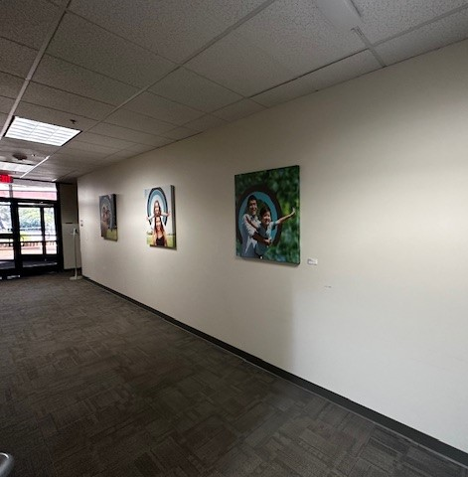
Public Hallway – Covered California Timeline
Looking to create a timeline of Covered California throughout our main hallway as visitors walk towards the public auditorium (Tahoe).

Slide 16
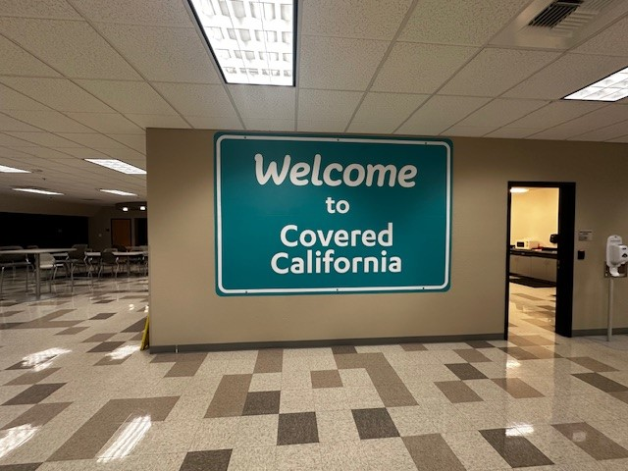
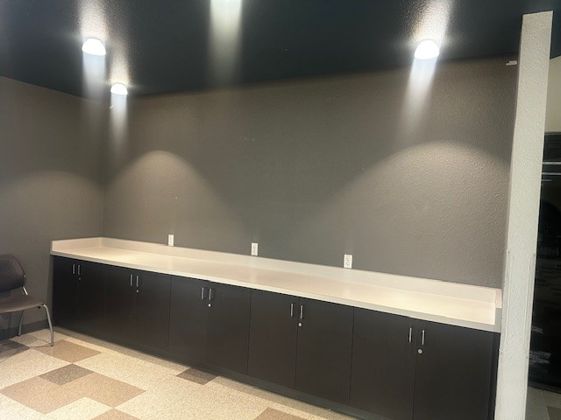
Café – Signature Wall
Replace the artwork with a signature art wall.
Add artwork to wall where cabinets are located (cabinets to be removed).

Slide 17
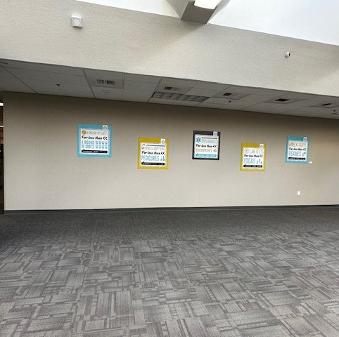
Second Floor Signature Wall
Bring in a signature art piece

Slide 18
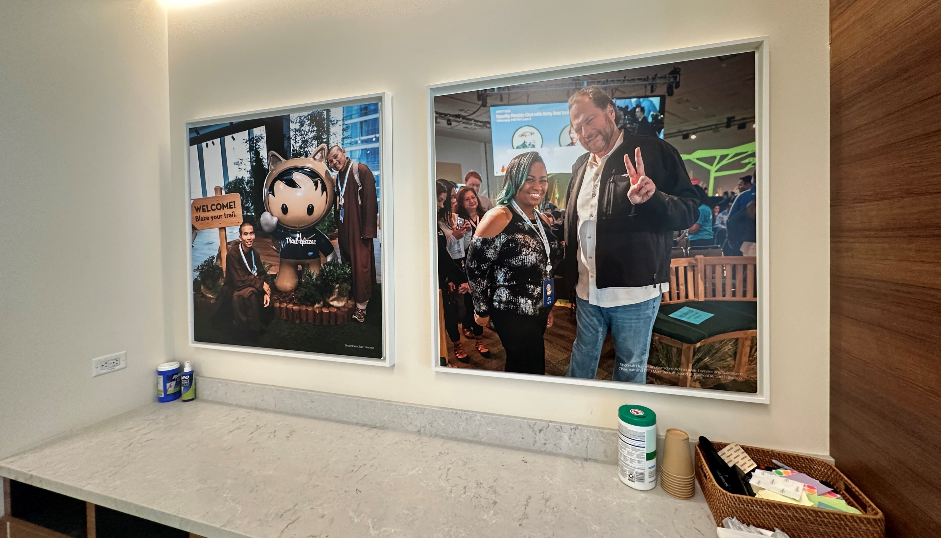
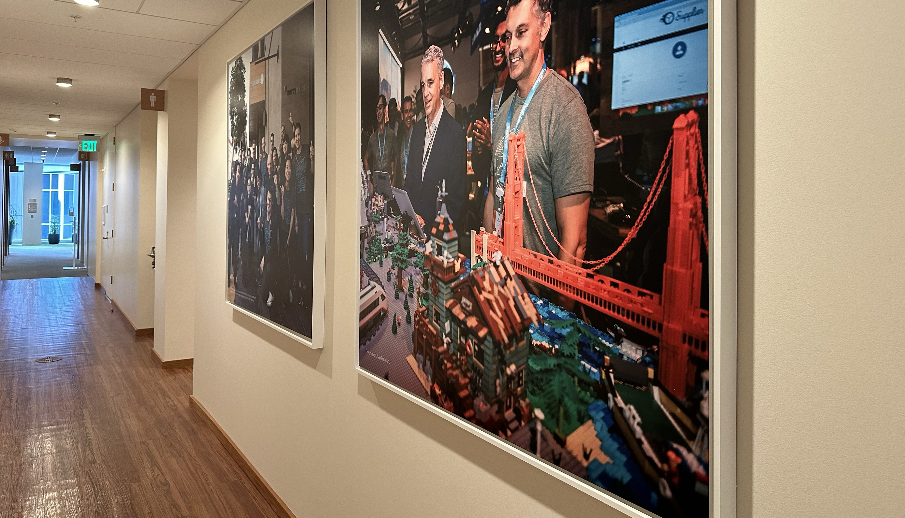
Standard Artwork Opportunities
Looking for opportunities across the entire building to create standard-sized artwork to showcase staff engagement, public outreach, and other art elements.
One size frame
One size for the art piece (e.g., photo printed on gatorboard)
Magnetic backing in frame and on art piece
Allows us to cycle through photos throughout the year and add to the collection

